Slide 1
DATA MANAGEMENT AND
INFORMATION TECHNOLOGY
WORKSHOP 2016

Slide 2
Objectives
  Orient the School ICT/EBEIS/LIS Coordinators regarding the implementation of EBEIS and LIS for SY 2016-2017
  And equip them regarding the EBEIS and LIS and provide technical assistance for schools at all levels;

Slide 3
Data Management and ICT Updates and Accomplishments

Slide 4
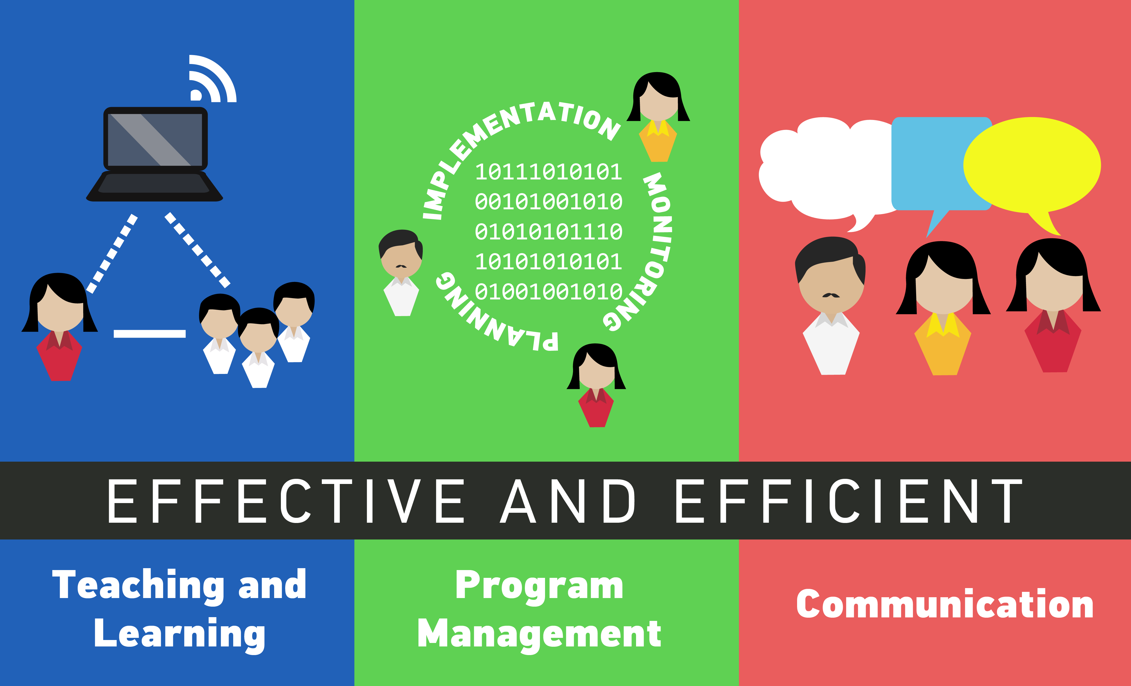
Appropriate use of technology can contribute to the Agency’s thrusts and direction

Slide 5
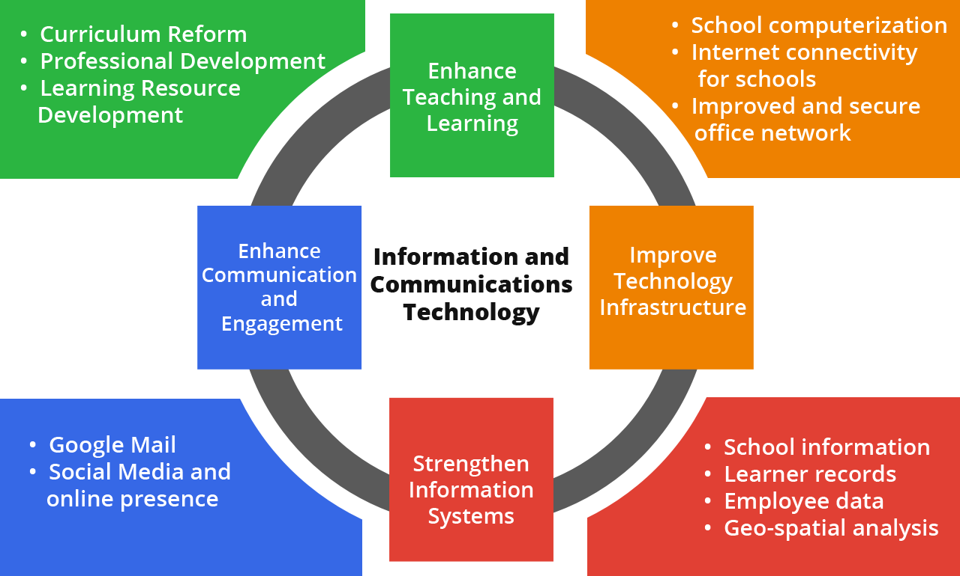
Four Pillars of ICT for Education
New website

Slide 6
Strengthen information systems

Slide 7
All Information Systems
Established single sources of truth for various basic education system information, allowing data sharing and linkages with other stakeholders’ databases for enhanced implementation of other reform programs
Better profiling of schools, learners and employees and their needs enabling more informed decision-making and policy formulation
Increased transparency of data for decision makers at all levels
Enforced standards for maintaining and managing records that promote diligence and enforce accountability in reporting accurate data
Streamlined processes, resulting to savings in operating expenses

Slide 8
Enhanced Basic Education
Information System (EBEIS)
Improved turnaround time for GESP/GSSP data collection
Easier consolidation of data
Budget proposal used more recent data as basis resulting to more accurate projections and budgeting

Slide 9
Learner Information System (LIS)
Ability to track learner movement within the basic education system
Increase in quality and veracity of enrolment data

Slide 10
National School Building Inventory (NSBI) and School Building Information System (SBIS)
From addressing backlogs to planning for future requirement
More accurate resource planning and allocation given more detailed information on school resource
Streamlined processes and enforced standards for planning and allocation of education facilities
Improved monitoring and effective communication of the status of project implementation

Slide 11
Geographic Information System (GIS)
Enabled geographic planning and data visualization

Slide 12
(2016) Enterprise Human Resource
Information System (eHRIS)
Will decrease the time spent communicating information through the organization
Will enable better human resource management and planning
Will allow Personnel Division, BHROD and HRMOs to effectively perform their HR functions to deliver better service to employees
Will enable employees to be more involved in the management of their employment data by providing them with access to their personal data
Routine work flows will be automated and embedded into the system, ensuring usability and sustainability

Slide 13
(2016) Payroll System
Will enforce standards in payroll processing and computation
Human intervention in payroll processing will be minimized
Will migrate from legacy system to mainstream technology that will allow easier integration with other systems

Slide 14
(2016) DCP Ticketing System
Will enable better monitoring of deployment for procured items
Will monitor performance of suppliers, in terms of deployment and aftersales support

Slide 15
Enhance communication and engagement

Slide 16
DepEd Email
Enabled faster communication and coordination among offices and employees
Enhanced the professional image and increases credibility in dealing with external stakeholders

Slide 17

DepEd Portal
Increased the availability of relevant information to the public

Slide 18
Social Media and Online Presence
Maximized the available communication platforms for engaging the public about education related concerns; increases accessibility of DepEd to the public
Improved the feedback mechanisms, i.e. response time, interaction and accessibility
Enabled faster communication and coordination among offices and employees
Enhanced the professional image and increases credibility in dealing with external stakeholders

Slide 19
Enhance teaching and learning

Slide 20
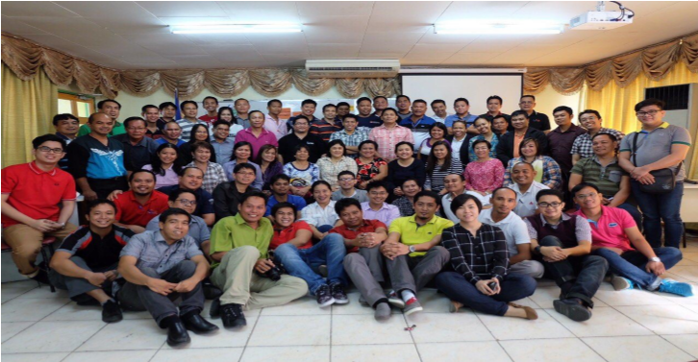
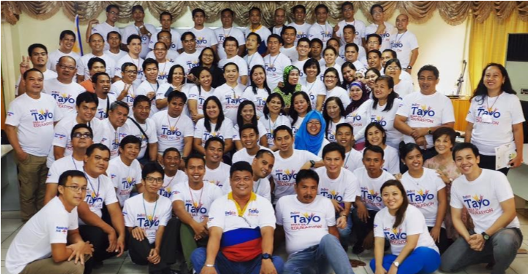
Teachers trained on ICT for pedagogy
ICT Literacy Skills Development Training of Trainers Level 1 (Division and Region) conducted total of 367 participants from Luzon, Visayas and Mindanao (Regional ITOs, Division ITOs, Division EPS for TLE)
Ongoing implementation of Division level ICT literacy skills development ToT

Slide 21
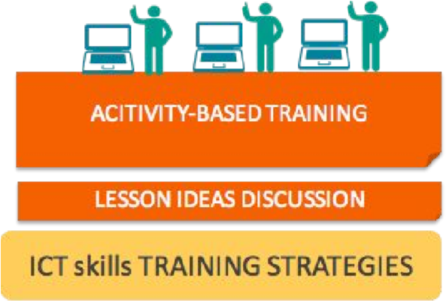
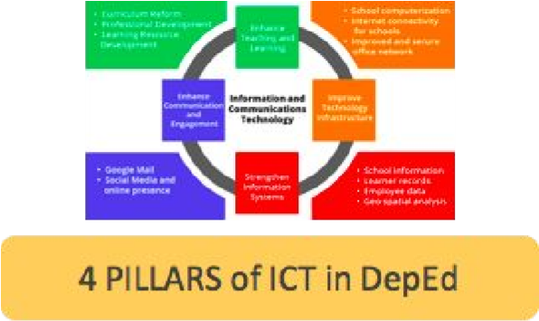



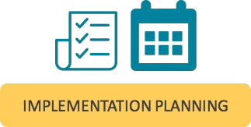
Teachers trained on ICT for pedagogy
ICT Literacy Skills Development ToT Content

Slide 22
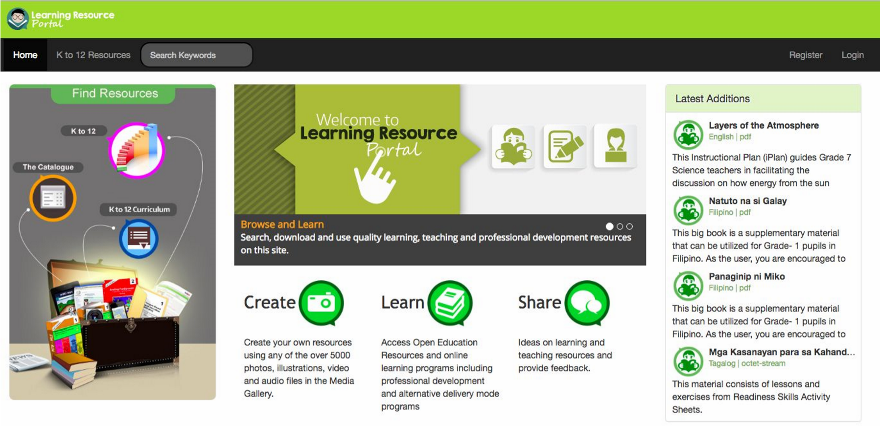
Materials are accessible through
LR Portal
Improved user registration with appropriate access rights to teacher specific materials
An operational LRMD Portal with increased capacity or resources
Provide a ‘browse view’ for Senior High School materials
QA platform to identify LR reviewers

Slide 23
IMPROVE TECHNOLOGY INFRASTRUCTURE

Slide 24
Computer Packages
All ES and JHS have received or been allocated computer packages
DALCs and ALS Mobile Teachers received multimedia packages
All Senior High Schools (SHSs) were allocated computer packages, with SHS offering programs that need heavier or specialized computing capabilities to receive specialized packages

Slide 25
Internet Connectivity
All schools with provision of Internet Fund in the MOOE
70 Mbps capacity for Central Office
Wireless environment in the whole of Central Office

Slide 26
IT Equipment
New servers procured and deployed
New data centers in CO and Region 7 designed and ready for procurement
Computers for heads of ROs and DOs deployed
Computers for all CO, RO and DO employees ongoing procurement
IUs allocated with laptops and printers

Slide 27
Planning & IT Staff Complement
ICTS newly created in CO
All regions with ICT Unit (Information Technology Officer and Computer Programmer) under the Office of the Regional Director
All Divisions ICT unit with Information Technology Officer
All schools with designated ICT Coordinators
Planning Service
All regions with Chief, EPS, Planning Officer III, Statistician under the PPRD
All Divisions with Planning Officer III and SEPS
All schools with designated LIS/EBEIS Coordinators

Slide 28
EBEIS and LIS Implementation for SY 2016-2017

Slide 29
Topics
Guidelines on LIS for SHS
DepEd Order No. 52, s. 2016
Overview of EBEIS SY 2016-2017
Matrix of Accountability
LIS Encoding and Registration
Workshop Proper

Slide 30
Guidelines on LIS for SHS
Milestones | Registration | Enrolment | Class Assignment | Exceptions

Slide 31
Imperative D.O. 25, s. 2016
Milestones for SHS
  SHS enrolment for SY 2016-2017 in all public secondary schools started on May 2, 2016.
  Online updating of SHS learner’s basic profile and enrolment in LIS started on May 10, 2016
  Opening of classes on June 13, 2016
  Assignment of classes and finalization of of enrolment masterlist via the LIS starts on June 17, 2016.

Slide 32

Registration and Enrolment of
SHS learners
Enrolment by learner no batch enrolment
Use SHS Enrolment Form and supporting documents (as specified in DO 25, Annex A) as bases for the following:
  Search and retrieve LRN with corresponding learner record
  Enrol learner in preferred program that is officially offered by the school
All enrolled learners prior to the opening of classes are recorded in the school’s “List of Registered Learners”
  School shall have the facility to view list of learners by program offering

Slide 33
Registration and Enrolment of
SHS learners
Learners with NO LRN shall be registered and appropriately identified as one of the following:
  From School Abroad, encode school name and country where learner finished JHS
  PEPT passer, encode PEPT Certificate No.
  A&E passer, encode A&E Certificate No.
  PVT passer, encode PVT certificate no.
  From the same school but not encoded in the LIS
  From other schools but not encoded

Slide 34
Registration and Enrolment of
SHS learners
Prior to issuance of LRN, record of newly-registered learner shall be subject to approval of Schools Division Office
School Head shall be responsible for organizing classes and creating class/sections in the LIS
Class Adviser shall be responsible for assigning enrolled learners.

Slide 35
Registration and Enrolment of
SHS learners
In creating SHS sections, the following data shall be provided:
  Program offering selected from drop-down list of school’s authorized program listing
  Section must be unique within a school
  Class adviser shall been created and updated under the List of School personnel hence selected from a drop-down list.

Slide 36
Assignment & Finalization of Classes
Assign learners from the “List of Registered Learner” to a class/section and enter date of first attendance
Class Adviser must “finalize” their classes to confirm list of learners for the semester. After finalization of class, learners with NO date of first attendance will no longer appear in the class’ enrolment list.
Learners with no date of first attendance will remain in the school’s Registration List until another school enrols the learner. School is notified of this movement

Slide 37
Exceptions
Learners registered in more than one school
  School where learner is enrolled on the cutoff date will count the enrolment
  Attendance in more than one school after the cutoff date will be subject to “transfer learner” policies in the LIS

Slide 38
DepEd Order No. 52, s.2016
Data Collection of Basic Education Statistics
in the Learner Information System (LIS) and
Enhanced Basic Education Information System (EBEIS)
for Beginning of School Year (BOSY) 2016-2017

Slide 39
Rationale
Data collection of basic education statistics and encoding of learner’s profile in the LIS and EBEIS is a yearly activity of all schools and learning centers
Establish an accurate and reliable registry of learners, schools, and learning centers that will ensure the availability of data and information that are essential in planning and budgeting, allocation of resources, and setting operational targets to provide access to complete basic education

Slide 40
Scope
Guide all personnel at all levels in all public and private elementary and secondary schools, learning centers State Universities and Colleges (SUCs), Local Universities and Colleges (LUCs) and Higher Education Institutions (HEIs) offering elementary and secondary schools
Provide all the additional and revised data gathering forms introducing new data elements to ensure collection and availability of needed data for policy formulation and allocation resources

Slide 41
Policy Statement
This DepEd order provides guidance in the conduct of the data collection and online registration of learners through the LIS and EBEIS respectively.
This shall be venue for sharing and collecting data that are accurate and relevant to school heads, educational managers, policy makers and various stakeholders in the education system that is integral part in the Department’s planning, policy and program development

Slide 42
Matrix of Accountability
Process | Data | Accountable Unit

Slide 43
A. Maintain School Profile In The EBEIS
Process / Data | Accountable Unit
1. Requesting for new School ID | Regional Office - PPRD
2. Assignment of School ID | EMISD – PS
3. Updating of geographic codes based on the Philippine Standard Geographic Code of the Philippine Statistics Authority | EMISD - PS
4. Creation of school record for newly established school in the EBEIS | Regional Office – PPRD
3. Updating of geographic codes based of the following school profile: School Level Address Contact details (telephone no., email address, website) Cost of transport from school to district office and division office School Head and position Distance (in kms) from school to district office and division office Class organization (multigrade, monograde or combination) | SGOD-Planning and Research Unit/PPRD EMISD

Slide 44
A. Maintain School Profile In The EBEIS
PROCESS/DATA | Accountable Unit
B. Division Level Curricular Offering Classification Opening/Closing of schools Updating of integrated schools Renaming of school Updating of school classification C. Regional Level Separation of annex, extension, merging and renaming of schools - Change in administrative level (division, legislative district, municipality, barangay) - Creation of profile of public and private schools, SUCs and LUCs | Division SGOD – Planning and Research Unit

Slide 45
B. Maintain Learner Profile In The LIS
Process / Data | Accountable Unit
6. Creation of learner record with system generated LRN | Class Adviser/ Registrar/Principal
7. Updating enrollment data of learners | Class Adviser/ Registrar/Principal
8. Defining and maintaining Classes for a given school year and class adviser’s data in the LIS | School System Admin/School Head

Slide 46
C. Support for Implementing ICT-Based Systems
Process / Data | Accountable Unit
9. Users Account Management System Admin | SGOD-Planning Research Unit/IT Officer
10. Technical Assistance | User Support Division – ICTS EMISD – PS Regional Office – PPRD Division SGOD – Planning and Research Unit and Unit IT Officer

Slide 47
Roles and Responsibility

Slide 48
Class advisers of public schools and designated school system administrators/school registrar of private schools and SUCs offering elementary and secondary education must ensure that all learners’ profile must be updated. School Heads (SHs) must ensure the accuracy and completeness of the school’s BOSY data.

Slide 49
Data Gathering Forms

Slide 50
Revised data gathering forms which consist of the following:
Annex A: Government Elementary School Profile (GESP)
Annex B: Government Junior High School Profile (GJHSP)
Annex C: Private School Profile (PSP)
Annex D: State and Local Universities and Colleges (SUCs & LUCs) School Profile
New Data Gathering Forms:
Annex E: GISP Elementary Level
Annex F: GISP Junior High School Level
Annex G: GISP Senior High School Level
Annex H: Government Senior High School (GSHSP)

Slide 51
Request and Transfer of Learners’ School Records
DepEd will establish a standard processes and protocols in the request and release of learners’ Form 137 (Permanent Record) and Form 138 (Report Card) in all schools nationwide.
Facility to transfer the record of learners will be made available for the easy processing of the request of permanent school records (Form 137) for an efficient and faster way of transferring documents without inconveniencing the parents or the learners. This facility will be operational in the LIS. A manual and video will be uploaded in the support page of LIS. This will be provided in a separate memorandum.

Slide 52
Standardization on the numbering of issuance of School ID
Type | School ID 1st Digit Assignment
 | Current | Proposed
Public- Deped ES | 1,2 | 1,2
Public-Deped SS including SHS | 3 | 3
Private | 4 | 4
 | 5, 6, 7, 9
SUCs / LUCs | 6 | 6
 | 4, 7, 9
Public Integrated |  | 5
BRAC | 0 | 0

Slide 53
Data Dictionary
DepEd data dictionary will communicate a common meaning of all the elements in the system for consistency and to have a common understanding among the stakeholders within and outside DepEd. These set of information describing content, format and structure of a database will be orderly managed in details.
This will also be a guide and reference of personnel for data description and collection.

Slide 54
Timeline
The following timeline in the conduct of LIS and EBEIS activities shall be observed:
Activity | Timeline
LIS
Encoding/Updating of LIS for BOSY 2016-2017
SHS | May 10, 2016 – August 31, 2016
K to Grade 10 | July 4, 2016 – August 31, 2016
Orientation and Workshop | July 6-7, 2016
ALS (Jan-Oct 2016) | July 4, 2016 – October 31, 2016
EBEIS
Encoding of BOSY 2016-2017
K to 10 | July 18, 2016 – September 16, 2016
Proposed Orientation and Workshop | July 18-22, 2016
SHS | August 1, 2016 – September 16, 2016
Generation of accomplished EBEIS Forms | September 26, 2016
Encoding for new data elements | October – November 2016

Slide 55
Learner Information System

Slide 56
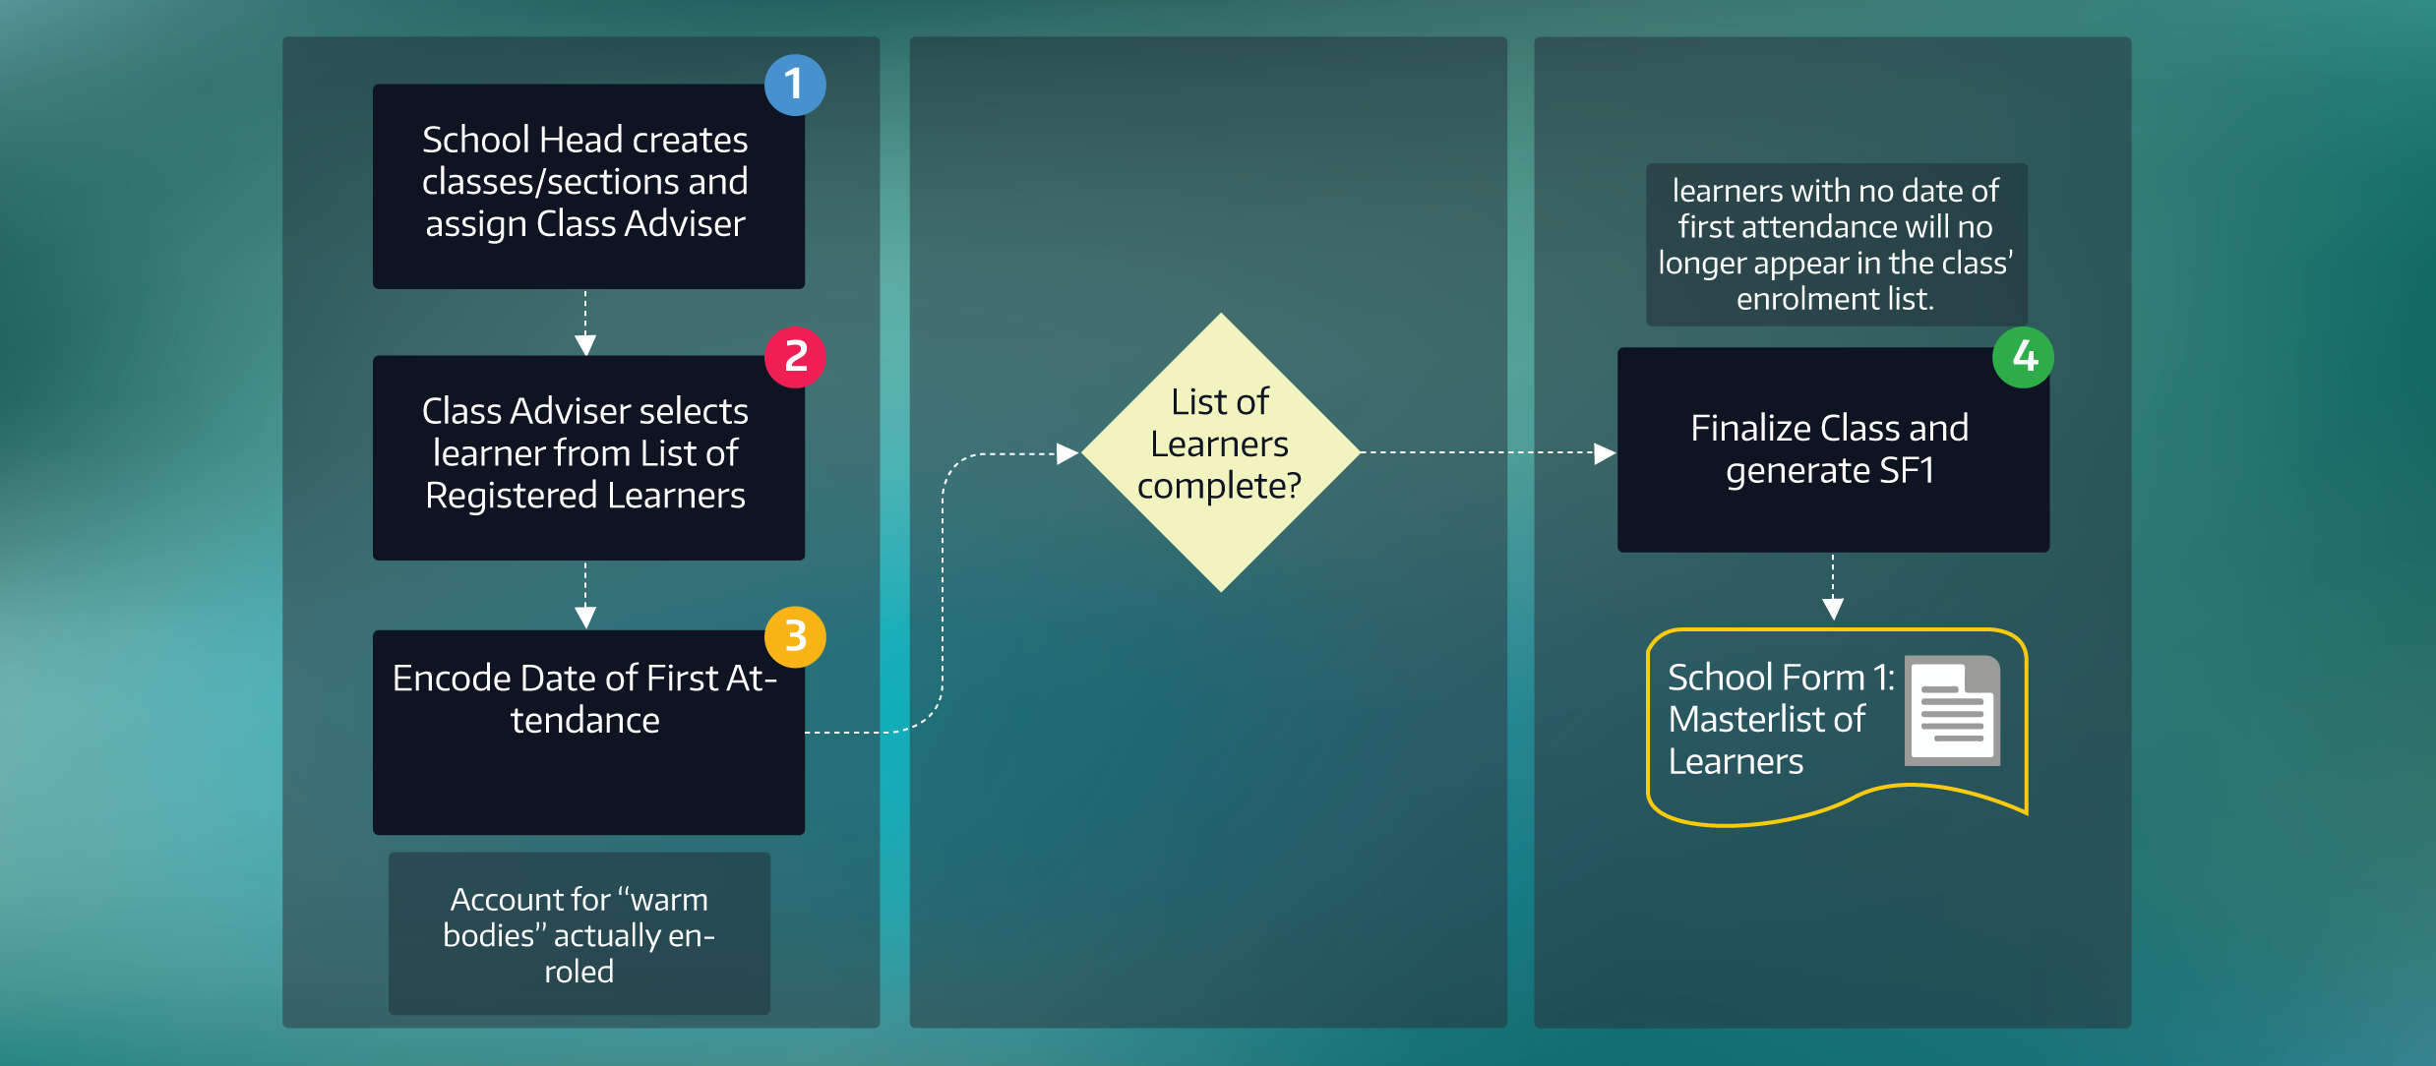
Assignment & Finalization of Classes

Slide 57

Matrix of Enrolment
 |  | Learners
Possible Cases |  | Eligible | Ineligible | Enrolment Action/Status
2015
Grade Level | Status
K to G10 | Promoted |  |  | Enrolled
 | Conditionally Promoted |  |  | Change of EOSY status (For Division approval) Upon submission of recomputed grades during remedial instruction
 | Dropped Out |  |  | Change of EOSY status (For Division approval)
 | Retained |  |  | Change of EOSY status (For Division approval)
 | No Status |  |  | Change of EOSY status (For Division approval)

Slide 58
Status Report
PROGRESS REPORT ON LIS UPDATING AS OF APRIL 8, 2016.xls

Slide 59
Status Report
TOP 10 ELEMENTARY SCHOOLS AS OF JULY 6, 2016
District | School | Partial Enrolment as of June 17, 2016 | No. of Sections Created
Balingasag South | Binitinan ES | 552 | 18
Opol | Luyong Bonbon ES | 307 | 22
Tagoloan | Natumolan ES | 297 | 13
Naawan | Naawan CS | 270 | 29
Opol | Barra ES | 268 | 21
Magsaysay II | Kandiis ES | 264 | 14
Salay | Salay CS | 225 | 7
Alubijid | Alubijid CS | 189 | 30
Alubijid | Sungay ES | 184 | 10
Villanueva | Vn Chavez MCS | 166 | 63

Slide 60
Status Report
TOP 10 SECONDARY SCHOOLS AS OF JULY 6, 2016
District | School | Partial Enrolment as of June 17, 2016 | No. of Sections Created
Medina | Medina NCHS | 325 | 40
Talisayan | Mandahilag NHS | 163 | 6
CDO | Mis. Or. Gen. CHS | 135 | 151
Tagoloan | Tagoloan NHS | 72 | 72
Alubijid | Alubijid NCHS | 62 | 44
Salay | Looc NHS | 55 | 8
Balingasag South | Baliwagan NHS | 52 | 34
Jasaan | Bobuntugan NHS | 51 | 13
Claveria I | Dr. Gerardo Sabal Memorial NHS | 44 | 25
Jasaan | Jasaan NHS | 37 | 52

Slide 61
DEMO

Slide 62
Lis Workshop proper

