Slide 1
Testing Personnel
Department of Education
BUREAU OF EDUCATION ASSESSMENT
2017
Edited 2017/BEA-EAD

Slide 2
Accronym
SDS - Schools Division Superintendent
RTC -Regional Testing Coordinator
DTC -Division Testing Coordinator
PSS -Private School Supervisor
SH -School Head
STC -School Testing Coordinator
CE -Chief Examiner
RS -Room Supervisor
RE -Room Examiner
LRN -Learner Reference Number
TMs -Test Materials
TB -Test Booklet
AS -Answer Sheet
EH -Examiner’s Handbook
SSH -Scannable School Header
ETRE -Examiner’s Transmittal Report Envelope
CETRE -Chief Examiner’s Transmittal Report Envelope
COR - Certificate of Rating

Slide 3
The Testing Staff and Their Roles and Responsibilities

Slide 4
The Testing Staff at the Division Level
Division Level
SDS*
DTC
PSS
School Level
School Head/ Chief Examiner – School Head of the Testing Center
School Testing Coordinator –
Guidance Counselor or designate
Room Supervisors
Coming from other schools
RE ₁
RE ₂
RE ₃
RE ₄
RE _{n}
Notes: 1. Assignment of the testing staff shall be done by the SDS.

Slide 5
The Schools Division Superintendent (SDS)
The SDS shall oversee the test administration and shall be responsible for the smooth conduct of the test in the Division.
He/she shall also designate the Education Program Supervisors/Qualified Personnel who shall serve as Division Testing Coordinator and Private School Supervisor.

Slide 6
The Regional Testing Coordinator (RTC)
He/she shall provide Division Offices the list of private schools operating with permit that are to be included in the test administration.
He/she shall also prepare a team to monitor the test in the whole region.

Slide 7
Division Testing Coordinator (DTC). He/she shall supervise the administration of the test in public schools.
Private School Supervisor (PSS) or Division Testing Coordinator Assistant (DTCA). He/she shall supervise the administration of the test in private schools.
Chief Examiner (CE). The School Head shall serve as the Chief Examiner and shall oversee the conduct of the test in the school.

Slide 8
School Testing Coordinator (STC). The Guidance Counselor/Department Head shall serve as the School Testing Coordinator whose task is to assist the Chief Examiner in the overall conduct of the test.
Room Supervisor (RS). Teachers from other schools shall serve as Room Supervisors. They shall monitor and supervise in the rooms assigned to them.
There must be 1 RS assigned in every 10 testing rooms if there are 20 examinees per room;1 RS in every 5 rooms if there are 30 examinees pe r room.
They shall conduct ocular inspection the day before the test to familiarize themselves with the layout of the school.

Slide 9
Room Examiner (RE). Teachers from other schools shall serve as Room Examiners.
They shall conduct the test in accordance with the standardized test administration guidelines. RSs and REs must NOT come from the same school.
Transportation and other incidental expenses shall be charged to their school’s Maintenance and Other Operating Expenses (MOOEs)/local funds.
Support Staff (SS). Administrative support staff shall provide any test-related assistance to the School Head, such as preparation of testing rooms.

Slide 10
Monitoring and Evaluation of Test Administration

Slide 11
The national test administration shall be monitored and evaluated in levels:
by the Central Office through BEA and
by the Regional and Schools Division Offices and schools through their field personnel. For the Placement/Accreditation/Equivalency
Tests, the test administration shall also be monitored and evaluated by the Bureau of Learning Delivery.

Slide 12
The Regional and Division Offices shall form a committee to monitor and evaluate the processes done before, during, and after the conduct of the test using a monitoring tool.
A monitoring tool is provided to every test monitor to ensure that the standard procedures are followed.
The monitoring and evaluation to be conducted in random schools in select divisions shall be part of the research on the effectiveness of the test administration scheme and utilization of data.

Slide 13
The Regional Office committee shall be composed of personnel from the Curriculum and Learning Management Division (CLMD) and Quality Assurance Division (QAD), while the Schools Division Office committee shall be composed of personnel from the Curriculum and Instruction Division (CID) and the School Governance and Operations Division (SGOD).

Slide 14
The Forms
Oath of Confidentiality
Form 1 – List of Actual Examinees
Form 2 – Seat Plan
Form 3 – Test Materials Accounting Form
Form 4 – Chief Examiner’s Report Form
Form 5 – Test Booklet Quantity and Completeness Verification Sheet
Form 6 – Answer Sheet Quantity and Completeness Verification Sheet
Form 7 – Room Examiner’s Test Administration Evaluation Report

Slide 15
Oath of Confidentiality
As part of the testing staff nationwide, tasked to receive, administer and retrieve the Test Materials for the ____________ (testing program), I hereby solemnly swear that I will strictly observe security measures to maintain the confidentiality of said materials.
Received from: Received by:
(The Division Testing Coordinator) (School Head/School Testing Coordinator)
________________________ ________________________
Printed Name and Signature Printed Name and Signature
____________________ ____________________
Date Date

Slide 16
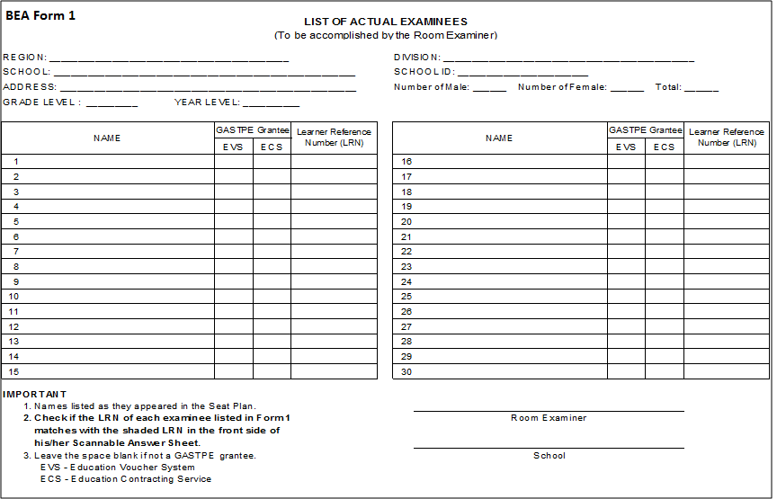
The Generic Forms Form 1

Slide 17
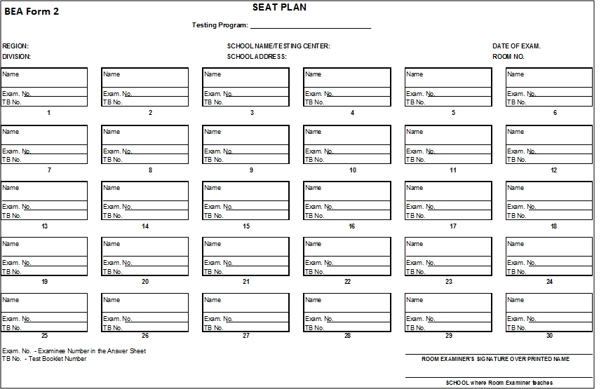
Form 2

Slide 18
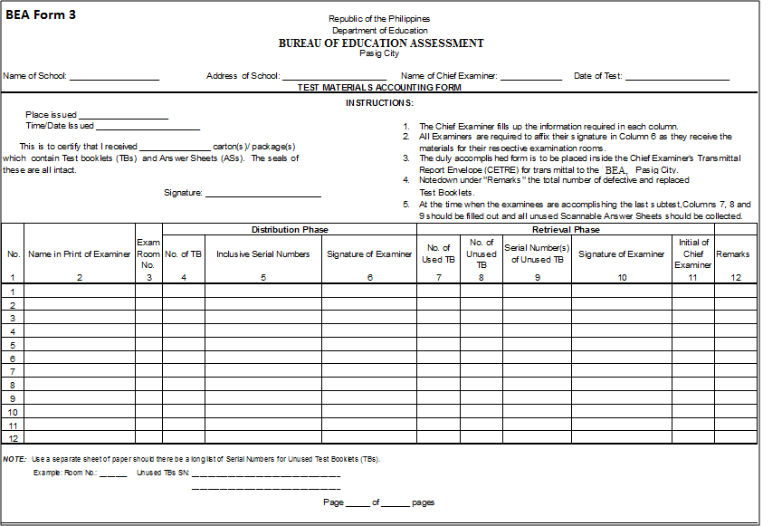
Form 3

Slide 19
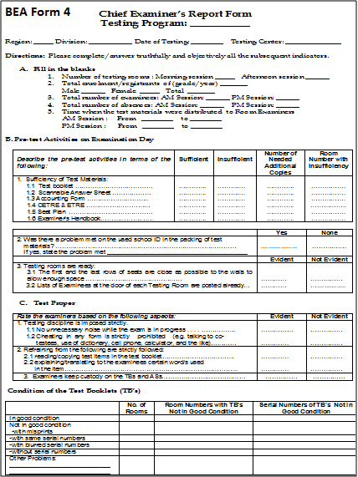
Form 4

Slide 20
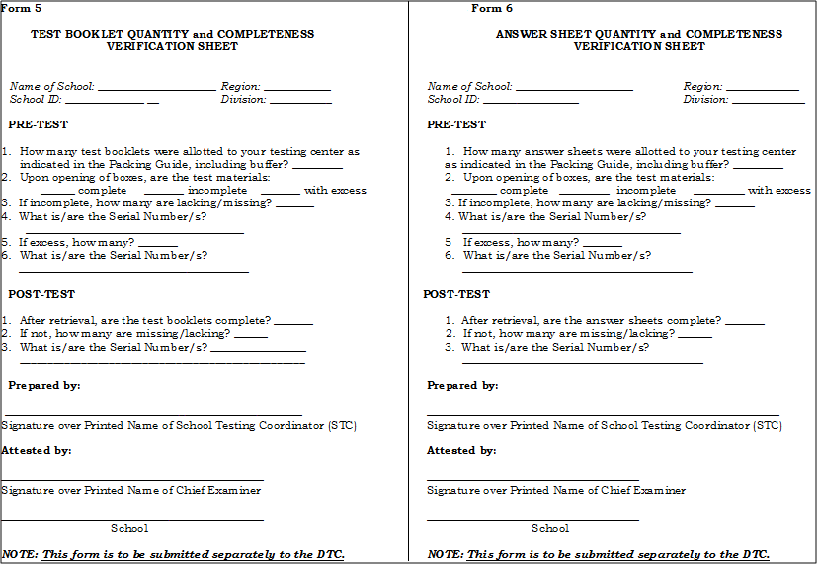
Forms 5 and 6

Slide 21
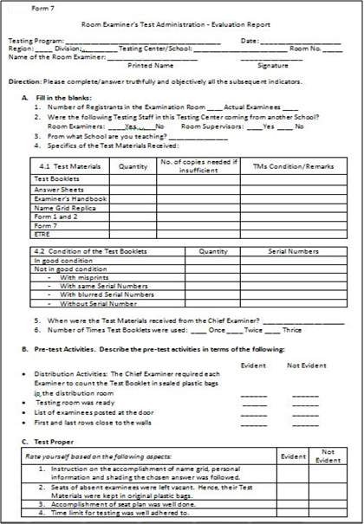
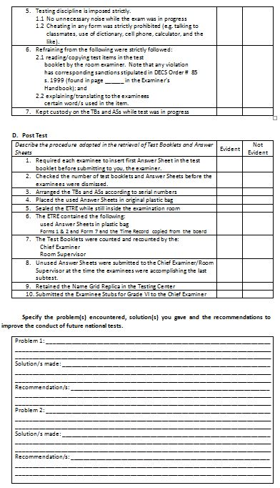
Form 7 – This will suffice the narrative report of the RE

Slide 22
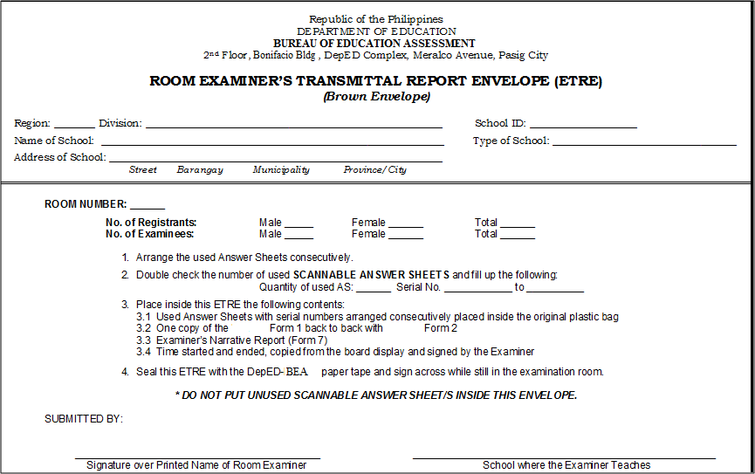
Room Examiner’s Transmittal Report Envelope

Slide 23
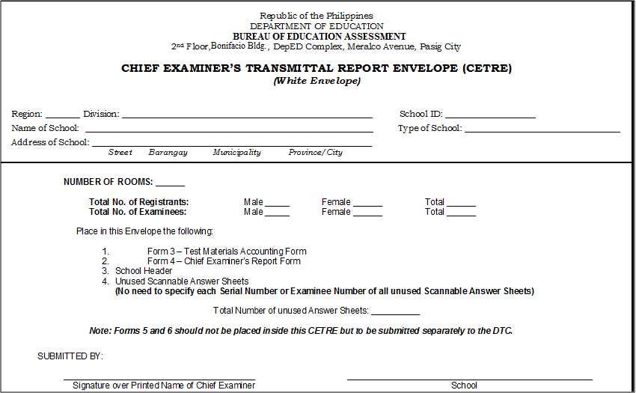
Chief Examiner’s Transmittal Report Envelope

Slide 24
On Photocopied Answer Sheets
In case there will be a shortage of Answer Sheets (ASs) in one testing center, Scannable Answer Sheets (SASs) may be photocopied.
The photocopied ASs SHOULD BE PLACED INSIDE THE RESPECTIVE ETRE corresponding with the list of actual examinees in Forms 1 and 2.
No Examinee Number should be written in Form 2 (Seat Plan) for the examinees with photocopied ASs. Instead, indicate in the blank “(Photocopied).”
Sample:
Name | Kristina M. Dela Cruz
Exam. No. | (Photocopied)
TB No. | 016657

Slide 25
On Photocopied Answer Sheets
Using a red marker, indicate at the upper right corner of the ETRE this note:
The instructions above are important in order for BEA to locate, transcribe and electronically process the photocopied ASs.
With _______Photocopied Answer Sheets (quantity) ROOM EXAMINER’S TRANSMITTAL REPORT ENVELOPE (ETRE) (Brown Envelope)

Slide 26
On the Storage of Examiner’s Handbook, Replicas of Name Grid and Board Displays
EHs will be stored in the Division Office. Name Grid replicas and Board Works will be stored in the schools or testing centers. These documents are for future use.
Replicas of the name grid intended for each testing program should be properly stored and utilized in school. These are generic to all testing programs; hence, may be used in future testing activities in case no reprints will be provided.

Slide 27
TMs for Retrieval by BEA thru Courier
All TBs packed in original boxes;
All used ASs in ETREs (Forms 1, 2 and 7 inside);
All unused ASs in CETREs (Forms 3 and 4, and School Headers inside) packed in original boxes for ASs ; and
Forms 5 and 6 submitted to DTCs for proper placement in respective boxes
Reminder: Do NOT mix up TBs with ASs. There are two separate warehouses for these TMs. Otherwise, misplaced TMs will not be accounted for properly.

Slide 28
The Forwarder of Test Materials

Slide 29
Dealing with the Forwarder of TMs
Exact addresses of Division Offices or drop-off points should be provided to BEA to be turned over to the Forwarder.
Forwarder must provide to BEA the contact persons and numbers as well as the itineraries of delivery and retrieval for ready reference.
Each Division should designate at least two authorized staff to receive the TMs other than the DTC.
The neighboring Divisions in the Region should establish a network of communication.

Slide 30
Dealing with the Forwarder of TMs
4.1 Every receiving Division should take note of Forwarder’s contact number and the date and time TMs will be retrieved
4.2 The next division to receive the TMs from the Forwarder should be alerted by the Division immediately after receiving its TMs while informing also the Forwarder that the next division to receive has been alerted already.
4.3 The same procedure will be followed in the retrieval of TMs.
4.4 Accomplish the evaluation form on the Performance of Forwarder and submit thru email (bea.ead@deped.gov.ph/bea.od@deped.gov.ph).

Slide 32
Other Concerns

Slide 33
Practices in Some Divisions Relative to the Utilization of the COR
Attach the COR in the Form 137 in Grade 6 as part of the student’s credentials prior to enrolment.
The COR is photocopied. One copy is for the school where the student intends to enrol while the original COR is given to him/her.

Slide 34
Refusal of State Univ./Colleges (SUCs) to Take National Exams
Send a communication to BEA regarding SUCs which refused the administration of national exams (NCAE, NAT, etc.).
The communication will be endorsed to the DepEd Secretary.

Slide 35
Good Practices as Reflected in a School Culture
Region/Division Codes and School ID
Posting permanently in every classroom (near the chalkboards) the information on the Region and Division Codes and the School ID
Learner Reference Number
The LRN is used by the examinee in any form of school and classroom-based assessments. This practice may be adopted not only during national examinations.

