Slide 1
Policy Guidelines on Awards and Recognition for the K to 12 Basic Education Program
DepEd Order No. 36 , s. 2016

Slide 2
Policy Guidelines on the Awards and Recognition for K to 12 Basic Education Program
DepEd O R D E R No. 36, s 2016 : Policy Guidelines on Awards and Recognition for the K to 12 Basic Education Program
giveS all learners equal opportunity to excel in relation to the standard set by the curriculum and focus on their own performance rather than to compete with one another;
acknowledges and promotes student excellence in academic, leadership, and social responsibility;
nurtures the formation of the learners’ values and attitudes anchored on the core values of the Department of Education;
one of the many ways by which teachers and schools provide students with positive feedback and affirmation, which can improve the learner’s confidence, self-awareness, and enthusiasm for learning.
Division of Misamis Oriental

Slide 3
I. What awards do we give?
DepEd O R D E R No. 36, s 2016 : Policy Guidelines on Awards and Recognition for the K to 12 Basic Education Program
A. Classroom Awards
B. Grade – level Awards
C. Special Recognition
These are recognition given to learners in each class or section. A simple recognition may be given per quarter, semester or at the end of the school year.
These are given to qualified learners for every grade level at the end of the school year. Candidates for the awards are deliberated by the Awards Committee (AC) if they have met the given criteria.
This is given by the school to the learners who have represented and/or won in competitions at the district, division, regional, national, or international levels.
Division of Misamis Oriental

Slide 4
A. Classroom Awards
DepEd O R D E R No. 36, s 2016 : Policy Guidelines on Awards and Recognition for the K to 12 Basic Education Program
1. Conduct Awards
2. Academic Excellence Award
3. Recognition for Perfect Attendance
Conduct Awards for grades 4 to 12 in each class will be given at the end of the school year. This will be based on the evaluation of the adviser and subject teachers, using the guidelines stipulated in Section VI of DepEd Order No. 8, s. 2015.
The Award for Academic Excellence within the quarter is given to learners from grades 1 to 12 who have attained an average of at least 90 and passed all learning areas. The Average Grade per Quarter is reported as a whole number following DepEd Order No. 8, s. 2015.
This award is given at the end of every quarter to encourage learners to attend and actively participate in class. Perfect attendance means that a learner must be present in all of his/her classes, and must have no absences for the entire quarter.
Division of Misamis Oriental

Slide 5
B. Grade-level Awards
DepEd O R D E R No. 36, s 2016 : Policy Guidelines on Awards and Recognition for the K to 12 Basic Education Program
1. Academic Excellence Award
2. Leadership Award
3. Award for Outstanding Performance in Specific Disciplines
At the end of the school year, the Academic Excellence Award is given to learners from grades 1 to 12 who have attained a General Average of at least 90 and a passing Final Grade in all learning areas. The General Average is reported as a whole number following DepEd Order No. 8, s. 2015.
The leadership award is given to learners in grades 6, 10, and 12 who have demonstrated exemplary skills in motivating others and organizing projects that have significantly contributed to the betterment of the school and/or community. This award is given during the completion or graduation ceremony.
These awards are given to recognize learners in grades 6, 10, and 12 who have exhibited exemplary skills and achievement in specific disciplines. These disciplines are Athletics, Arts, Communication Arts, Mathematics and Science, Social Sciences, and Technical-Vocational Education (Tech-Voc).
Division of Misamis Oriental

Slide 6
B. Grade-level Awards
DepEd O R D E R No. 36, s 2016 : Policy Guidelines on Awards and Recognition for the K to 12 Basic Education Program
4. Award for Work Immersion
5. Award for Research or Innovation
6. Award for Club or Organization Achievement
Award for Work Immersion is specific to Senior High School (SHS) tracks. This award may be given to grade 12 graduating students who have exemplified outstanding performance based on the terms of reference or engagement set by the school and evaluation of the direct supervisor and subject teacher. The awardee(s) must have received high efficiency rating for their diligence and consistency in performing their duties and responsibilities throughout the immersion program.
Award for Research or Innovation is specific to the SHS tracks. Grade 12 graduating students—individuals, pairs, or groups of not more than four members—must have led the planning and execution of a research or innovation to advance the potential applications of technology, or research whose findings can be used to drive better efficiency and productivity as well as to improve the lives of the people in the school and/or community.
This award is given to a duly recognized club or organization that has created positive impact on the school and/or community it serves through the implementation of all its planned projects and activities, provided strong support to the implementation of the school activities and attainment of the school’s objectives, and taken great strides to help its members develop their potentials.
Division of Misamis Oriental

Slide 7
C. Special Recognition
DepEd O R D E R No. 36, s 2016 : Policy Guidelines on Awards and Recognition for the K to 12 Basic Education Program
Learners who have represented and/or won in competitions at the district, division, regional, national, or international levels will be recognized. These awardees have demonstrated their exemplary performance in academics, athletics, and the arts, and/or represented the school in DepEd-recognized activities.
Division of Misamis Oriental

Slide 8
II. What do awardees receive?
DepEd O R D E R No. 36, s 2016 : Policy Guidelines on Awards and Recognition for the K to 12 Basic Education Program
The grade-level awardees shall receive certificates, medals, and/or plaques from the school, bearing the official seal of the Department (DepEd Order No. 63, s.2011).
Division of Misamis Oriental

Slide 9
III. How do schools determine awardees?
DepEd O R D E R No. 36, s 2016 : Policy Guidelines on Awards and Recognition for the K to 12 Basic Education Program
AWARDS COMMITTEE (AC)
- organized by the school head for each grade level at the beginning of the school year;
-chairperson could be any of the teachers, department head, grade-level chairperson, or curriculum head;
-no member of the AC must be related within the second degree of consanguinity or affinity to any of the candidates for awards.
-Composed of at least three (3) members from the teaching staff, guidance counselor or designated teacher;
Division of Misamis Oriental

Slide 10
IV. When to file and settle protests?
DepEd O R D E R No. 36, s 2016 : Policy Guidelines on Awards and Recognition for the K to 12 Basic Education Program
Cases of protest shall be filed by the candidate with his/her parent or guardian to the School Head within three (3) working days from the announcement and shall be decided on by the school head or principal, considering the recommendations of the AC within three (3) working days from filing.
Division of Misamis Oriental

Slide 11
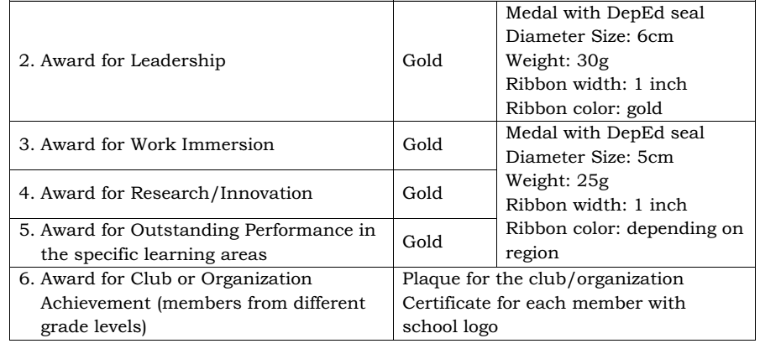
Grade - level Awards

Slide 12
The table below shows the specific Academic Excellence Award given to learners who meet the following cut-off grades.
DepEd O R D E R No. 36, s 2016 : Policy Guidelines on Awards and Recognition for the K to 12 Basic Education Program
Academic Excellence Award | General Average
With Highest Honors/ May Pinakamataas na Karangalan | 98–100
2. With High Honors/ May Mataas naKarangalan | 95–97
3. With Honors/ May Karangalan | 90–94
Division of Misamis Oriental

Slide 13
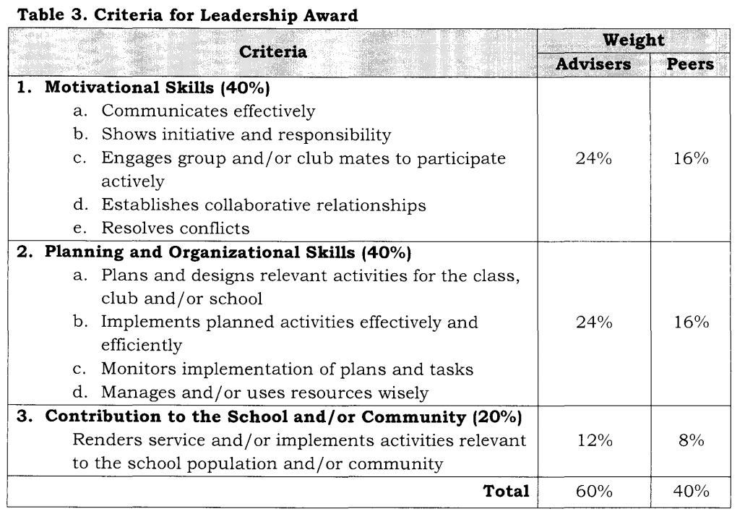
Grade - level Awards

Slide 14
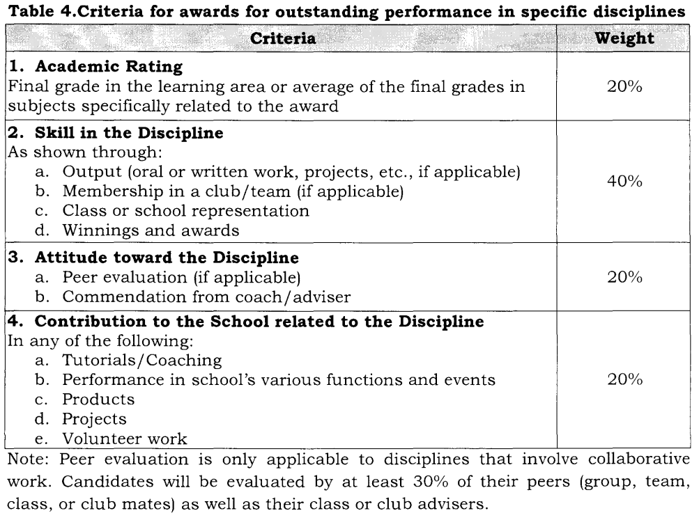
Grade - level Awards

Slide 15
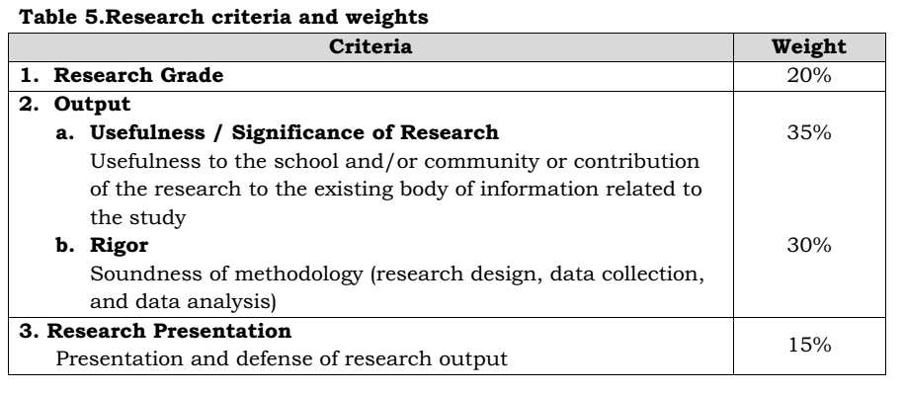
Grade - level Awards

Slide 16
Grade - level Awards

Slide 17
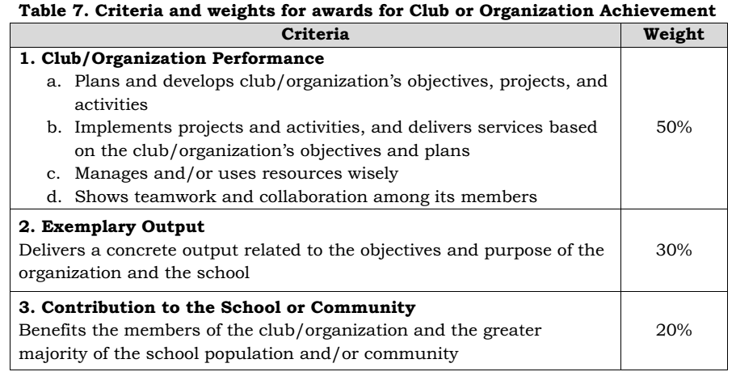
Grade - level Awards

Slide 18
Summary of Awards
A. Classroom Awards – given in every section per quarter, semester or at the end of school year, such as:
1. Performance Awards for Kindergarten
2. Conduct Awards
a. Character traits for Kindergarten to Grade 3
b. Conduct Awards for Grades 4-12
3. Academic Excellence Award for Grades 1-12
4. Recognition for Perfect Attendance

Slide 19
Summary of Awards
B. Grade Level Awards – given at the end of the school year
1. Academic Excellence Award - for all learners who
attained a general average of not less than 90.
2. Leadership Awards – for grades 6, 10 and 12 learners
3. Award for Outstanding Performance in Specific
Disciplines - for grades 6, 10 and 12 learners
(Athletics, Arts, Communication Arts, Science,
Mathematics, Social Sciences, Tech-Voch Ed.)
4. Award for Work Immersion
5. Award for Research and Innovation
6. Award for Club or Organization Achievement

Slide 20
Summary of Awards
C. Special Recognition – for learners who won in competitions

