Slide 2
Unsa nga sapot ang angay natong ipasuot sa bata sa iyang pag eskwela?
Bagay sa panahon/ okasyon
Kompleto ug komportable
Maayo lantawon
Lig-on ug mulahutay sa taas nga panahon
Presyo nga makatarunganon

Slide 3
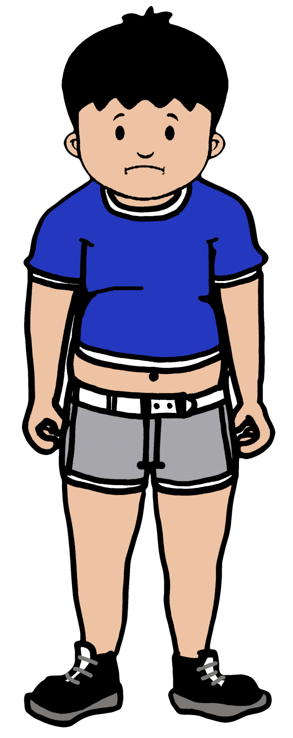
Sapot A?

Slide 4
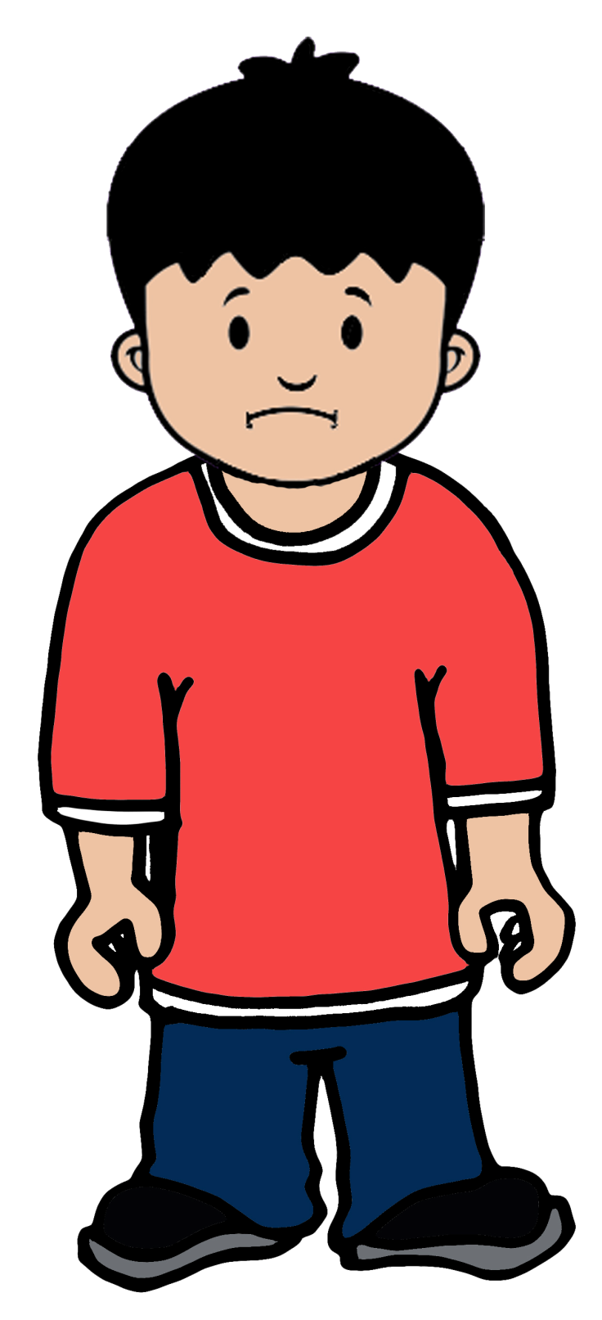
Sapot B?

Slide 5
Sapot C ?

Slide 6
Sama sa pagpili nato sa sapot nga ipasu-ot sa atong mga bata, pilion usab nato ang klase sa edukasyon nga angayan para kanila. Edukasyon nga :
Kompleto ug taas ug kalidad
Ha-om sa panginahanglanon sa panahon
Libre o presyo nga makatarunganon
Kapareha sa edukasyon sa laing mga nasud
Nag-abre sa mga dalan alang sa gawasnong pagpili sa atong kabataan basi sa ilang kahibalo, kahanas ug interes

Slide 7
Ang Programang K to 12

Slide 8
Akta Republika 10533
Ang K to 12
usa ka balaod nga ginganlan
Enhanced Basic Education
Act of 2013

Slide 9
Ang Mga Graduado sa K to 12
Makaangkon sa abilidad nga gikinahanglan sa bag-ong panahon, sama sa:
Information, Media and Technology Skills
Effective Communication Skills
Learning and Innovation Skills
Life and Career Skills

Slide 10
Ang Mga Graduado sa K to 12
Kompleto, andam ug gawasnon nga mupili sa iyang padulngan sama sa:
Pag-eskwela sa Kolehiyo
Pagpadayon pagtuon ug Bokasyonal
Pagnegosyo
Pagpangimpleyo

Slide 11
Ang mga Hiyas sa K to 12
1. Kindergarten
Sinugdanan sa K to 12
Nahimong balaod pinaagi sa Akta Republika10157

Slide 12
Ang mga Hiyas sa K to 12
2. Naandang Pinulungan
Kadaghanan sa mga leksiyon gikan sa Kinder padulong sa Grade 3 naggamit sa naandang pinulungan.

Slide 13
Ang mga Hiyas sa K to 12
3. Senior High School
Dugang nga duha ka tuig nga gitawag Grade 11 ug Grade 12
Mokompleto sa dose ka tuig nga Basic Education nga maoy panginahanglanon dinhi sa sulod o gawas sa nasud

Slide 14
Modelong K to 12 ( K+6+4+2)
Senior High School
Grades 11-12 (16-17 anyos)
Junior High School
Grades 7-10 (12-15 anyos)
Elementary School
Grades 1-6 (6-11 anyos)
Kindergaten (5 anyos)

Slide 15
ANG MGA PAGAKAT-ONAN NGA NAHILAKIP SA K TO 12

Slide 16
Core Subjects: English, Filipino, AP, EsP,
Math, Science, MAPEH
Elective Technology and Livelihood Educ
Core Subjects: English, Filipino, AP, EsP,
Math, Science, MAPEH
Exploratory Technology and Livelihood Educ
GRADES 9-10
Junior High
GRADES 7-8
Junior High
Core Subjects: English, Filipino, AP, EsP,
Math, MAPEH, Science (Grades 3-6)
EPP (Grades 4-6), MTB- MLE (Grades 1-3)
GRADES 1-6
KINDERGARTEN
Learning Domains: English, Filipino, AP,
EsP, Math, Science, MAPEH

Slide 17
SENIOR HIGH SCHOOL
Grades 11-12

Slide 18
4 KA DALAN
TECHNICAL VOCATIONAL-LIVELIHOOD
ARTS AND DESIGN
ACADEMIC
SPORTS
Strands:
ABM
STEM
HumSS
GAS

Slide 19
AKADEMIKO - ABM
Accountancy, Business and Management
Business Management
Banking and Financial Services
Business Information Technology
Bookkeeping and Accounting Technology
Management Services
Advertising and Public Relations
Hotel and Restaurant management
TECHNICAL VOCATINAL-LIVELIHOOD
ARTS AND DESIGN
ACADEMIC
SPORTS

Slide 20
AKADEMIKO - STEM
Science, Technology, Engineering and Mathematics
Pharmacy, Radiology, Medical Technology, Pathology,
Atmospheric Science, Environmental Science,
Agricultural Science and Fishery, Animal Science,
Information Technology and Computer Studies,
Multimedia, Animation, Programming and Computer Science, BS Math, BS Physics, Statistics
Information Management System,
Engineering(Mechanical, Electronics, Communication,
Metallurgical, Computer, Biomedical, Chemical, Geodetic, Electrical, Meteorological, Mining)
TECHNICAL VOCATINAL-LIVELIHOOD
ARTS AND DESIGN
ACADEMIC
SPORTS

Slide 21
AKADEMIKO - HumSS
Humanities and Social Sciences
Philosophy, Literature, Liberal and Fine Arts
Education (major in Math, Science, Physics, Chemistry, Reading, English, Educational/
Media Technology, Special Education, Music, Physical Education and Health),
Communication, Psychology, Social Work, Criminology, Sociology, Anthropology,
Political Science, Law
TECHNICAL VOCATINAL-LIVELIHOOD
ARTS AND DESIGN
ACADEMIC
SPORTS

Slide 22
AKADEMIKO - HumSS
Humanities and Social Sciences
Philosophy, Literature, Liberal and Fine Arts
Education (major in Math, Science, Physics, Chemistry, Reading, English, Educational/
Media Technology, Special Education, Music, Physical Education and Health),
Communication, Psychology, Social Work, Criminology, Sociology, Anthropology,
Political Science, Law
TECHNICAL VOCATINAL-LIVELIHOOD
ARTS AND DESIGN
ACADEMIC
SPORTS

Slide 23
AKADEMIKO - GAS
General Academic Strand
Para sa mga wala pa maka desisyon kung unsa nga korso ang kuhaon inig ka kolehiyo
TECHNICAL VOCATINAL-LIVELIHOOD
ARTS AND DESIGN
ACADEMIC
SPORTS

Slide 24
Grades 11 – 12 (4 Semesters)
31 TOTAL SUBJECTS
15 CORE Subjects | 16 TRACK SUBJECTS
 | 7 Contextualized Subjects | 9 Specialization Subjects
Each subject will have 80 hours per semester
P.E. and Health will have 20 hours per semester
Number of Hours
Core | Track | Total
1,200 | 1,280 | 2,480
2,480 hours divided by 400 school days (50 school days/semester)
= 6.2 hours per day

Slide 25
Senior High School
Core Subjects | Same content | Same competencies
Contextualized Subjects | Different content | Same competencies
Specialization Subjects | Different content | Different competencies

Slide 26
IC Ang Senior High School
Libre sa mga publikong eskwelahan
Libre o may counterpart ang estudyante sa mga partner nga pribadong eskwelahan
Anaa sa mga pinili ug andam nga mga publiko ug pribado nga tunghaan

Slide 27
Barog alang sa
Kaugmaon!
Edukasyon!
K to 12!

