Slide 2
Legal Base
Sec. 14 of RA 10121 “Integration of Disaster Risk Reduction Education into the School Curricula and Sanggunian Kabataan Program and Mandatory Training for Public Sector Employees.”

Slide 3
Legal Base…
Sec. 1043.01 of Rule 1040 – “Principal Duties of the Health and Safety Committee” “Develops and maintains a disaster contingency plan and organizes such emergency service units as may be necessary to handle disaster situations pursuant to the emergency preparedness manual for establishments of the Office of Civil Defense.”

Slide 4
Objectives
To ensure the safety of administrators, staff, students and employees during and after a damaging earthquake;
To help agency / school administrators and their Disaster Control Groups / School Disaster Management Committees to design a specific response plan for the workplace/School;

Slide 5
Objectives
To train administrators, staff, students and employees on the proper actions and response during an earthquake; and
To test various elements of the response plan designed by the Agency Disaster Control Group (DCG) / School Disaster Management Committee (SDMC)

Slide 6
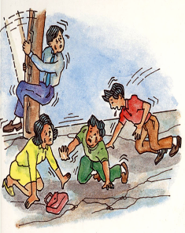
EARTHQUAKE
A weak to violent shaking
of the ground produced by
the sudden movement of
rock materials below the
earth’s surface.

Slide 7
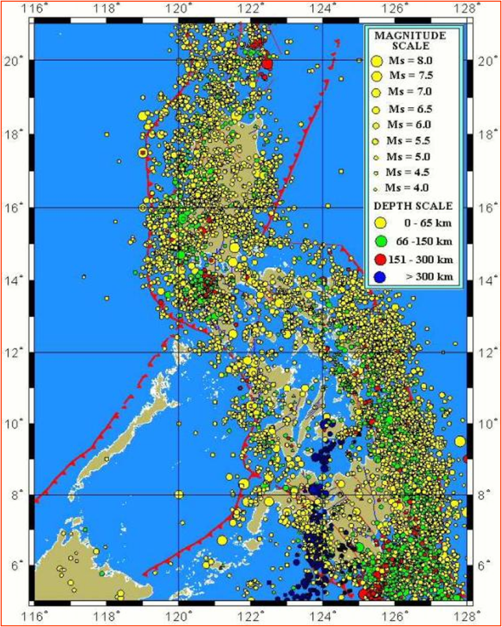
at least 20 earthquakes per day
4 – 5 felt earthquakes per week

Slide 8
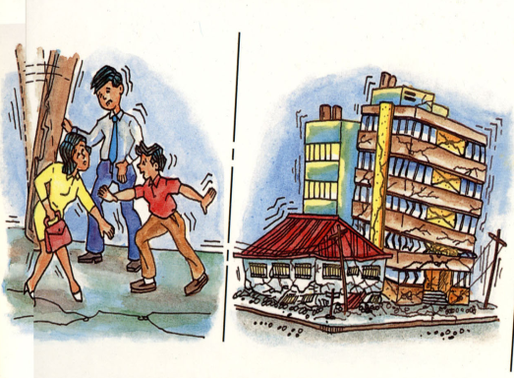
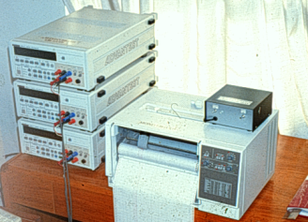
Two ways of describing the strength of an earthquake
1. Intensity
perceived strength of an
earthquake based on
relative effect to people
and structures; generally
higher near the epicenter
2. Magnitude
based on instrumentally derived information and correlates strength with the amount of total energy released at the earthquake’s
point of origin

Slide 9
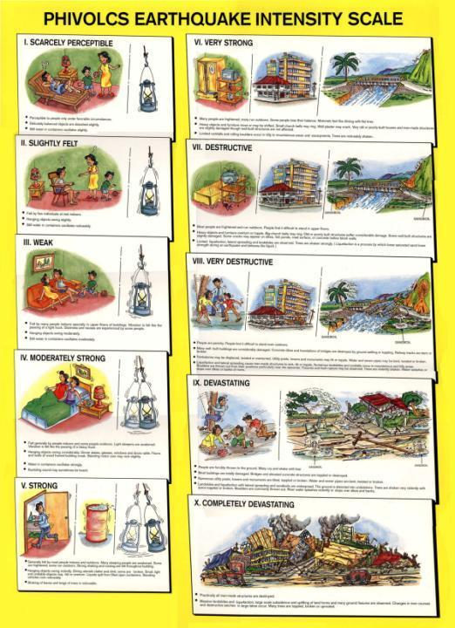
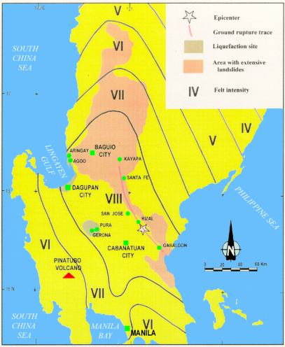
INTENSITY

Slide 11
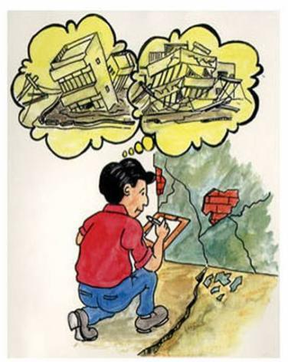
What to do BEFORE an earthquake
The key to effective disaster
prevention is planning.
Determine if site is along an active fault and/or prone to liquefaction or landslide.
Use proper structural design and engineering practice when constructing a house or building.
Evaluate structural soundness of buildings and important infrastructures; strengthen or retrofit if found necessary.

Slide 12
What to do BEFORE an earthquake
Familiarize yourself with your place of work, school and residence
Identify relatively strong parts of the
building where you can take refuge
during an earthquake:
door jambs
elevator shafts
sturdy tables
Learn to use fire extinguishers, first aid kits, alarms and emergency exits. These should be accessible/conveniently located and properly marked.

Slide 13
What to do BEFORE an earthquake
Prepare your place of work and
residence for the event
Strap heavy furniture to walls to prevent sliding or toppling.
Store breakable items, harmful Chemicals and flammable materials in lower most shelves and secure firmly.
Turn off gas tanks when not in use.
Keep heavy materials in lower shelves.
Check stability of hanging objects.
Maintain an earthquake survival kit.

Slide 14
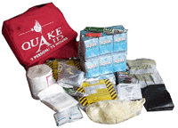
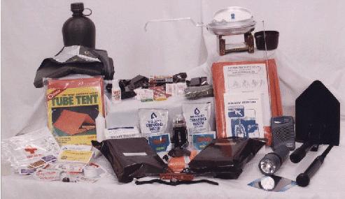
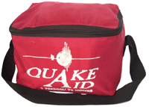
Earthquake Survival Kits

Slide 15
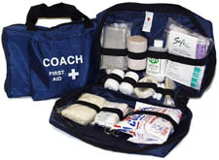
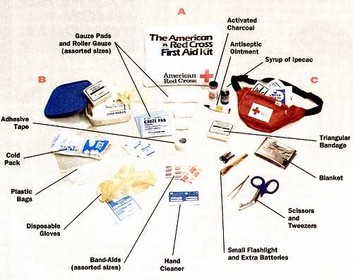
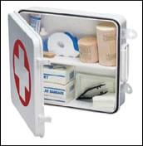
First-Aid Kits

Slide 16
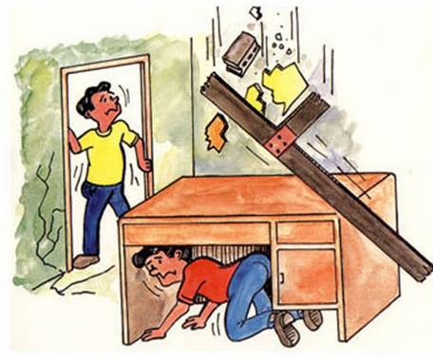
What to do DURING an earthquake
If inside a structurally sound building, stay there!
Protect your body from falling debris by bracing
yourself in a doorway or by getting under a sturdy desk or table.

Slide 17
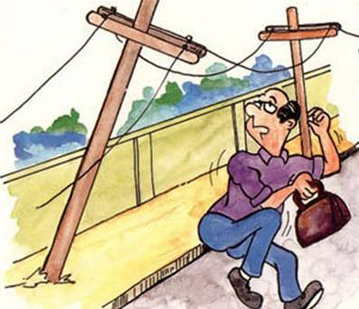
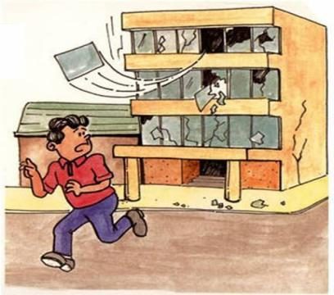
What to do DURING an earthquake
If outside, move to an open area
Get away from power lines,
posts, walls and other structures
that may fall or collapse.
Stay away from buildings with
glass panes.

Slide 18
What to do DURING an earthquake
If along the shore and you feel an earthquake,
strong enough to make standing difficult.
Run away from
the shore toward higher ground

Slide 19
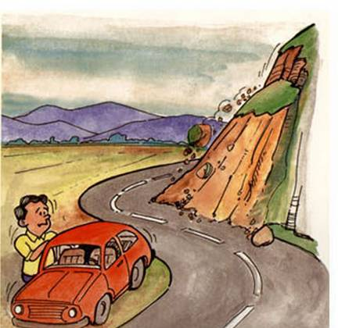
What to do DURING an earthquake
If on a mountain, or near a steep hill slope,
move away from steep escarpments which
may be affected by landslides

Slide 20
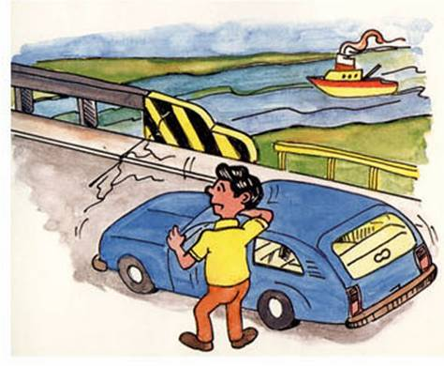
What to do DURING an earthquake
When driving a vehicle, pull to the side of the road and stop.
Do not attempt to cross bridges or overpasses which may have been damaged.

Slide 21
What to do AFTER an earthquake
If inside an old, weak structure, take the
Fastest and safest way out!
Get out calmly in an orderly manner. Do not rush to the exit.
Use the stairs. Do not use elevators.
Check yourself and others for injuries

Slide 22
What to do AFTER an earthquake
Check surroundings
Clean up chemical spills, toxic flammable materials to avoid any chain of unwanted events.
Check for fire and if any,
have it controlled.
Check water and electrical lines for defects. If any damage is suspected, turn the system off
in the main valve or switch.

Slide 23
What to do AFTER an earthquake
If you must evacuate your residence, leave a
message stating where you are going
Take with you your earthquake survival kit,
which should contain all necessary items
for your protection and comfort.

Slide 24
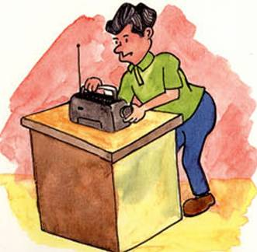
What to do AFTER an earthquake
Help reduce the number of casualties from the earthquake
Don’t enter partially damaged building, strong aftershocks may
cause these to collapse.
Gather information and disaster prevention instruction from battery-operated radios.
Obey public safety precautions.

Slide 25
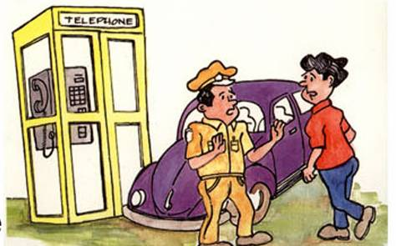
What to do AFTER an earthquake
Unless you need emergency help:
Do not use your telephone to call relatives and friends. Disaster prevention authorities may need the lines for emergency communications
Do not use your car and drive around areas of damage. Rescue and relief operations need the road for mobility.

Slide 26
Pre-earthquake Drill Procedures
Follow guidelines on what to do before an earthquake
Conduct a building watching exercise to identify safe and unsafe spots
Prepare evacuation routes
Prepare a master plan for earthquake crisis with definition of roles of different committees

Slide 27
Organization Chart
Overall Coordinator
Site Security
Head
Evacuation
Head
First Aid
Head
Fire Safety
Head
Communication
Head
Search &
Rescue Head
Ground
Maintenance
Head
Assistants
Marshalls

Slide 28
SPECIFIC TASKS:
Overall Coordinator – confirms emergency situation and coordinates with all crew heads.
Site Security Head – gives instructions to guards and make sure only authorized personnel are allowed to enter premises for the search/rescue/salvage operation.
a. Assistants – assume position of Site Security Head in case latter is not available.
b. Perimeter Guards – cordon and guard properties left behind.

Slide 29
Evacuation Head – takes charge of final head count.
a. Marshall – direct the flow of evacuation.
First Aid Head – provides first aid treatment and coordinates with the hospital.
Fire Safety Head – instructs crew members of the necessary response.
Communication Head – coordinated with the Overall Coordinator and crew heads in sending out the alarm.

Slide 30
Search & Rescue Head – takes charge of rescue and retrieval.
a. Search – searches for dead bodies
b. Rescue – rescues the injured
c. Salvage – retrieves property
Ground Maintenance Head – gives instructions to crew members.
a. Genset Power Operator – turns off power lines
b. Ground Clearing – clears the ground for debris

Slide 31
Fire Drill vs. Earthquake Drill
FIRE DRILL
EARTHQUAKE DRILL
Siren/Bell Alarm
( Fire )
Siren/Bell Alarm
( Earthquake )
Duck, Cover, and Hold
While the siren/bell is
ongoing
Evacuate the building
while the siren/bell is
ongoing
Evacuate after the
siren/bell

Slide 32
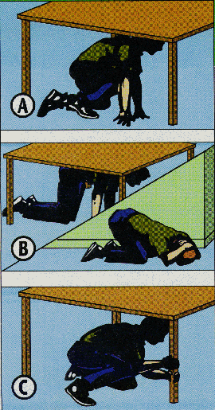
Earthquake Drill Procedure
1. ALARM PHASE:
Continuous ringing
of siren/bell for one minute simulates ongoing earthquake.
RESPONSE:
DUCK, COVER and HOLD

Slide 33
Earthquake Drill Procedure
2. EVACUATION PHASE
=> alarm/siren stops
RESPONSE:
drill participants should:
Be alert & don’t panic
Listen to the Marshal for instruction
Walk out of the room in an orderly manner & watch out for falling debris (Protect head)
DON’T RUN, DON’T PUSH
Don’t bring your things
Proceed to the designated evacuation area & wait for further instruction

Slide 34
Earthquake Drill Procedure
3. ASSEMBLY PHASE:
At the assembly area, groups from
each room/floor must stay together.
4. HEADCOUNT PHASE:
During this phase, every section head/leader / marshal must determine if everyone is present or accounted for.
absent = casualty

Slide 35
Earthquake Drill Procedure:
5. EVALUATION:
Must have evaluators to identify:
snags in the drill
problem areas or potential
problem areas to rectify these
problems for future earthquake
drills or in actual earthquake
scenario.

Slide 36
When is the time to evacuate?
After a very strong earthquake with
observed or felt Intensity of VI or
higher in the area.
As need arises or as declared by
authorities.

