Slide 1
SUBMIT
SDRRM TEAM
SDRRM PLAN
SDRRM TWINNING
to
sgod.ckr@gmail.com
Deadline : OCTOBER 15, 2015

Slide 2

SCHOOL
DRRM
TEAM

Slide 3
Why have SDRRM Team?
1. Provide a coordinated, effective response to emergency and disaster situations
2. Protect and preserve the health, safety and well-being of all members of the school community, namely, the faculty, support staff, volunteers and caretakers, and learners
3. Ensure that all school members know what to do in the event of an emergency or disaster
4. Ensure that prevention and preparedness systems are in place at the school level to minimize the damaging effects of disasters.

Slide 4
DRRM TEAM Template
SDRRMC | Thematic Areas | Roles and Responsibilities
PREVENTION AND MITIGATION
PREPAREDNESS
Pillar 1:
Safe Learning Facilities
Pillar 2:
School Disaster Management
Pillar 3
DRR in Education
RESPONSE
RECOVERY & REHABILITATION
The knowledge and capacities developed by governments, professional response and recovery organizations, communities and individuals to effectively anticipate, respond to, and recover from, the Impacts of likely, imminent or current hazard events or conditions. (R.A. 10121)
The limitation of the adverse impacts of hazards and related disasters. Mitigation measures encompass eng’g techniques & hazard-resistant construction as well as improved environmental policies and public awareness (R.A. 10121)
The provision of emergency services and public assistance during or immediately after a disaster in order to save lives, reduce health impacts, ensure public safety and meet the basic subsistence needs of the people affected. (R.A. 10121)
Measures that ensure the ability of affected communities/areas to restore their normal level of functioning by rebuilding livelihood and damaged infrastructures and increasing the communities' organizational capacity. (R.A. 10121)
Pillar 1:
  Safe school sites and resilient classroom designs and construction strategies
  Retrofitting and replacement of schools
  Incorporation of the welfare of people with disabilities in school design and construction
  Identification of temporary learning spaces (TLS)
- Develop quality teaching and learning materials for students and teachers.
- Mapping and review of DRRM learning
- Psychosocial training materials
- Updated Physical Facilities Manual and DRR - Resource Manual
- Provision of training for teachers on DRRM curriculum materials and methodologies.
-Engage schools in making early warning and early action systems meaningful and effective.
-School-based drills
-School waste management and vegetable gardens
-Orientation of school heads and school DRRM focal persons on protocols during emergencies or disasters
Pillar 2:
Creation of DRRM Office
Designation of regional, division and school DRRM focal persons
Institutionalization of Frontline Responders Team
- Establishment of a coordination and information management protocol
- Issuance of school safety and preparedness measures
- Conduct of school-based risk assessments and mapping
Prevention & Mitigation
Preparedness
RESPONSE
Recovery & Rehabilitation
Notes:
First is to organizing our drrm team in a very strategic way. This is now the direction of DepEd which is to be very strategic in every thing that we do. I already have templates to help us organize. All we have to do is to plot members from our school drrm committee and identify their specific roles that are existing and in line with the DRRM. Each member has different roles in every thematic area. These areas are preparedness (define), mitigation (define), preparedness (define), response (define) and recovery and rehabilitation (define). The roles of the members will then be categorized into pillars. These pillars are School facilities (pillar1), DRRM in School (pillar2) and DRR in School.
Engage schools in making early warning and early action systems meaningful and effective.
School-based drills
School waste management and vegetable gardens

Slide 5
DRRM TEAM Template
SDRRMC | Thematic Areas | Roles and Responsibilities
Pillar 1:
Safe Learning Facilities
Pillar 1:
Safe Learning Facilities
Pillar 2:
School Disaster Management
Pillar 3
DRR in Education
TLE
TEACHER
Prevention & Mitigation
ASSESS BUILDING
TLE
TEACHER
RECOMMEND REPAIRS
Preparedness
TLE
TEACHER
RESPONSE
ASSESS DAMAGES
TLE
TEACHER
Recovery & Rehabilitation
SUPERVISE REPAIRS
Notes:
First is to organizing our drrm team in a very strategic way. This is now the direction of DepEd which is to be very strategic in every thing that we do. I already have templates to help us organize. All we have to do is to plot members from our school drrm committee and identify their specific roles that are existing and in line with the DRRM. Each member has different roles in every thematic area. These areas are preparedness (define), mitigation (define), preparedness (define), response (define) and recovery and rehabilitation (define). The roles of the members will then be categorized into pillars. These pillars are School facilities (pillar1), DRRM in School (pillar2) and DRR in School.
Engage schools in making early warning and early action systems meaningful and effective.
School-based drills
School waste management and vegetable gardens

Slide 6
DRRM TEAM Template
SDRRMC | Thematic Areas | Roles and Responsibilities
Pillar 1:
Safe Learning Facilities
Pillar 2:
School Disaster Management
Pillar 2:
School Disaster Management
Pillar 3
DRR in Education
DRRM FOCAL
PERSON
Prevention & Mitigation
COORDINATE ALL DRRM
EFFORTS
DRRM FOCAL
PERSON
ORGANIZE
DRRM TEAM
DRRM PLAN
Preparedness
DRRM FOCAL
PERSON
RESPONSE
REPORT DISASTER IMPACTS
DRRM FOCAL
PERSON
Recovery & Rehabilitation
ASSESS POST
DISASTER
INTERVENTIONS
Notes:
First is to organizing our drrm team in a very strategic way. This is now the direction of DepEd which is to be very strategic in every thing that we do. I already have templates to help us organize. All we have to do is to plot members from our school drrm committee and identify their specific roles that are existing and in line with the DRRM. Each member has different roles in every thematic area. These areas are preparedness (define), mitigation (define), preparedness (define), response (define) and recovery and rehabilitation (define). The roles of the members will then be categorized into pillars. These pillars are School facilities (pillar1), DRRM in School (pillar2) and DRR in School.
Engage schools in making early warning and early action systems meaningful and effective.
School-based drills
School waste management and vegetable gardens

Slide 7
DRRM TEAM Template
SDRRMC | Thematic Areas | Roles and Responsibilities
Pillar 1:
Safe Learning Facilities
Pillar 2:
School Disaster Management
Pillar 3
DRRM in Education
Pillar 3
DRR in Education
SCIENCE TEACHER
Prevention & Mitigation
CRAFT ADVOCACY MATERIALS
SCIENCE TEACHER
OVERSEES DRRM LESSONS
Preparedness
SCIENCE TEACHER
RESPONSE
MONITORS
TEMPORARY LEARNING FACIILIIES
SCIENCE TEACHER
Recovery & Rehabilitation
REHABILITATE LEARING FACILITIES
Notes:
First is to organizing our drrm team in a very strategic way. This is now the direction of DepEd which is to be very strategic in every thing that we do. I already have templates to help us organize. All we have to do is to plot members from our school drrm committee and identify their specific roles that are existing and in line with the DRRM. Each member has different roles in every thematic area. These areas are preparedness (define), mitigation (define), preparedness (define), response (define) and recovery and rehabilitation (define). The roles of the members will then be categorized into pillars. These pillars are School facilities (pillar1), DRRM in School (pillar2) and DRR in School.
Engage schools in making early warning and early action systems meaningful and effective.
School-based drills
School waste management and vegetable gardens

Slide 8
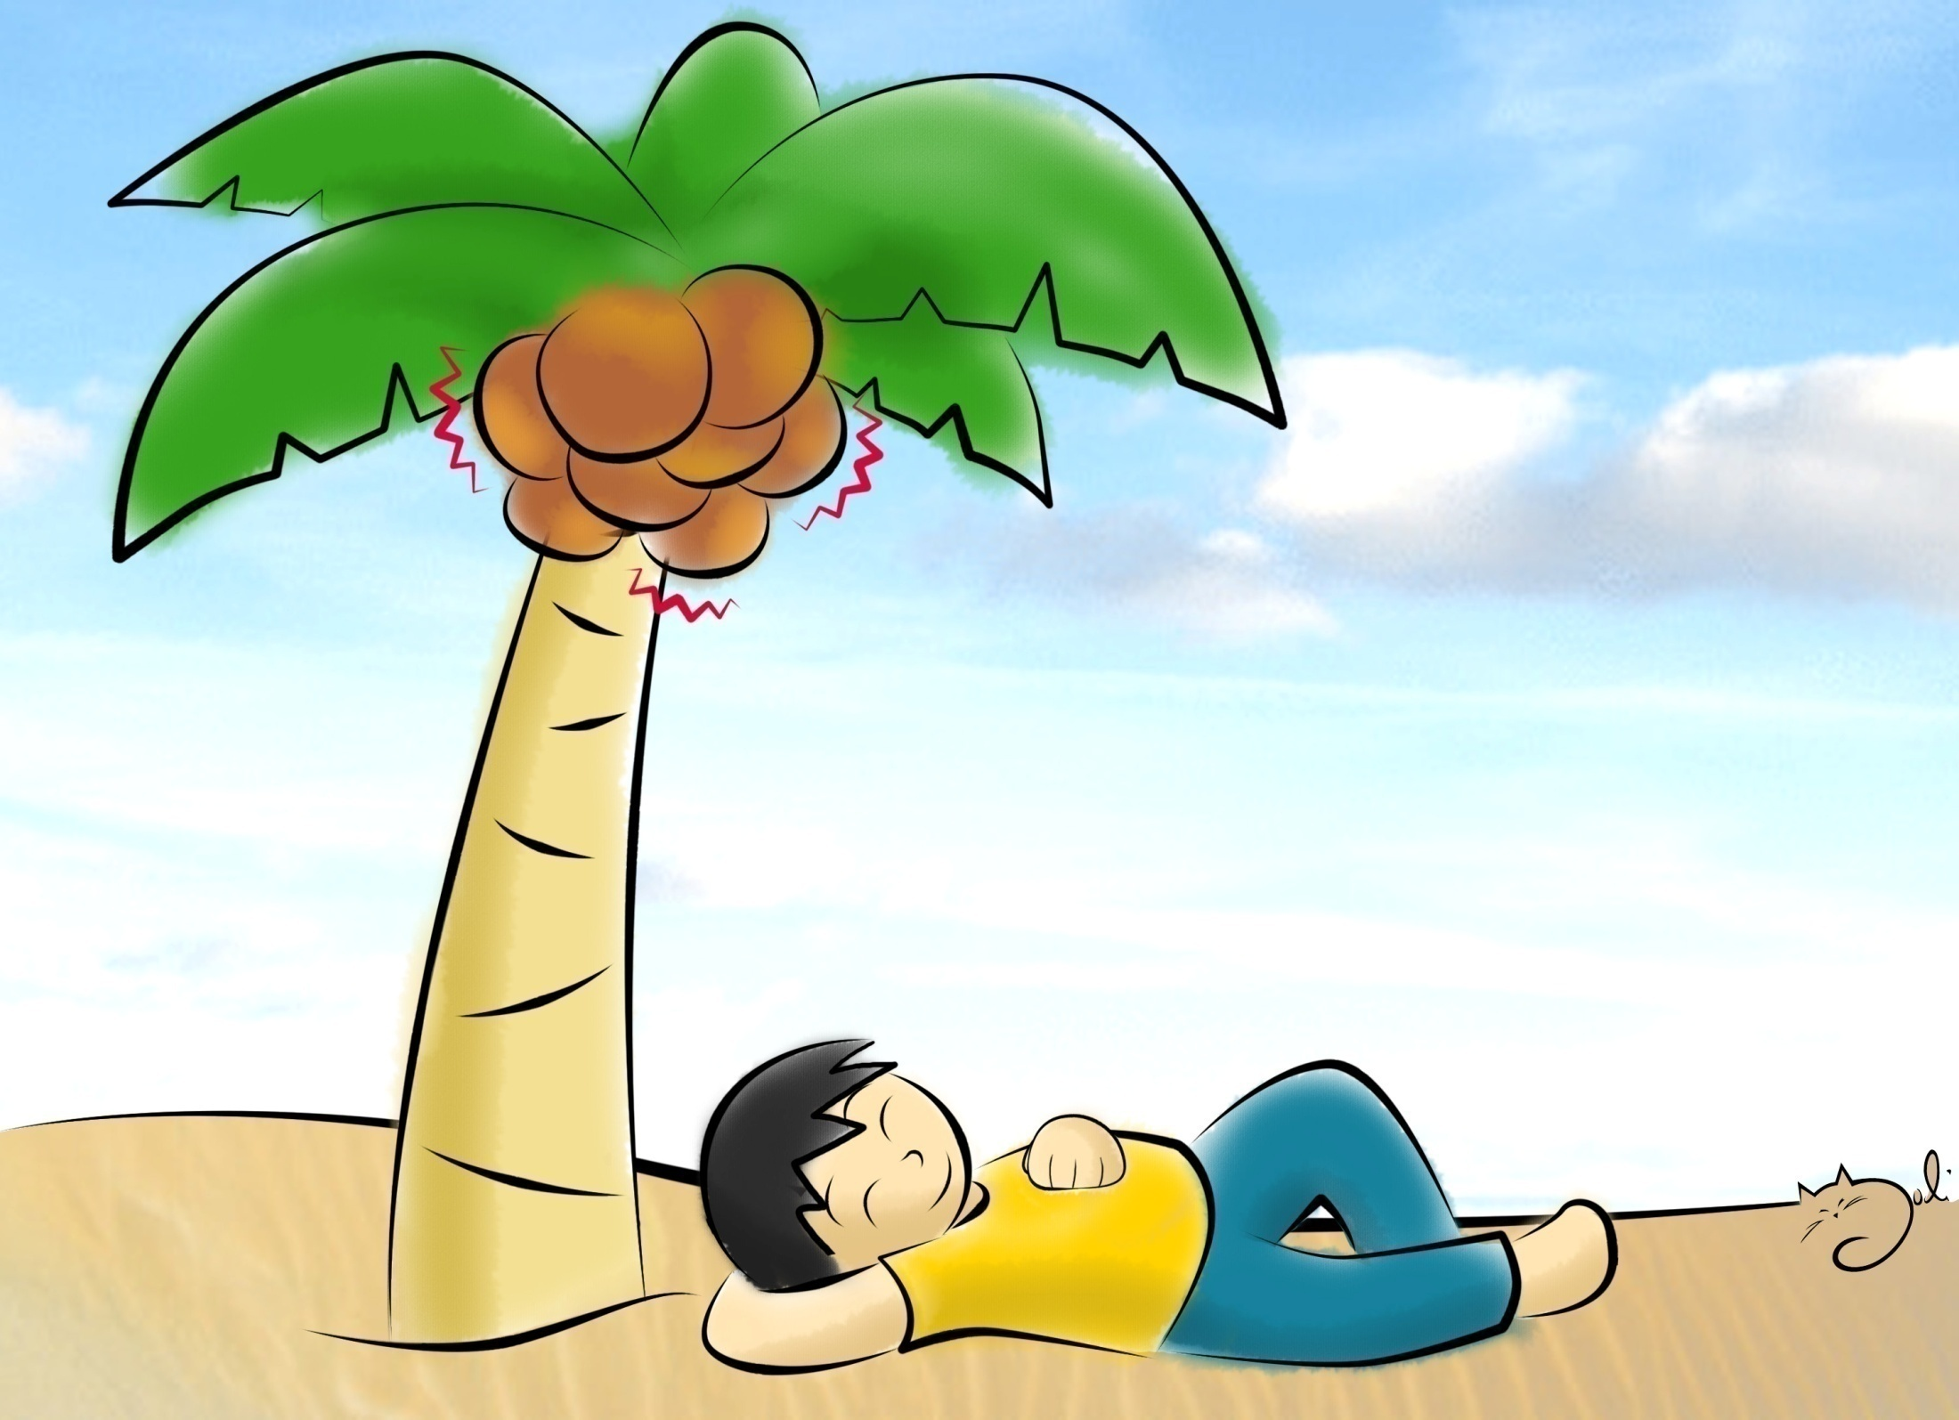
HAZARD

Slide 9

PREVENTION
Notes:
Measures to provide permanent protection from disasters
Reduce the intensity & frequency of a hazard event
Disaster Prevention" - the outright avoidance of
adverse impacts of hazards and related disasters. It expresses
the concept and intention to completely avoid potential adverse
impacts through action taken in advance such as construction
of dams or embankments that eliminate flood risks, land-use
regulations that do not permit any settlement in high-risk
zones, and seismic engineering designs tHat ensure the survival
and function of a critical building in any likely earthquake

Slide 10
Disaster Prevention
the outright avoidance of adverse impacts of hazards and related disasters.
Notes:
It expresses the concept and intention to completely avoid potential adverse impacts through action taken in advance such as:
Construction of dams or embankments that eliminate flood risks, land-use regulations that do not permit any settlement in high-risk zones, and seismic engineering designs that ensure the survival and function of a critical building in any likely earthquake

Slide 11
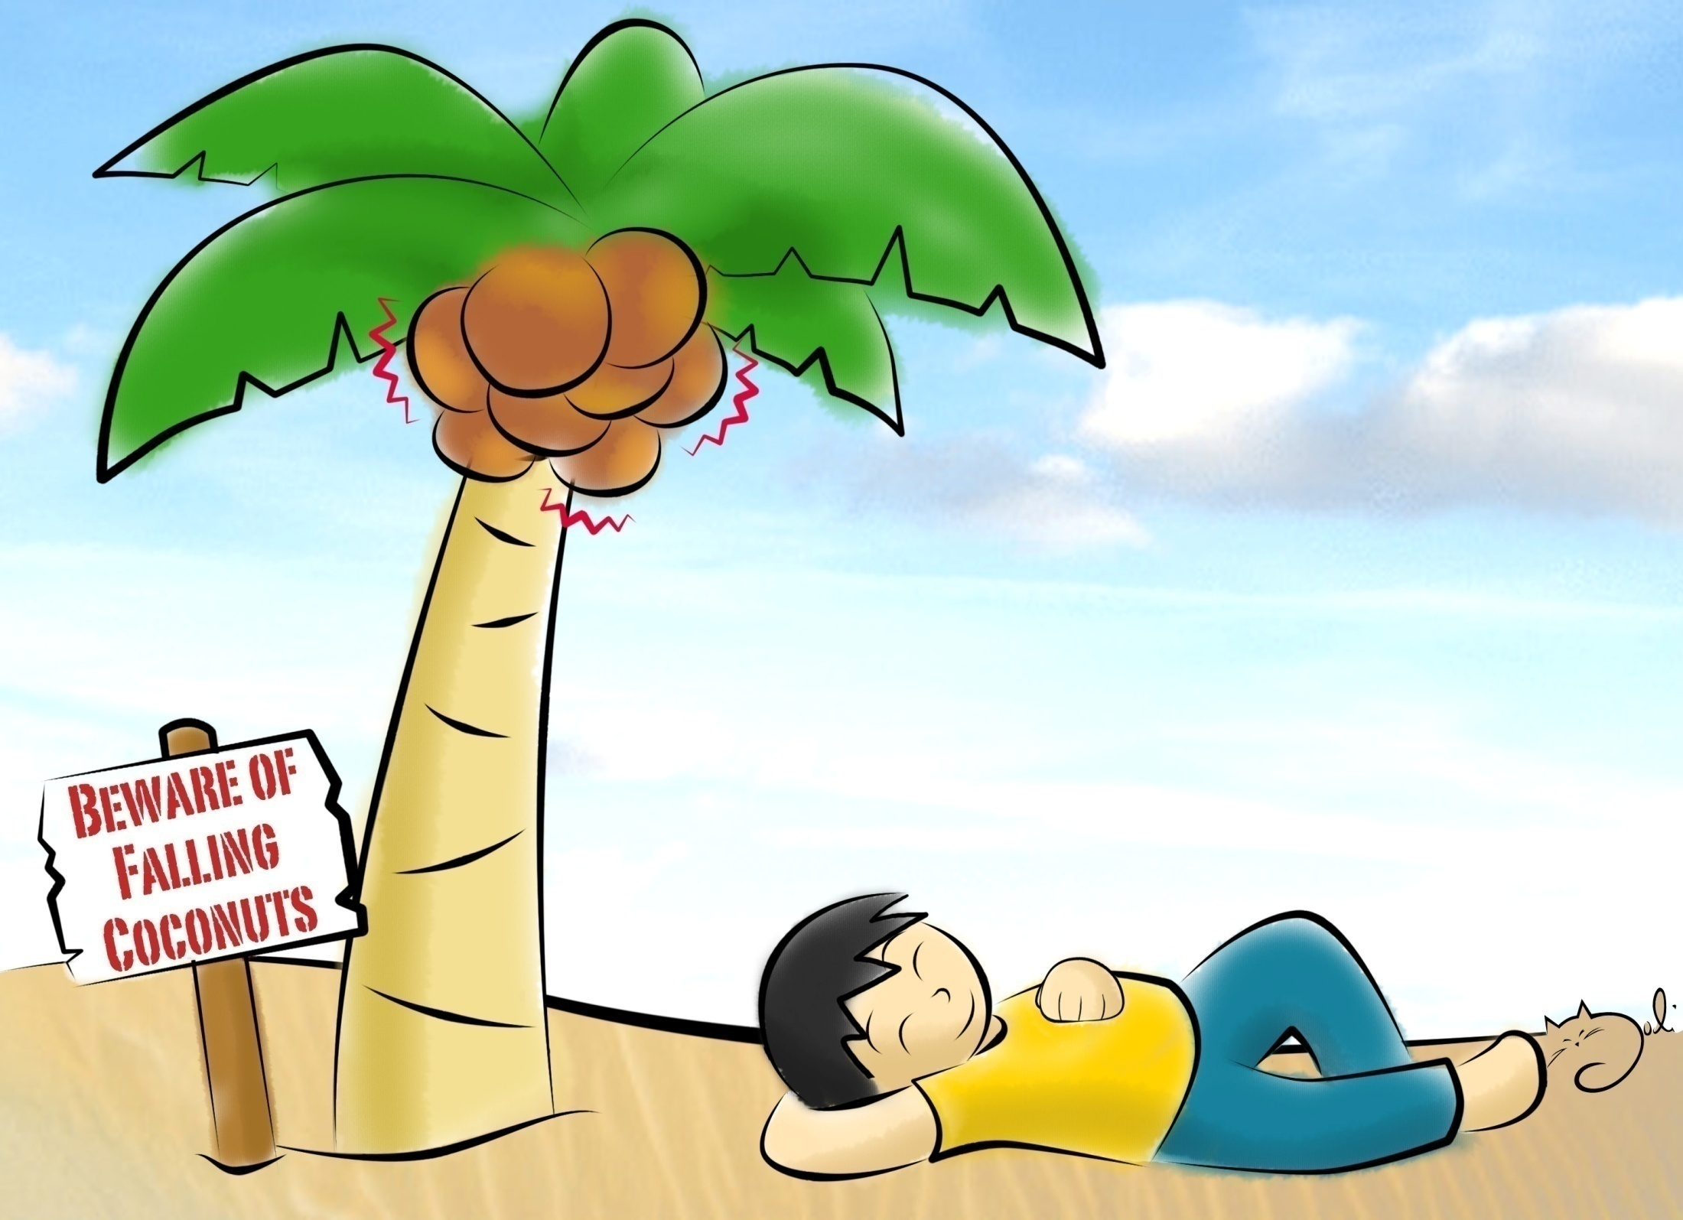
MITIGATION

Slide 12
Disaster Mitigation
- the lessening or limitation of the adverse impacts of hazards and related disasters.
Notes:
Mitigation measures encompass engineering techniques and hazard-resistant construction as well as improved environmental policies and public awareness.

Slide 13
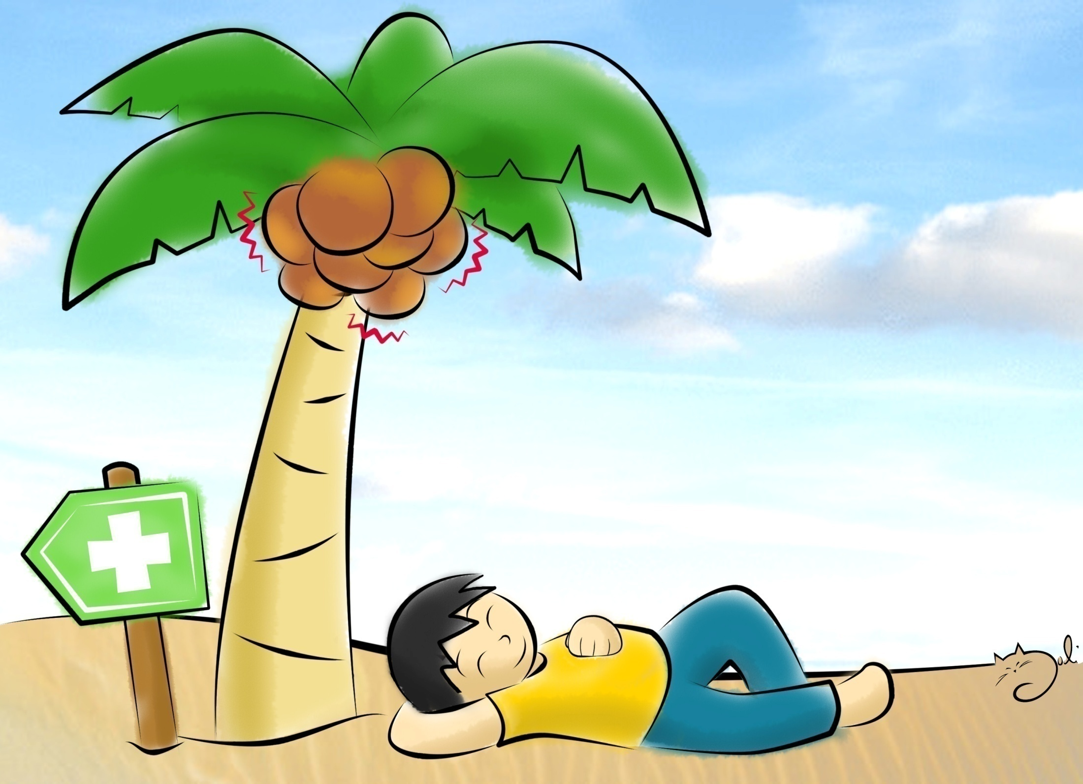
PREPAREDNESS
Notes:
Disaster Preparedness" - the knowledge and capacities developed by governments, professional response and recovery
organizations, communities and individuals to effectively anticipate, respond to, and recover from, the Impacts of likely,
imminent or current hazard events or conditions.
Preparedness action is carried out within the context of disaster risk reduction and management and aims to build the capacities
needed to efficiently manage all types of emergencies and achieve orderly transitions from response to sustained recovery.
Preparedness is based on a sound analysis of disaster risk and good linkages with early warning systems, and includes such
activities as contingency planning, stockpiling of equipment and supplies, the development of arrangements for coordination,
evacuation and public information, and associated training and field exercises. These must be supported by formal
institutional, legal and budgetary capacities.

Slide 14
Disaster Preparedness
- the knowledge and capacities to effectively anticipate, respond to, and recover from, the impacts of likely, imminent or current hazard events or conditions.

Slide 15
EXAMPLE
of
DRRM TEAM

Slide 19
COORDINATION
PROTOCOL

Slide 20
How and why we do DRRM?
NDRRMC
DepEd
DRRMO
Regional DRRM Focal
Local DRRMC
Division DRRM Focal
Schools
Notes:
This organizational structure provides an overview of our
coordination and reporting mechanism not only within DepEd
but also with other partner agencies.
The DepEd EXECOM as member of the NDRRMC and lead of
the Education Cluster provides STRATEGIC directions for the
DRRM in Education system
Through the DRRMO and DRRM focal persons the strategic directions are being translated into operational directions.
Since we have organized our DRRM Team, we now ready for coordination protocol
This organizational structure provides an overview of our coordination and reporting mechanism not only within DepEd but also with other partner agencies. DepEd is a member of the NDRRMC and lead of the Education Cluster provides STRATEGIC directions for the DRRM in Education system
Through the DRRMO and DRRM focal persons the strategic directions are being translated into operational directions.

Slide 21
IMPORTANT REMINDERS
#SchoolPatrolPH will be launched to engage the general public in the collection of pictures of damaged schools through social media such as Twitter and Facebook.

Slide 22
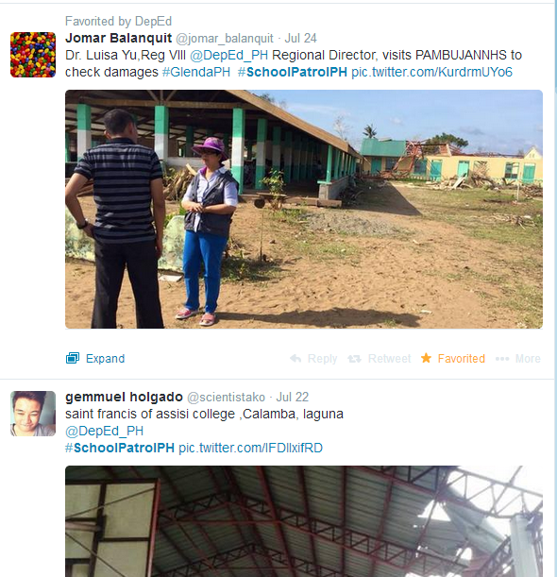
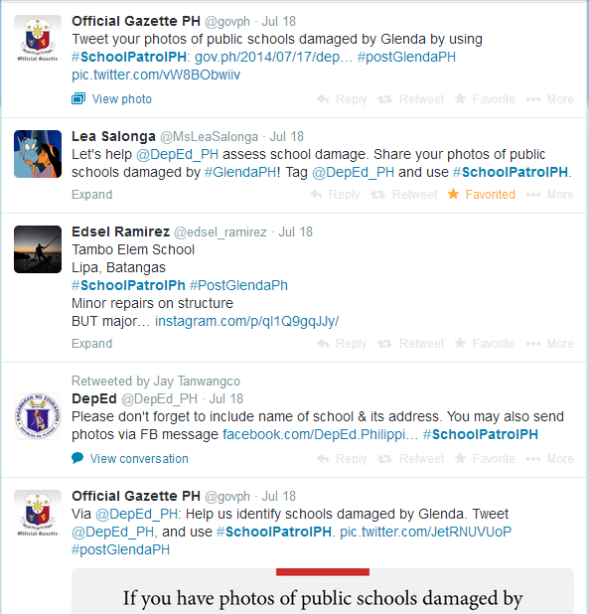
How can we communicate?

Slide 23
RADAR (Rapid Disaster Assessment Report) 1

Slide 24
RADAR (Rapid Disaster Assessment Report) 1
Division ___________________________
# | QUESTIONS | ANSWERS
1 | Name of incident (Can be name of tropical cyclone, name of volcano or description of incident)
2 | EBEIS SCHOOL ID
3 | Incurred damages because of incident (Indicate Yes/No only)
4 | Number of academic classrooms that are totally damaged classrooms (damaged academic classrooms that cannot be used)
5 | Number of academic classrooms with major damage (damaged academic classrooms needing major repair and cannot be repaired by school)
6 | Number of academic classrooms with minor damage (damaged academic classrooms needing minor repair that can all be repaired by school)
7 | Number of temporary learning spaces (TLS) needed for immediate class resumption
8 | Number of deceased DepEd teaching and non-teaching personnel
9 | Number of injured DepEd teaching and non-teaching personnel
10 | Number of missing DepEd teaching and non-teaching personnel
11 | Number of displaced DepEd teaching and non-teaching personnel
12 | Number of academic classrooms used for evacuation of families (all academic classrooms used since Day 1)
13 | Are there still evacuees after three days? (Indicate Yes/No only)
RADAR1,Luis,102121,No,0,0,0,0,0,0,0,0,0,No,Orville Benigno,HT

Slide 25
RADAR (Rapid Disaster Assessment Report) 2

Slide 26
RADAR (Rapid Disaster Assessment Report) 2
Division ___________________________
# | QUESTIONS | ANSWERS
1 | Name of incident (Can be name of tropical cyclone, name of volcano, or description of incident)
2 | EBEIS SCHOOL ID
3 | Number of damaged school furniture (armchairs) that needs to be replaced for use of learners (Additional information on damaged teachers’ tables and chairs, tables, and chairs for Kinder, and/or desktops shall be consolidated by respective divisions. Divisions shall endorse the detailed assessment to respective DepEd offices for proper intervention.)
4 | Number of copies of learning materials/textbooks used for instruction that were damaged because of incident (Detailed information on number of copies needed for instruction per grade level and subject area shall be consolidated by respective divisions. Divisions shall endorse the detailed assessment to respective DepEd offices for proper intervention.)
5 | Number of sets of computer equipment used for instruction that were heavily damaged because of incident (Detailed information on type of equipment damaged shall be consolidated by respective divisions. Divisions shall endorse the detailed assessment to respective DepEd offices for proper intervention.)
RADAR2,Luis,102121,0,0,0,Orville Benigno,HT

Slide 27
Consolidated RADaR 1, July-December 2014
 | Region |  | Total Number of Schools | Glenda | Luis | Mario | Ruby | Seniang
 | CARAGA |  | 2,039 | - | - | - | - | 37
 | Region X |  | 2,446 | - | - | - | - | 1
 | Region XI |  | 1,934 | - | - | - | - | -
 | Total |  | 6,419 | - | - | - | - | 38
Notes:
reformat

Slide 28
Consolidated RADaR 2, July-December 2014
 | Region |  | Total Number of Schools | Total Number of Affected Schools | Damaged school furniture | Damaged textbooks | Damaged desktop computers
 | CARAGA |  | 2,039 | 2,039 | 2,130 | 32,635 | 201
 | Region X |  | 2,446 | 2,446 | 101 | 1,187 | 17
 | Region XI |  | 1,934 | 1,107 | - | - | -
 | Total |  | 6,419 | 5,592 | 2,231 | 33,822 | 218

Slide 29
IMPORTANT REMINDERS
All Divisions should instruct their schools to submit the RADaRs 1 and 2 through SMS via these numbers 0908-263-0382 and 0915-515-3138.
All RADaR should be submitted within 72 hours after any hazard or emergency.
Divisions whose schools have not incurred damages and were not used as ECs are required to submit a certification of no damages and no schools were used as Ecs.

Slide 30
SCHOOL
TWINNING

Slide 31
Twinning, means consisting of or being two separate but similar or closely related things; being a counterpart
(Collins American English Dictionary)

Slide 32
Benefits of twinning
Capacity building or strengthening
Cultural exposure
Opportunities to identify and share best practices- ideas, approaches, techniques, or methods
Relationship building and networking

Slide 33
Guide in identifying twin offices
Twin offices may be identified based on:
Location or topographic characteristics
Hazards
Language
Travel distances
Notes:
Location (Intra/inter-region, intra/inter-island, etc.)
Hazards (areas with same hazard experiences may be more able to assist each other effectively)
Language (consider if this will pose a barrier)
Travel distances

Slide 34
Twinning in the Philippines
Hospitals twinning during TY Yolanda to augment personnel, facilities, and equipment
Twinning of provinces or LGUs as prevention and preparation measure for TY Ruby
Notes:
In the context of DRRM, twinning has also been used. Examples are the hospital twinning during TY Yolanda in 2013 and LGUs twinning in anticipation of TY Ruby in 2014.

Slide 35
How DepEd could employ twinning system
Prevention and Mitigation and Preparedness
Information and capacity sharing
Response
Personnel deployment
Other assistance
Recovery and Rehabilitation
Assistance in assessments (damages, needs, etc.)
Psychosocial support
Materials sharing
Strategic prepositioning
Office/school adoption
Notes:
Prevention and Mitigation and Preparedness
Information and capacity sharing
Materials sharing
Strategic prepositioning
Response
Personnel deployment
Other assistance
Recovery and Rehabilitation
Assistance in assessments (damages, needs, etc.)
Psychosocial support
Office/school adoption
ple areas for partnership include…

Slide 36
Twinning Template
SCHOOL: ______________________
POTENTIAL TWIN OFFICES | CONSIDERATIONS TAKEN IN SELECTION | Thematic Area | Possible Assistance |  |  | Office/ Officer/s in charge
 |  |  | Pillar 1 | Pillar 2 | Pillar 3
 |  | Prevention & Mitigation
 |  | Preparedness
 |  | Response
 |  | Recovery & Rehabilitation

Slide 37
EXAMPLE of SCHOOL TWINNING

Slide 38
Twinning Template
REGION/ DIVISION: MISAMIS ORIENTAL
POTENTIAL TWIN OFFICES | CONSIDERATIONS TAKEN IN SELECTION | Thematic Area | Possible Assistance |  |  | Office/ Officer/s in charge
 |  |  | Pillar 1 Facilities | Pillar 2 SDRRM | Pillar 3 DRR in Educ
LOCAL DRRM BFP PNP OCD Red Cross DSWD | Geographical consideration/Adjacent Office | Prevention & Mitigation | Annual inspection of electrical system | 5 yrs schl.-level data collection | National greening program | BFP School Head SDRRM Focal Person SDRRMC
 |  | Preparedness | PWD friendly/ Safe site selection | Integration of DRR in SIP/ Class suspension protocol | Training for teaching and non-teaching staff on fire and earthquake drill | School Head SDRRM Focal Person SDRRMC LDRRM BFP
 |  | Response | Capacitating FRT through training | RaDAr Protocol Class resumption | Psychosocial support | School Head SDRRM Focal Person SDRRMC DSWD/BFP/LDRRM
 |  | Recovery & Rehabilitation | Improved designs & Standards | Validation of reports, damages or casualties | Livelihood programs | School Head SDRRM Focal Person SDRRMC DSWD LGU

Slide 39
SCHOOL
DRRM
PLAN

Slide 40
School DRRM Plan
Activity | Target number of participants | Indicative schedule | Person/office(s) involved | Fund source
Student-led school watching and hazard mapping
Orientation on school DRRM Manual
Multihazard drills
National Greening Program
Preparation and posting of hazard-appropriate evacuation plans
Inclusion of DRRM in school improvement plans
Updating and posting of emergency hotline numbers
DRRM Orientation

Slide 41
EXAMPLE of SCHOOL PLAN

Slide 43
automatic Cancellation/Suspension of Classes

Slide 44
Automatic Cancellation/Suspension of Classes
All concerned DepEd officials and personnel are directed to observe the weather bulletins of the Philippine Atmospheric Geophysical and Astronomical Services Administration (PAGASA) announced through various media outlets (radio, television, and internet).
When Signal No. 1 is raised by PAGASA, public and private preschool and kindergarten classes in the affected areas shall be automatically cancelled or suspended.
When Signal No. 2 is raised by PAGASA, public and private preschool, kindergarten, elementary and secondary classes in the affected areas shall be automatically cancelled or suspended.
When Signal No. 3 is raised by PAGASA, work in all DepEd offices in the affected areas shall be automatically cancelled or suspended.

Slide 45
Automatic Cancellation/Suspension of Classes
Depending on signal numbers declared at 10:00 p.m. and 4:30 a.m. of the following day, classes in appropriate levels for the whole day are deemed automatically cancelled/suspended.
Afternoon classes in the appropriate levels in areas with signal numbers declared at 11:00 a.m. that day are likewise automatically cancelled/suspended.
Teaching personnel handling cancelled or suspended classes are likewise allowed to leave their stations in consideration of the work they will need to undertake during make-up classes.
Heads of private schools shall exercise discretion on their teaching personnel handling cancelled or suspended classes.

Slide 46
Localized Cancellation/Suspension of Classes and Work
In the absence of typhoon signal warnings from PAGASA, localized cancellation/suspension of classes in both public and private schools and work in government offices may be implemented by local chief executives in their capacity as chairpersons of the Local Disaster Risk Reduction and Management (LDRRMC).
Concerned local DepEd and private school officials are directed to establish effective lines of communications with their respective local government units (LGUs).
Any decision to cancel or suspend classes must come from the local government. A school head (SH) may only cancel or suspend classes in cases where urgent action is needed to prevent loss of life or bodily harm.
As stated in Section 2 of EO No. 66, LGU officials are expected to announce cancellation or suspension not later than 4:30 a.m. for whole day cancellation or suspension, or not later than 11:00 a.m. for afternoon cancellation or suspension.

Slide 47
Responsibility of Parents
The DepEd still maintains that parents have the ultimate responsibility for determining whether their children should go to school, even if no order for cancellation/suspension of classes has been issued, if they feel that traveling to or from school will place their children at risks.
Parents are advised to check for media advisories coming from PAGASA, NDRRMC, RDRRMCs, LDRRMCs or the Office of the President itself.
Parents and teachers are reminded that the required number of school days for the school year shall be considered especially in holding make-up classes to offset the days when classes are cancelled/suspended. These make-up classes shall be held on Saturdays or on weekdays beyond the originally set school calendar in both public and
private schools.
School officials, members of the DRRMCs in schools designated as evacuation centers are requested to render service even when classes are suspended. They shall coordinate with the local government official on rules, orders, and guidelines prescribed for evacuation/centers.

Slide 48
THANK YOU!

Slide 49
The Comprehensive DRRM in Basic Education Framework

Slide 50
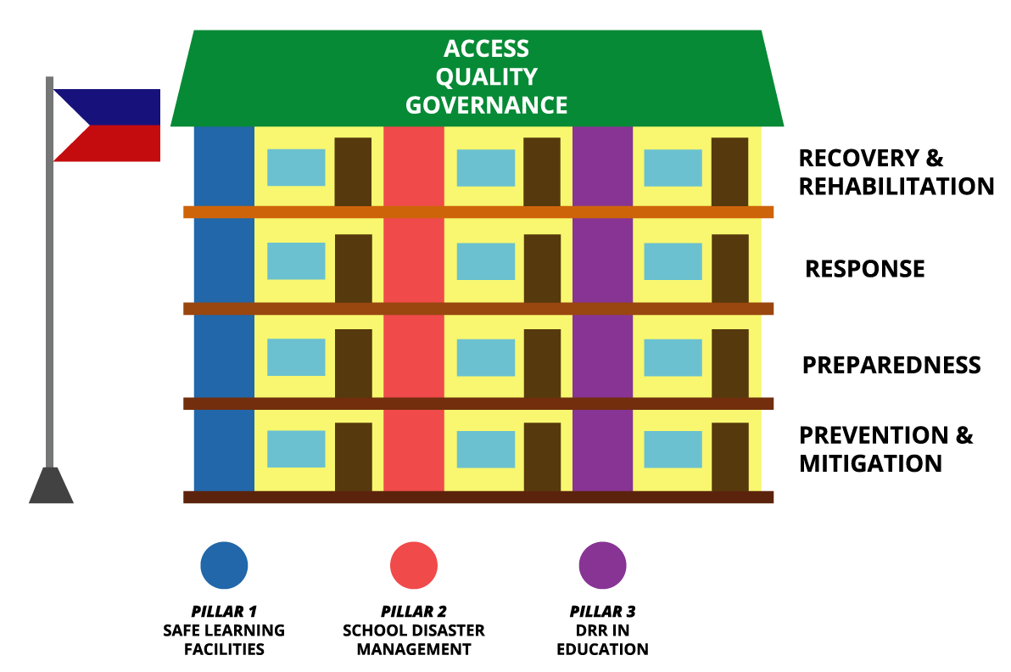

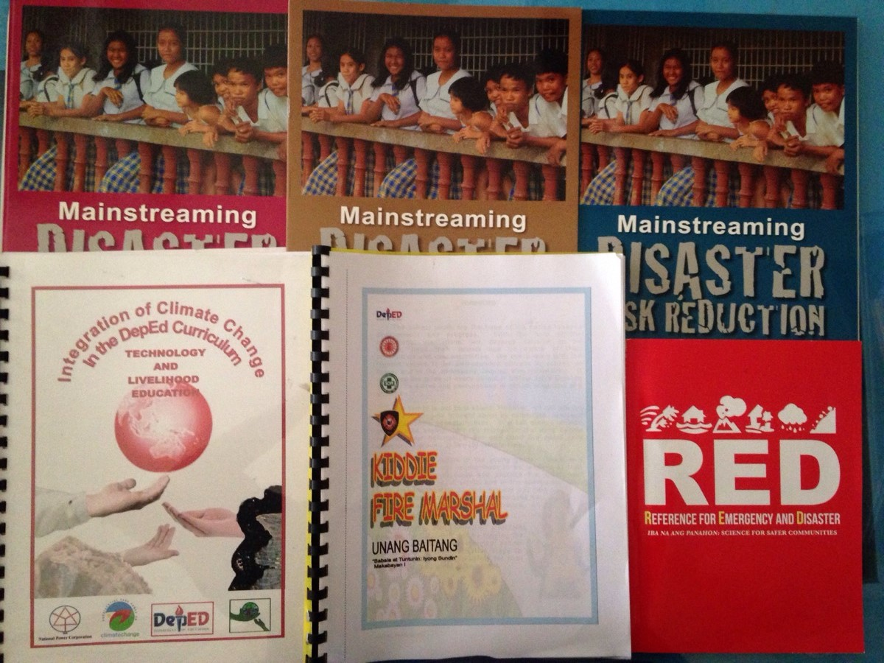
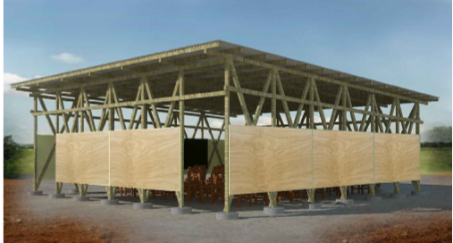
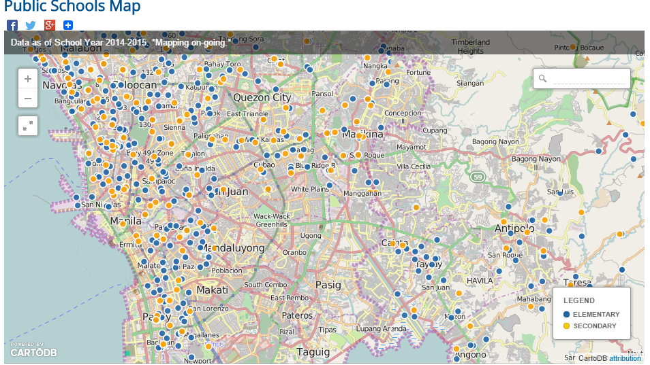
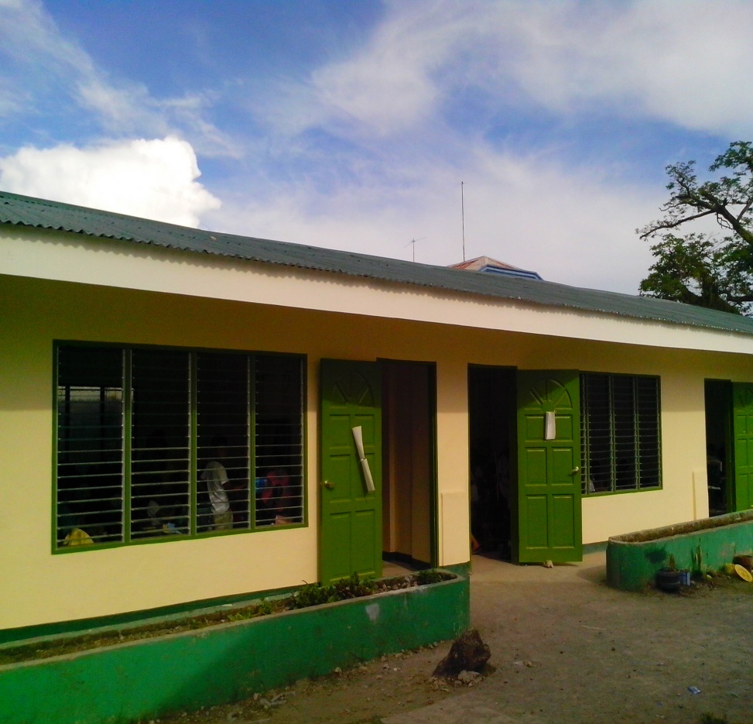
The Comprehensive DRRM in Basic Education Framework
Strengthened construction monitoring process by engaging school heads
Policy on student-led school watching and hazard mapping (DM 179)
PREVENTION & MITIGATION
Policy on Family Earthquake Preparedness Homework
Continued implementation of 3-pronged school-based National Greening Program
    Tree planting/Reforestation
    Vegetable garden in schools
    Solid Waste Management
88% of schools were already mapped for geospatial analysis
PREPAREDNESS
Designed temporary learning spaces as alternative to tents
Established DRRM office with coordinators in 17 regions and 221 division offices
National budget support for improving the organizational preparedness and response
Uploading of DRRM reference materials in the learning portal beginning 2015 (46 titles)
RESPONSE
Adopted disaster resilient designs for classroom construction
Integration of DRRM/CCA in the new K to 12 curriculum
RECOVERY & REHABILITATION
Notes:
The DRRM implementation in DepEd is expressed in 3 pillars, namely :
Pillar 1: Safe Learning Facilities
Pillar 2: School Disaster Management
Pillar 3: DRR in Education
This strategy seeks to ensure that the implementation of the four thematic areas are clearly aligned to the core operations of the schools and learner interests are prioritised.
We outline DepEd’s role in building safer and resilient communities by adopting the thee pillars of the Comprehensive Safe Schools Framework and ensuring that these help attain our educational outcomes as well. These will serve as a guide to our DRRM interventions defined both at national and local levels.
Essentially, we want to:
Protect learners and education workers from death, injury, and harm in schools
Plan for educational continuity in the face of all expected hazards and threats
Safeguard education sector investments
Strengthen risk reduction and resilience through education
This is an adaptation of the COMPREHENSIVE SCHOOL SAFETY FRAMEWORK (3 Pillars)
The DRRM in Basic Education Framework is a combination of the following:
AQG Education Outcomes
Four phases of DRR as mandated by RA 10121
Three Pillars of Comprehensive School Safety

Slide 51
COMPREHENSIVE SCHOOL SAFETY FRAMEWORK
QUALITY
ACCESS &
GOVERNANCE
SCHOOL DISASTER MANAGEMENT
DRR IN EDUCATION
SAFE LEARNING
FACILITES
PREVENTION &
MITIGATION
PREPAREDNESS
RESPONSE
RECOVERY &
REHABILITATION
Notes:
The CSS Framework is aligned to the DepEd’s strategic directions: Quality, Access and Governance and the NDRRM Framework.
The pillars of the CSS are interacting as the interventions within each pillar are complimentary. For instance, structural gaps can be mitigated through SDM or DRR in Education strategy.

