Slide 1
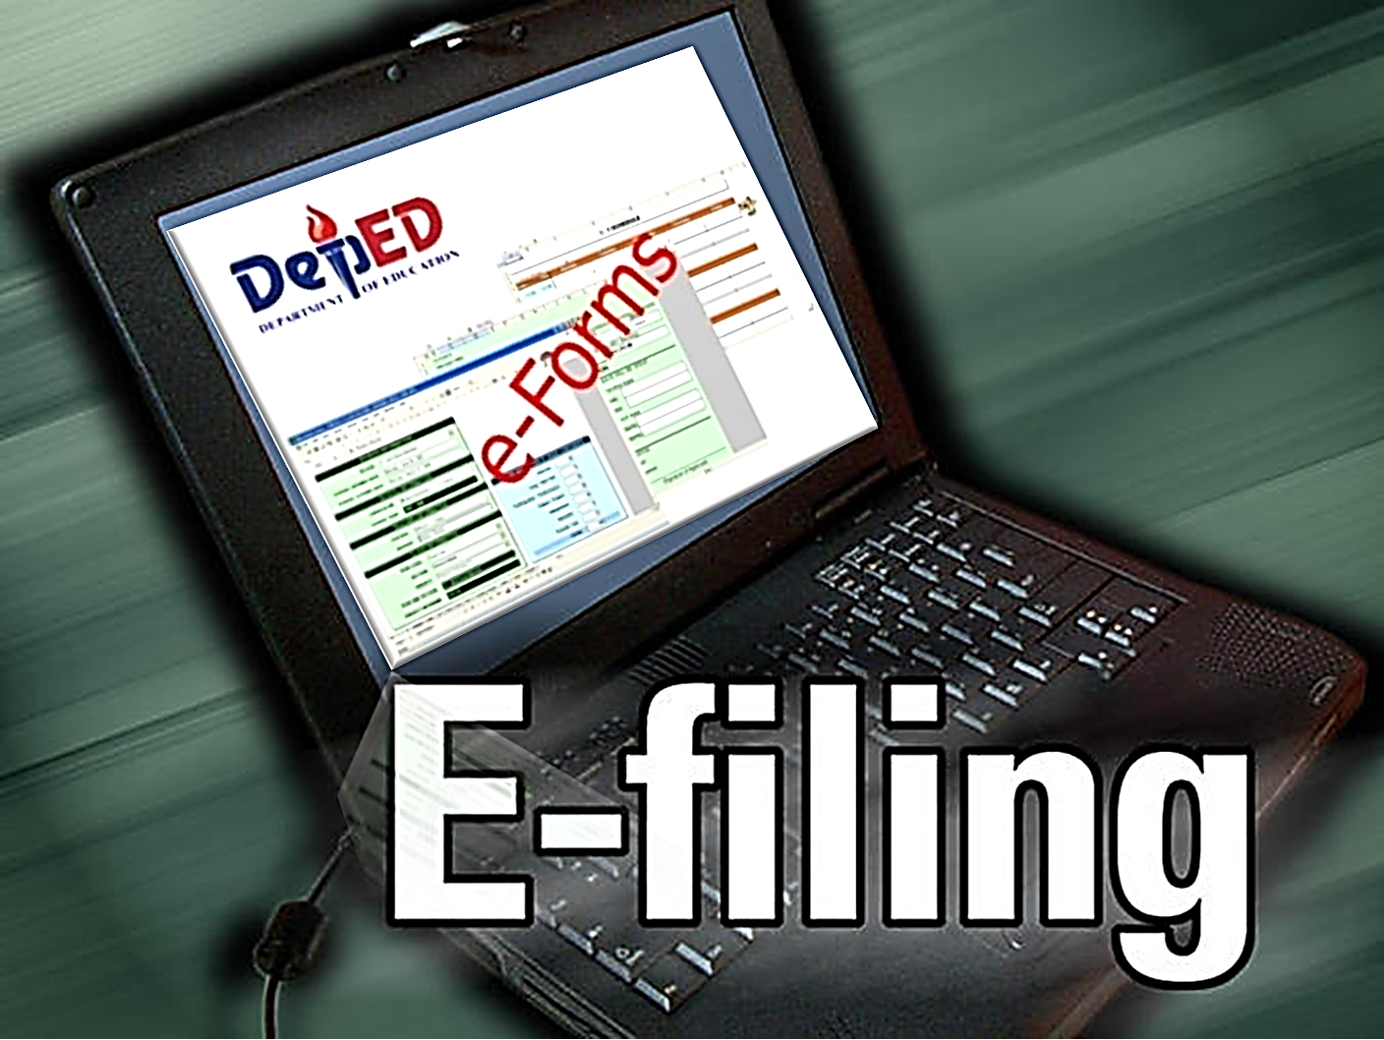
By: Gerry P. Madrid
Education Program specialist II – School Monitoring and Evaluation

Slide 2
ABSTRACT:
Most government agencies today use an electronic file and record keeping system - making it easier to capture and retrieve information, generate data, check learner’s profile and even providing documents as required. Setting up an electronic record keeping system earns a remarkable advantage over manual style, thus, making it efficient
and requires less storage space.

Slide 3
ADVANTAGES:
While there are still institutions prefer manual record keeping, the use of e-files has its edge.
Easy access. Electronic documents can be retrieved immediately, shared and routed to any authorized employee who needs it.
Cost Savings. Switching to electronic documents can be a tremendous cost saving opportunity.
Security. Electronic files never go missing nor do they easily fall elsewhere. They can be protected with access controls using passwords and authentication system.

Slide 4
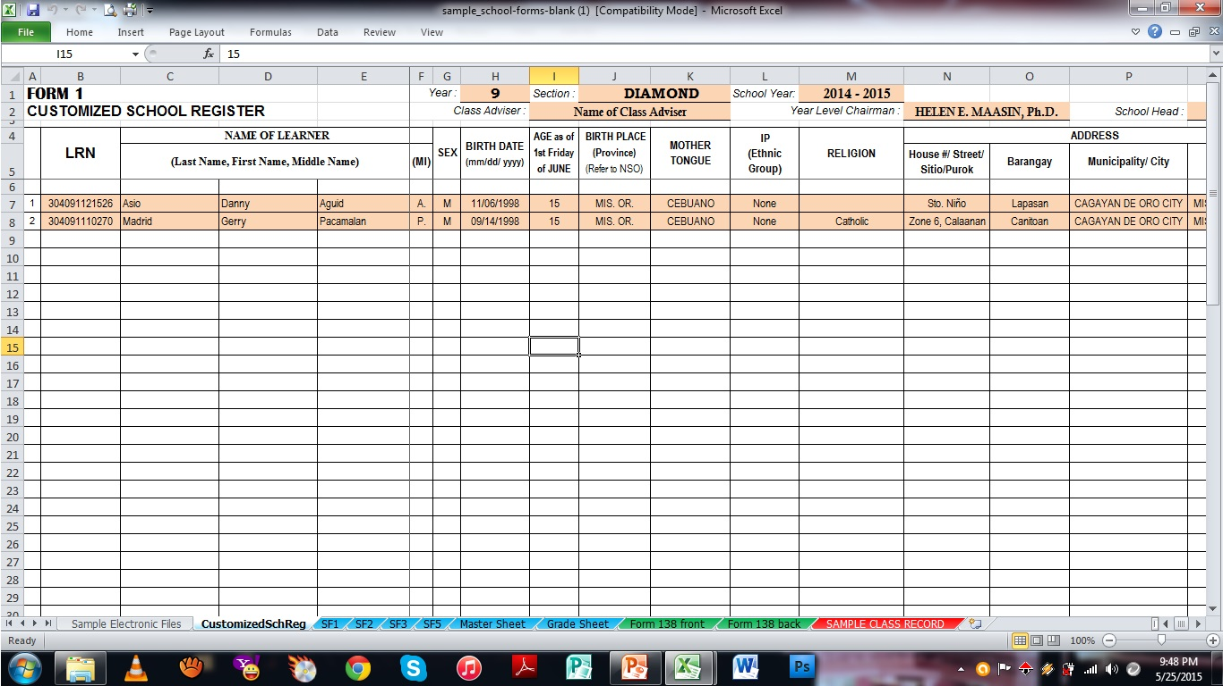
KEY FEATURES:
Customized School Register

Slide 5
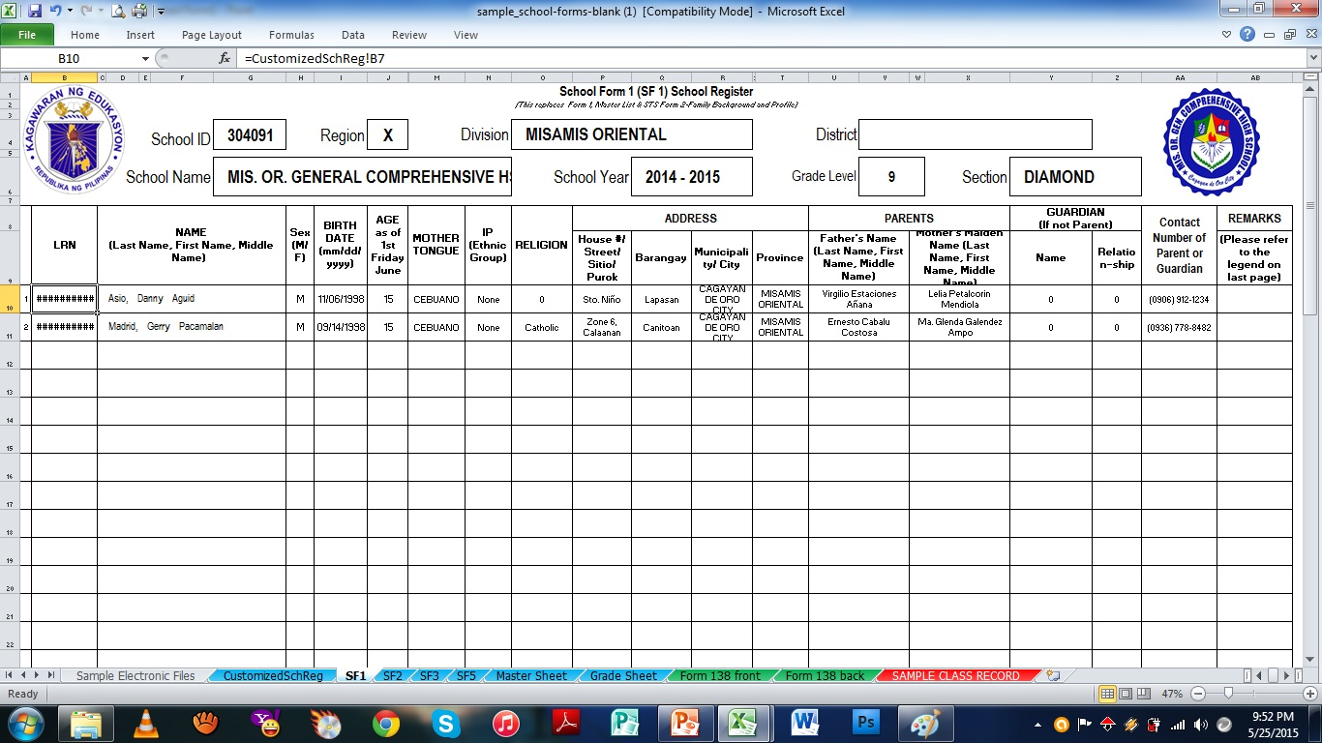
KEY FEATURES:
School Form 1 (SF1) School Register

Slide 6
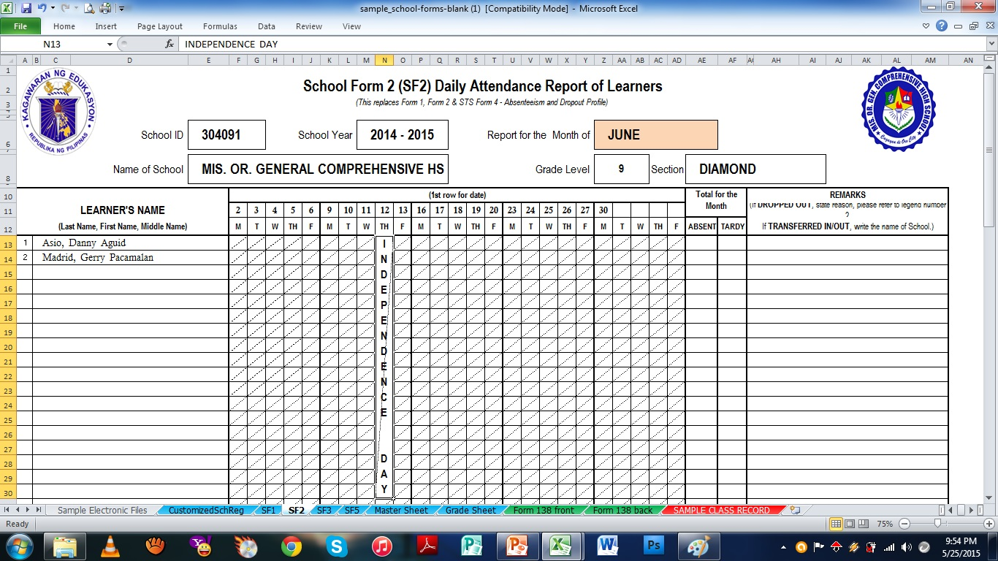
KEY FEATURES:
School Form 2 (SF2) Daily Attendance Report

Slide 7
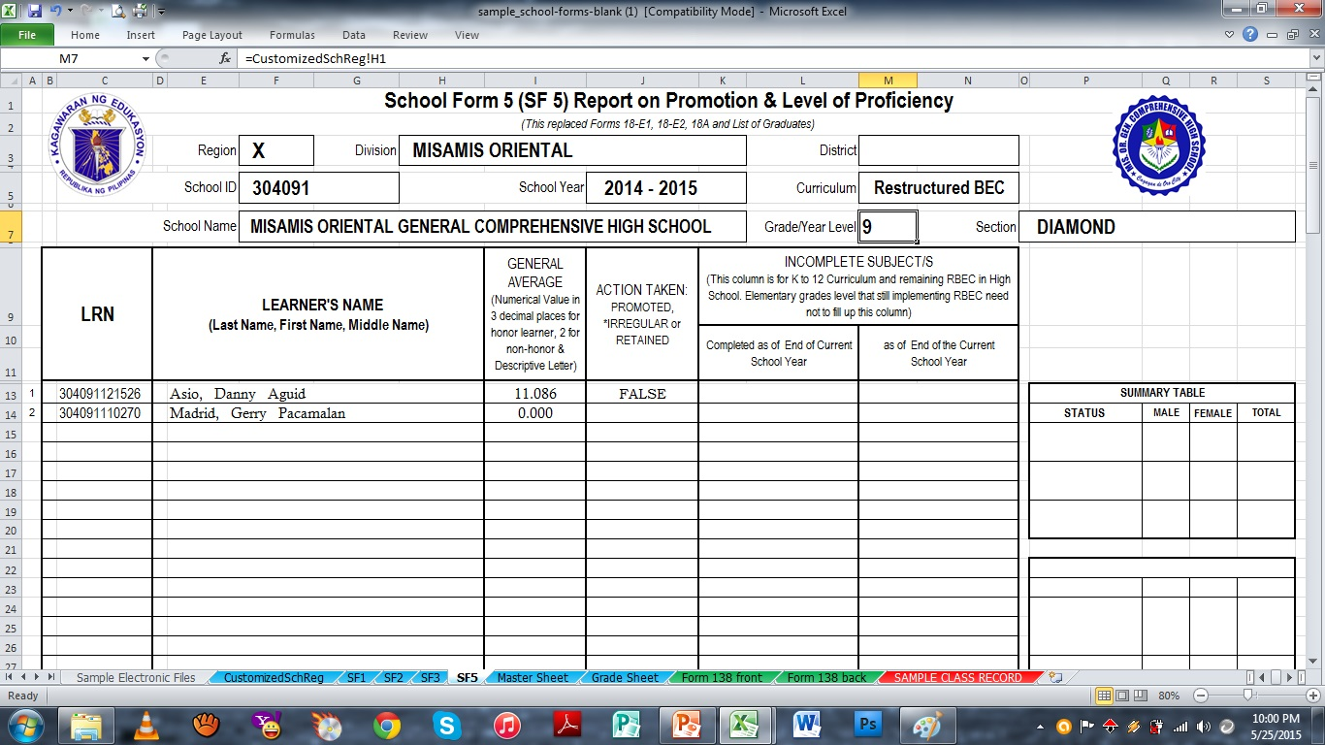
KEY FEATURES:
School Form 5 (SF5) Report on Promotion

Slide 8
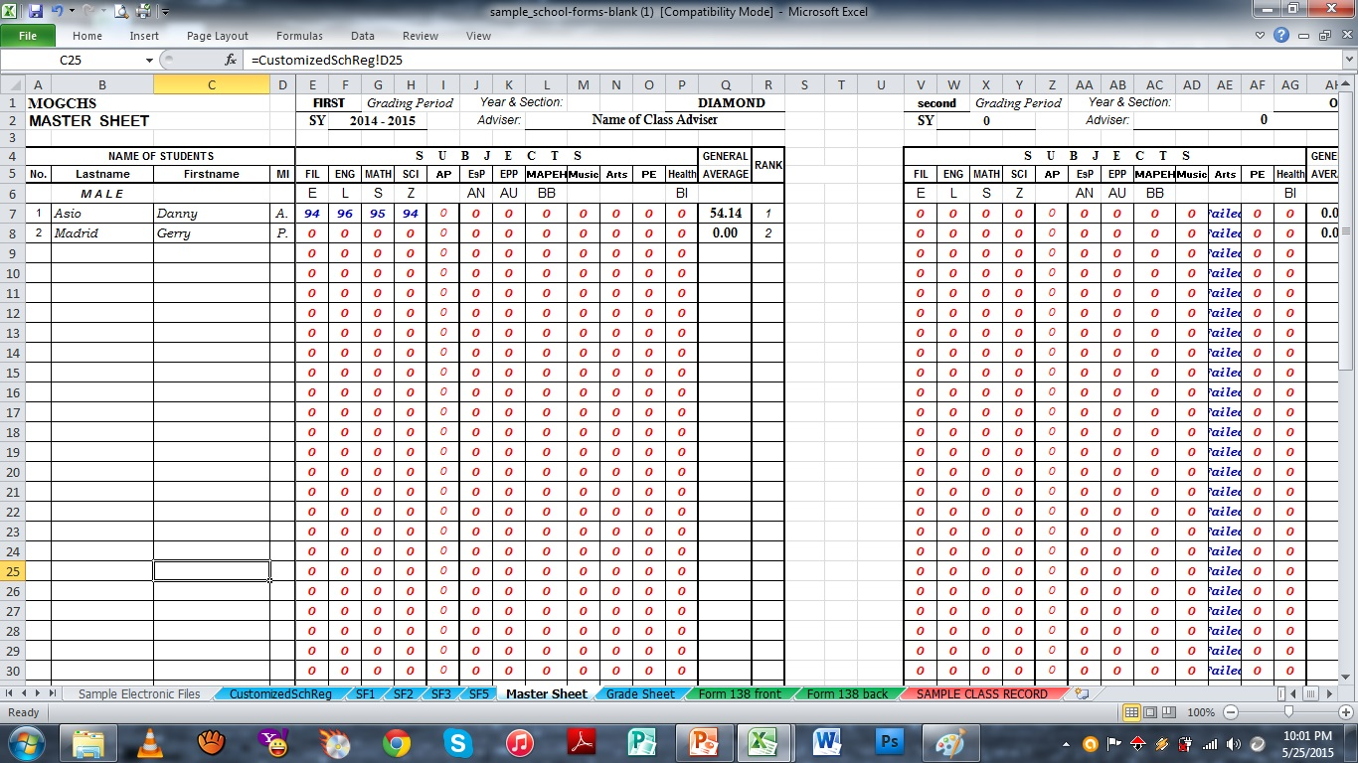
KEY FEATURES:
Master Sheet

Slide 9
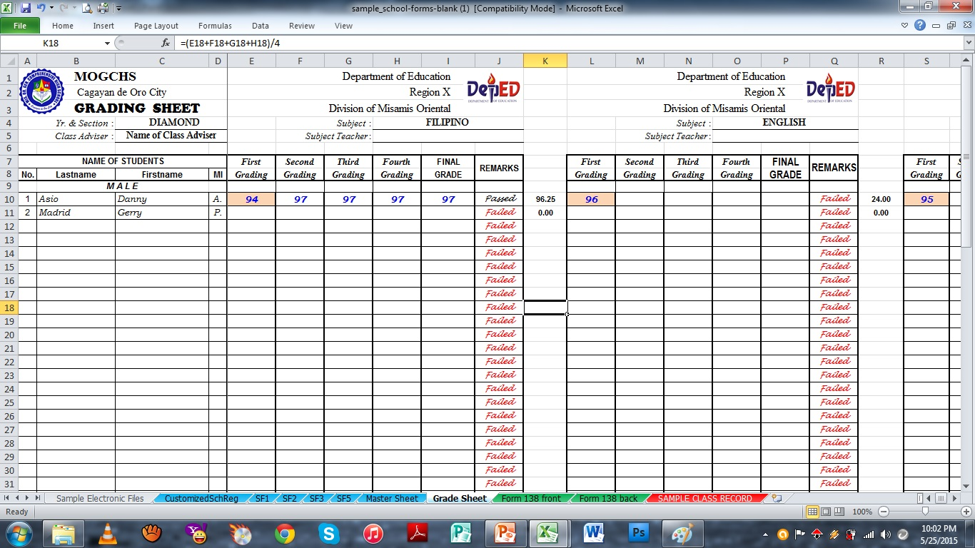
KEY FEATURES:
Grade Sheet

Slide 10
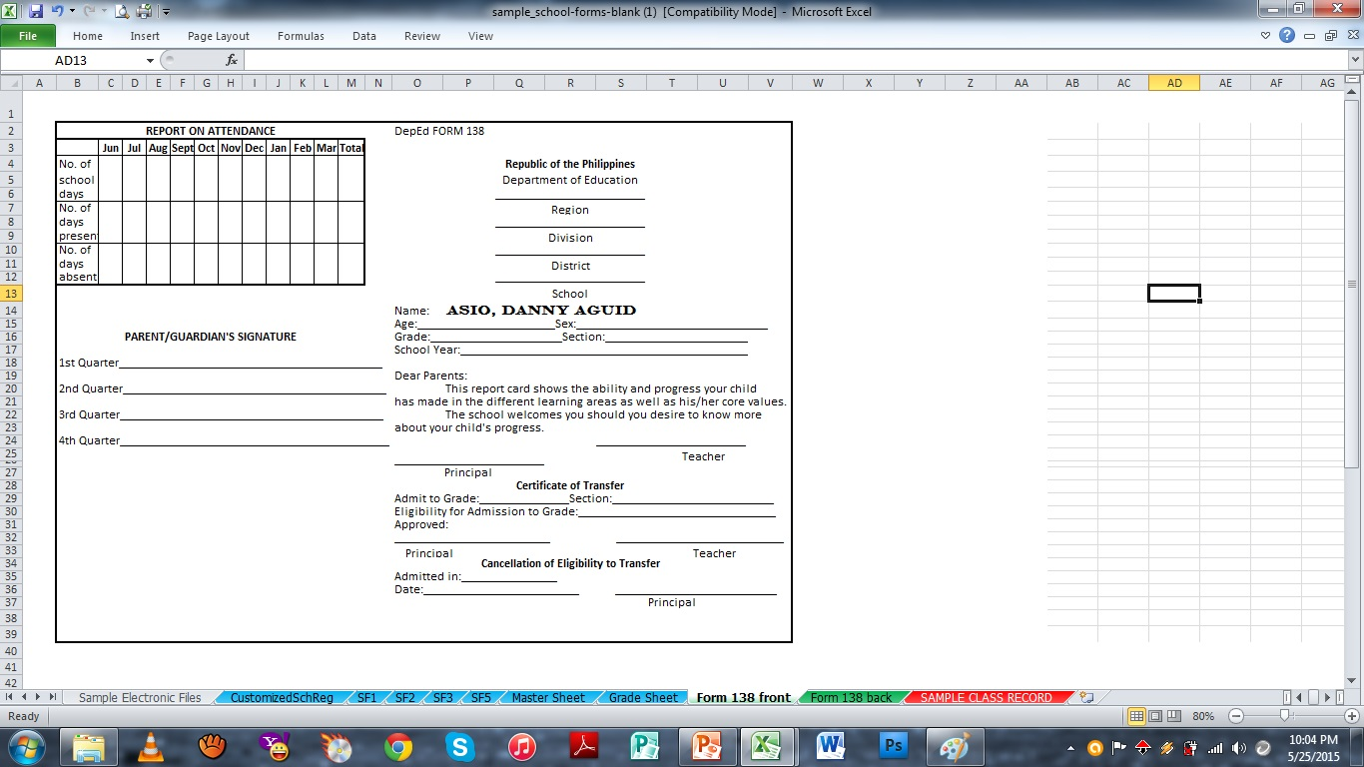
KEY FEATURES:
Form 138 (Front)

Slide 11
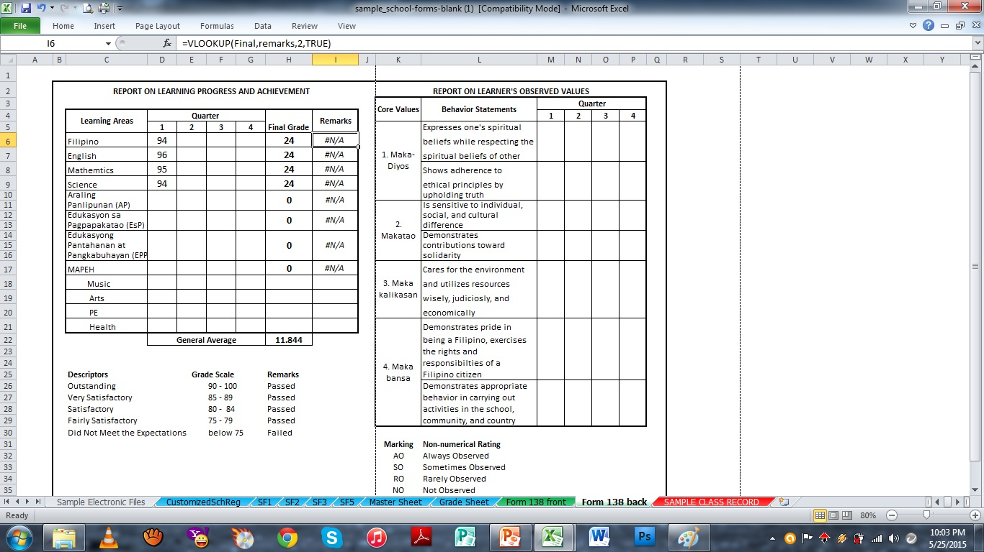
KEY FEATURES:
Form 138 (Back)

Slide 12
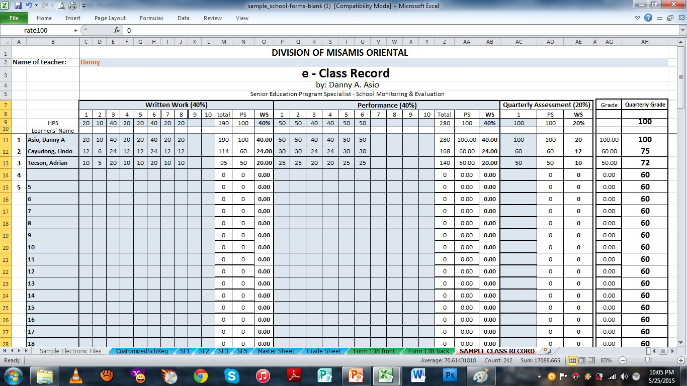
KEY FEATURES:
Class Record

Slide 13
KEY FEATURES:
Other Related Forms
School Form 3 (SF3) Books Issued & Returned
Monitoring Checklist
Masterlist of Learners

Slide 14
APPROACHES:
e-files can be easily done with the following tips:
Fill up ONLY the form(s)/sheet(s) being required.
( i.e., Customized School Register, Class Record )
This is a template for computing learner’s output, where most of the sheets were protected. You cannot change any restricted sheet since this is already programmed at your convenience. Alterations may cause errors and the programmed template will be lost.
Remember, this tool is created for purpose of helping teachers in making quarterly reports easy with less time and effort spent on generating forms.
In cases of altered programs, refer to your IT expert.

Slide 15
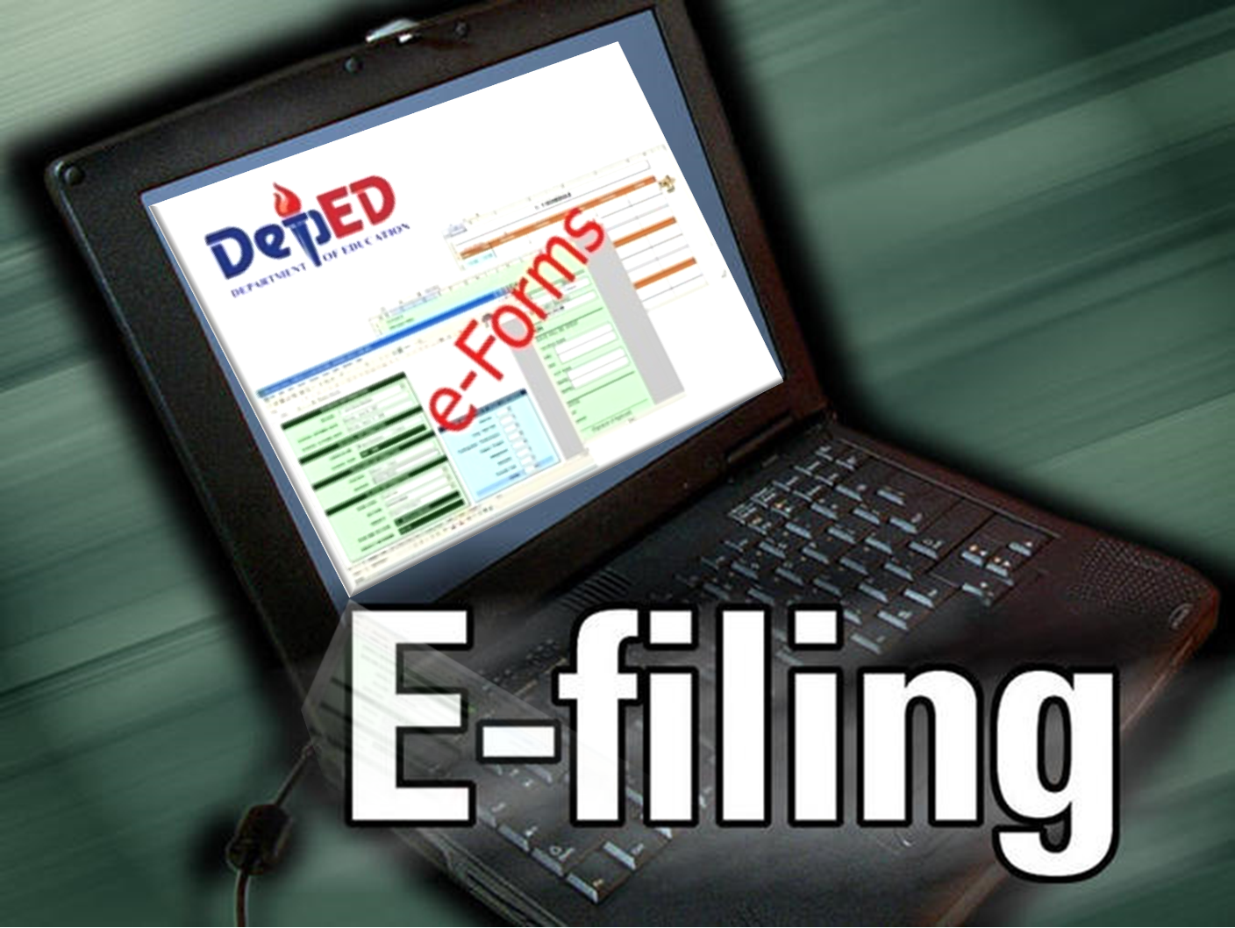
THANK YOU.!
HAVE A GREAT DAY AHEAD..!

