Slide 1
The K to 12 Curriculum
Notes:
Good day, everyone! I’m glad to have all of you here to discuss one of the most important basic education reform measures we have ever undertaken as a country.
I will be discussing with all of you the key features and details of the K to 12 Curriculum or the Enhanced Basic Education Program.
Hopefully this will give you a better understanding of the Program and how we can collectively make basic education better for the Filipino learner.

Slide 2
The K to 12 Basic Education Curriculum Framework
Notes:
Let’s start with the framework of the K to 12 Basic Education Curriculum.

Slide 3
The K to 12 Philippine Basic Education Curriculum Framework
CONTEXT
PHILOSOPHICAL
& LEGAL BASES
RA 10533 Enhanced Basic Education Act of 2013
Kindergarten Act
The 1987 Phil. Constitution
BP 232, Education Act of 1982
RA 9155, Governance of Basic Education Act of 2001
The vision, mission statements of DepEd
SOUTELE, 1976
The EDCOM Report of 1991
Basic Education Sector Reform Agenda (BESRA)
The four pillars of education (UNESCO)
NATURE OF
THE LEARNER
Has a body and spirit, intellect, free will, emotions, multiple intelligence, learning styles
Constructor of knowledge and active maker of meaning, not a passive recipient of information
NEEDS OF NATIONAL & GLOBAL COMMUNITY
Poverty reduction and human development
Strengthening the moral fiber of the Filipino people
Development of a strong sense of nationalism
Development of productive citizens who contribute to the building of a progressive, just, and humane society
Ensuring environmental sustainability
Global partnership for development
NEEDS OF
THE LEARNER
Life skills
Self-actualization
Preparation for the world of the work, entrepreneurship, higher education
DEPARTMENT OF EDUCATION
Notes:
K to 12 curriculum built on previous reform initiatives
EDCOM Report of 1991
BESRA
UNESCO four pillars of education
MAIN legal bases:
Republic Act No. 10533, the Enhanced Basic Education Act of 2013
Republic Act No. 10157, the Kindergarten Education Act
Nature and needs of the learner
Learner-centered
Needs of the national and global community
Curriculum is contextualized
Addresses national and global needs
Strategy to reduce poverty
Consistent with ASEAN 2015
Leapfrog

Slide 4
The K to 12 Philippine Basic Education Curriculum Framework
Holistically Developed Filipino with 21st Century Skills
Being and Becoming a Whole Person
SKILLS
Information, Media, and Technology Skills
Learning and Innovation Skills
Communication Skills
Life and Career Skills
LEARNING AREAS
Language
Technology and Livelihood Education (TLE)
Mathematics and Science
Arts and Humanities
Curriculum Support System
Teachers
Materials, Facilities, and Equipment
ICT
Environment
Assessment
School Leadership and Management
Schools Divisions Technical Assistance
Community-Industry Relevance and Partnerships
Monitoring and Evaluation System
DEPARTMENT OF EDUCATION
Notes:
Holistically developed Filipino
21st century skills
Learning areas
Strong curriculum support system
Monitoring and evaluation system

Slide 5
The K to 12 Philippine Basic Education Curriculum Framework
A
Notes:
Curriculum not reinvented
K to10 curriculum = spiral
SHS curriculum = disciplinal
Education is everybody’s business

Slide 6
Curriculum Exits
DEPARTMENT OF EDUCATION
Notes:
4 Exits: higher education, employment, entrepreneurship, middle-level skills development
Developing 21st century skills:
Information, Media, and Technology Skills
Learning and Innovation Skills
Communication Skills
Life and Career Skills
REMINDER: Strong career guidance and advocacy programs for proper student advising

Slide 7
Philippine Qualifications Framework
DEPARTMENT OF EDUCATION
Notes:
Philippine Qualifications Framework
Level I at end of Grade 10
Level II at end of Grade 12

Slide 8
Proposed PQF Articulation for Grades 10 & 12
Level | Knowledge, Skills and Values | Application | Degree of Independence
I (G10) | Possess foundational knowledge across a range of learning areas with core competencies in communication; scientific, critical and creative thinking; and the use of technologies. Have an understanding of right and wrong; one’s history and cultural heritage; and deep respect for self, others and their culture, and the environment. | Apply foundational knowledge, skills, and values in academic and real-life situations through sound reasoning, informed decision-making, and the judicious use of resources. | Apply skills in limited situations with close supervision.
II (G12) | Possess functional knowledge across a range of learning areas and technical skills in chosen career tracks with advanced competencies in communication; scientific, critical and creative thinking; and the use of technologies. Have an understanding of right and wrong; one’s history and cultural heritage; and deep respect for self, others and their culture, and the environment. | Apply functional knowledge, technical skills and values in academic and real-life situations through sound reasoning, informed decision-making, and the judicious use of resources. | Apply skills in varied situations with minimal supervision.
DEPARTMENT OF EDUCATION
Notes:
Proposed DepEd articulation of PQF Level I and II
Knowledge and Skills
Values
Application
Degree of independence

Slide 9
Curriculum Outcomes
Outcomes / Standards
Learning Areas / Grade Level
PQF
LEARNING RESOURCES
Teacher’s Guides and Learner’s Materials
Key
Stage
Outcomes
LEARNING COMPETENCIES
Content and Performance
STANDARDS
G3
G6
G10
G12
DEPARTMENT OF EDUCATION
Notes:
Key Stage Outcomes translated into:
Content standards and performance standards
Learning competencies
Learning resources

Slide 10
Learning Standards
Learning standards refer to how well the student must perform, at what kinds of tasks, based on what content, to be considered proficient or effective
They define what learning should be achieved in what grades or over certain grade spans
DEPARTMENT OF EDUCATION
Notes:
Definition of learning standards

Slide 11
Learning Standards
Key Stage Standards
Content Standards
Performance Standards
Learning Competency
DEPARTMENT OF EDUCATION
Notes:
Different learning standards and competency

Slide 12
Sample Key Stage Standard
Mother Tongue (Kinder to Grade 3):
“By the end of grade III, students will enjoy communicating in their first language on familiar topics for a variety of purposes and audiences using basic vocabulary, and phrases; read L1 texts with understanding, and create their own stories and texts in their L1.”
DEPARTMENT OF EDUCATION
Notes:
Sample Key Stage Standard: Mother Tongue Kinder to Grade 3

Slide 13
Sample Content and Performance Standards and Learning Competency
Science Grade 9
DEPARTMENT OF EDUCATION
Notes:
Sample standards and competencies from Science Grade 9

Slide 14
Sample Content and Performance Standards and Learning Competency
Science Grade 9
Content Standards:
The Learners demonstrate an understanding of how the different structures of the circulatory and respiratory systems work together to transport oxygen-rich blood and nutrients to the different parts of the body
DEPARTMENT OF EDUCATION
Notes:
FOCUS: sample content standards for Science Grade 9

Slide 15
Sample Content and Performance Standards and Learning Competency
Science Grade 9
Performance Standards:
The Learners shall be able to:
conduct an information dissemination activity on effective ways of taking care of the respiratory and circulatory systems based on data gathered from the school or local health workers
DEPARTMENT OF EDUCATION
Notes:
FOCUS: sample performance standards for Science Grade 9

Slide 16
Sample Content and Performance Standards and Learning Competency
Science Grade 9
Learning Competency:
The Learners explain how the respiratory and circulatory systems work together to transport nutrients, gases, and other molecules to and from the different parts of the body
DEPARTMENT OF EDUCATION
Notes:
FOCUS: sample learning competency for Science Grade 9

Slide 17
The K to 12 Basic Education Program
Notes:
Now let’s discuss the features and details of the K to 12 Basic Education Program

Slide 18
Basic Education Program
Elementary
Kinder to Grade 6
Junior
High
School
Grades 7 to 8
(Exploratory TLE)
Grades 9 to 10
(Specialized TLE)
Senior
High
School
Core Subjects
Tracks
Contextualized Track Subjects
Academic Track
Technical Vocational Livelihood Track
Sports Track
Arts & Design Track
General Academic Strand
STEM
ABM
HUMSS
Home Economics
Agri-Fishery
Industrial Arts
ICT
DEPARTMENT OF EDUCATION
Notes:
Structure/architecture of the K to 12 curriculum
Elementary: K-6
Junior High: 7-10
SHS: 11-12
SHS curriculum has 4 tracks:
Academic
Technical-Vocational-Livelihood
Sports
Arts and Design

Slide 19
Features of the K to 12 Curriculum
learner-centered, inclusive, and research-based
standards- and competence-based, seamless, decongested
culture-responsive and culture-sensitive, integrative and contextualized, relevant
and responsive
flexible, ICT-based,
and global
DEPARTMENT OF EDUCATION
Notes:
All these are catchphrases from the law
[discuss each quadrant]
BALANCE between the ideal, the meaningful, the logistically feasible
Allows for varied ways of delivery
ONE STOP SHOP and inclusive
Standards- and competence-based
Built around the needs of the learner and the community

Slide 20
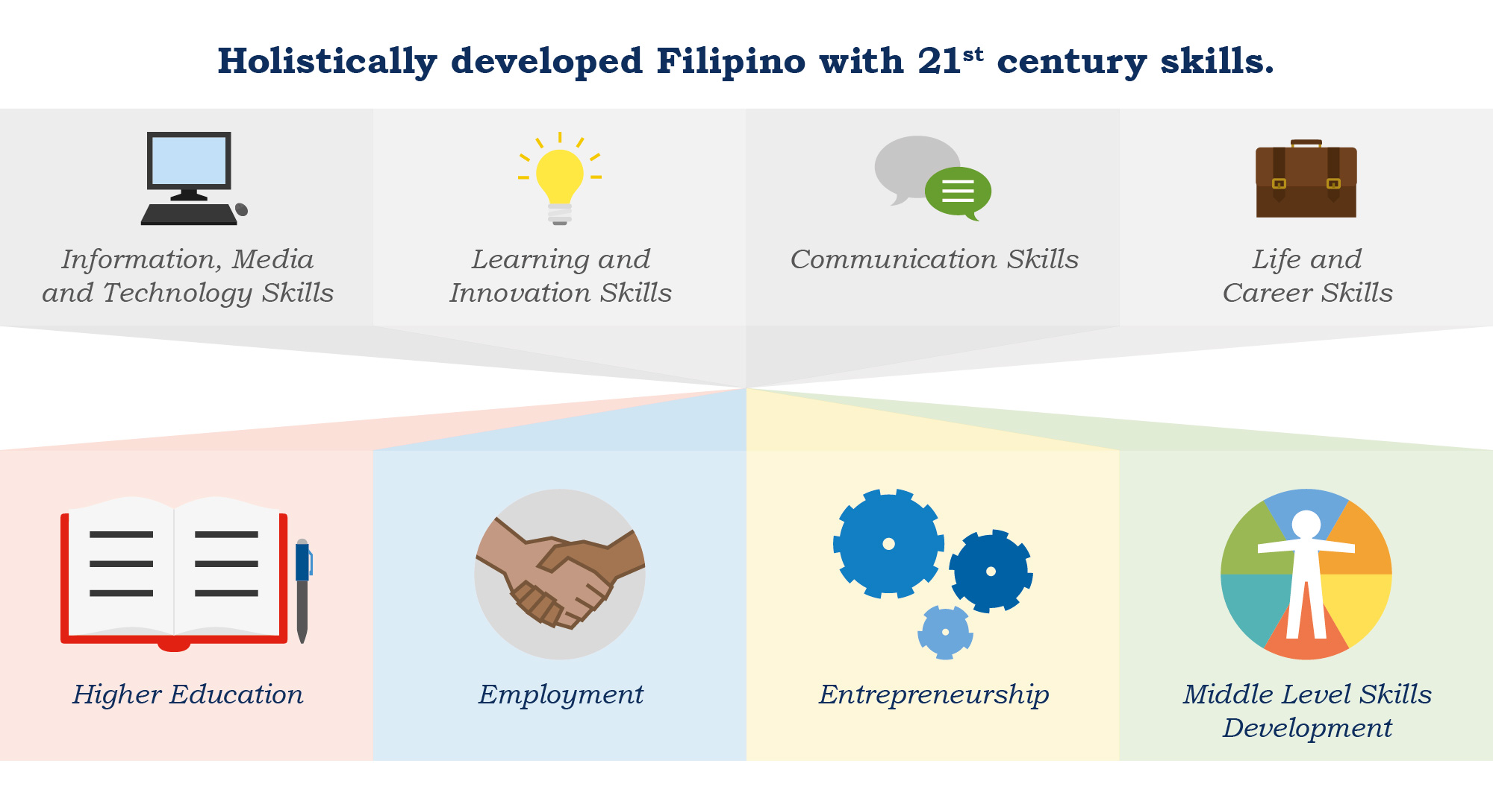
21st Century Skills
Visual and information literacies
Media literacy
Basic, scientific, economic and technological literacies and multicultural literacy
Global awareness
Creativity and curiosity
Critical thinking problem solving skills
Risk taking
Collaboration and interpersonal skills
Flexibility and adaptability
Initiative and self-direction
Social and cross-cultural skills
Productivity and accountability
Leadership and responsibility
Ethical, moral and spiritual values
DEPARTMENT OF EDUCATION
Notes:
Skills embedded in the curriculum
Skills developed bit by bit through the learning competencies and performance standards
Above is our example

Slide 21
TLE
Personal Entrepreneurial Competencies (PECS) across AF, IA, HE and ICT
AP (Sinaunang Kabihasnan sa Asya)
Naisasagawa ng mag-aaral ang kritikal na nakapagsusuri sa mga kaisipang Asyano, pilosopiya at relihiyon na nagbigay-daan sa paghubog ng sinaunang kabihasnan sa Asya at sa pagbuo ng pagkakilanlang Asyano
EsP
Naisasagawa ng mag-aaral ang paglalapat ng wastong paraan upang itama ang mga maling pasiya o kilos bilang kabataan batay sa tamang konsiyensiya.
English
(Philippine Literature)
The learner transfers learning by: resolving conflicts presented in literary selections; using tools and mechanisms in locating library resources; extracting information and noting details from texts to write a précis, summary, or paraphrase; distinguishing between and using literal and figurative language and verbal and non-verbal cues; use phrases, clauses, and sentences meaningfully and appropriately.
Math
Numbers and Number Sense The learner is able to formulate challenging situations involving sets and real numbers and solve these in a variety of strategies.
Statistics and Probability
The learner is able to collect and organize data systematically and compute accurately measures of central tendency and variability and apply these appropriately in data analysis and interpretation in different fields.
Learning and Innovation Skills
Music
(Music of Cordillera, Mindoro, Palawan, and the Visayas)
The learner improvises simple rhythmic/melodic accompaniments to selected music from the Cordillera, Mindoro, Palawan and of the Visayas.
PE (Training Guidelines, FITT Principles)
The learner designs an individualized exercise program to achieve personal fitness.
Filipino (Ibong Adarna) Naisasagawa ng mag-aaral ang malikhaing pagtatanghal ng ilang saknong ng koridong naglalarawan ng mga pagpapahalagang Pilipino.
Science
The learner investigates the properties of mixtures of varying concentrations using available materials in the community for specific purposes.
Health (Injury, Prevention, Safety and First Aid)
The learner consistently demonstrates resilience, vigilance and proactive behaviors to prevent intentional injuries.
Arts (Festivals and Theatrical Forms)
The learner creates appropriate festival attire with accessories based on authentic festival costumes.
Grade 7
DEPARTMENT OF EDUCATION
Notes:
Example of how curricular areas (in Grade 7) can lead to 21st century skills
Make all the skills and competencies connect at the level of the classroom

Slide 22
Mother Tongue-Based Multilingual Education
(MTB-MLE)
In Kinder to Grade 3, the child’s dominant language is used as the language of learning.
Filipino and English language proficiency is developed from Kinder to Grade 3 but very gradually.
Mother Tongue is used in instruction and learning materials of other learning areas.
The learners retain their ethnic identity, culture, heritage and values.
Children learn better and are more active in class and learn a second language even faster when they are first taught in a language they understand.
DEPARTMENT OF EDUCATION
Notes:
Mother tongue = child’s dominant language
Field must be able to determine the real language of the child, not the ideal language
Not the same as bilingual education.
During K-3, the child is taught in his/her dominant language
Learners materials written in 19 languages currently
Children retain their ethnic identity, culture, heritage and values (Madrasah/ALIVE as an example)

Slide 23
MTB-MLE Bridging Framework
A multi-literate Filipino learner
Literate in L1 and L2
English
Filipino
Literate in L1
Mother Tongue
DEPARTMENT OF EDUCATION
Notes:
MTB-MLE Bridging Framework

Slide 24
Contextualization and Localization
“The curriculum shall be contextualized and global;”
“The curriculum shall be flexible enough to enable and allow schools to localize, indigenize and enhance the [curriculum] based on their respective educational and social contexts.”
‒Sec. 10.2 (d) and (h), RA 10533 Implementing Rules and Regulations
DEPARTMENT OF EDUCATION
Notes:
Contextualization and localization as stipulated in RA 10533 and its IRR

Slide 25
Spiralling of Content
Basic concepts/general concepts are first learned.
More complex and sophisticated versions of the basic/general concepts are then rediscovered in the succeeding grades.
This strengthens retention and enhances mastery of topics and skills as they are revisited and consolidated time and again.
This also allows learners to learn topics and skills appropriate to their developmental and cognitive stages.
DEPARTMENT OF EDUCATION
Notes:
Spiralling of content and competencies
Basic → Complex not the other way around
Iterate content over time
Spiral → Disciplinal

Slide 26
Technology and Livelihood Education (TLE) and
the Technical-Vocational-Livelihood (TVL) Track
TLE in Junior High School
Exploratory at Grades 7 and 8
Given the opportunity to explore from a maximum of 4 TLE mini courses for each level
Taught five basic competencies common to all TLE courses
Learners may earn the Certificate of Competency (COC) in Grade 9 and the National Certificate I/II (NC I/II) in Grades 9 and 10
The learner may opt to take the Technical-Vocational-Livelihood Track in Grades 11 and 12 to continue the TLE specialization taken in Grades 9 and 10. This enables him to get an NC II.
DEPARTMENT OF EDUCATION
Notes:
5 common competencies in Grades 7-8
Hopefully they will find their inclinations and will have decided by Grade 9 if they will go for the Academic track

Slide 27
Ensuring Higher Education and Tech-Voc Readiness
Notes:
Next we discuss the key considerations in ensuring that the curriculum adequately prepares learners for higher education and technical-vocational education and training (TVET).

Slide 28
K to 12 and CHED GE Course Comparison
K to 12 Basic Education Curriculum |  |  | New General Education Curriculum (CHED)
Grades 7-10 | SHS Core Subjects | SHS Contextualized Subjects
Edukasyon sa Pagpapakatao Health | Personal Development |  | Understanding the Self / Pag-uunawa sa Sarili
Araling Panlipunan Filipino |  |  | Readings in Philippine History / Mga Babasahin hinggil sa Kasaysayan ng Pilipinas
English / Filipino Araling Panlipunan | 21st Century Literature from the Philippines and the World |  | The Contemporary World / Ang Kasalukuyang Daigdig
Math | General Math Statistics and Probability |  | Mathematics in the World / Matematika sa Makabagong Daigdig
English Filipino | Oral Communication Reading and Writing Komunikasyon at Pananaliksik sa Wika at Kulturang Filipino Pagbasa at Pagsusuri ng Iba't-Ibang Teksto Tungo sa Pananaliksik Media and Information Literacy | English for Academic and Professional Purposes Pagsulat sa Filipino sa Piling Larangan (Akademik, Arts, Isports at Tech-Voc) | Purposive Communication / Malayuning Komunikasyon
DEPARTMENT OF EDUCATION
Notes:
Connects with the new General Education Curriculum of CHED
For ex. G 7-10’s “Edukasyon sa Pagpapakatao” and SHS’ “Personal Development” connects with the “Understanding the Self” of CHED
Done to prepare the learners for college

Slide 29
K to 12 and CHED GE Course Comparison
K to 12 Basic Education Curriculum |  |  | New General Education Curriculum (CHED)
Grades 7-10 | SHS Core Subjects | SHS Contextualized Subjects
Music and Arts Physical Education | Contemporary Philippine Arts from the Regions |  | Art Appreciation / Pagpapahalaga sa Sining
Physical Education Health |  | Physical Education and Health
Science Araling Panlipunan English Filipino Health | Understanding Culture, Politics and Society Physical Science Earth and Life Science | Empowerment Technologies: ICT for Professional Tracks | Science, Technology and Society / Agham, Teknolohiya, at Lipunan
Edukasyon sa Pagpapakatao Araling Panlipunan | Introduction to Philosophy of the Human Person |  | Ethics / Etika
Edukasyong Pantahanan at Pangkabuhayan Technology Livelihood Education |  | Entrepreneurship
English Filipino Araling Panlipunan Science Math |  | Research in Daily Life 1 and 2
All learning areas |  | Research Project/Career Advocacy/ Work Immersion/ Culminating Activity
DEPARTMENT OF EDUCATION
Notes:
Connection between other high school subjects and the new GE curriculum

Slide 30
Ensuring College Readiness
Working with CHED to:
Ensure alignment of Core and Contextualized Subjects to the College Readiness Standards (CRS)* and new General Education (GE)** Curriculum
Develop appropriate Specialization Subjects for the Academic, Sports, and Arts and Design Tracks
Process:
CHED Technical Panel/Committee members take part in content and skills review for the development, refinement, and finalization of the SHS Curriculum Guides
*CEB Resolution No. 298-2011
**CHED Memorandum Order No. 20, s. 2013
DEPARTMENT OF EDUCATION
Notes:
CHED has been a partner in the development of the SHS curriculum

Slide 31
Strengthening TVET Integration in
Secondary Education
Working with TESDA to:
Integrate TVET skills, competencies, and qualifications in TLE in JHS and Technical-Vocational-Livelihood (TVL) track in SHS
Ensure that any Grade 10 finisher and all Grade 12 TVL graduates are eligible for TESDA competency/qualifications assessments (i.e. COC, NC I, or NC II)
Prepare learning resources that are consistent with promulgated Training Regulations
Develop appropriate INSET and certification programs for TLE teachers
Process:
TESDA representatives take part in Curriculum Guides development, refinement, and finalization for TLE and the TVL track
TESDA representatives assist in crafting of TLE learning resouces
TESDA representatives assist in development of summer ToT and mass training program for TLE teachers
DEPARTMENT OF EDUCATION
Notes:
TESDA has always been included in all writing activities

Slide 32
TLE and TVL Common Competencies
DepEd and TESDA agreed on common competencies to be embedded in the TLE and Technical-Vocational Livelihood Curriculum for Grades 7 to 12.
Use of Tools
Perform Mensuration and Calculation
Practice Occupational Health and Safety Proecdures
Use and Maintain Hand Tools, Equipment and Paraphernalia
Read and Interpret Manuals/Specifications
Other common competencies:
Personal Entrepreneurial Competencies
Environment and Market
DEPARTMENT OF EDUCATION
Notes:
Common TVET competencies in Grades 7-10 and 11-12

Slide 33
K to 12 Curriculum Development Process
Notes:
Now let’s talk about how the curriculum was developed.

Slide 34
Who helped make the Curriculum Guide?
Who helped make the Curriculum Guide
Curriculum Guide Writing Workshops were held which were attended by the following:
Bureau Focal Person
Field Person
External Reviewer
Internal Reviewer
Encoder
Bureau Focal Person
Field Person
Internal and External Reviewer
CHED Technical Panel Member / TESDA Crafters
Encoder
DEPARTMENT OF EDUCATION
Notes:
People involved in making the curriculum guides

Slide 35
Who helped make the Curriculum Guide?
Ateneo de Manila High School
Ateneo de Manila University
Ballet Philippines
Cavite State University
Central Bicol State University
Centro Escolar University
CHED
Cultural Center of the Philippines
Davao Wisdom Academy
De La Salle University - Dasmariñas
De La Salle-College of St. Benilde
De La Salle University – Taft
Don Bosco School
Foundation for Information Technology Education and Development
International Training for Pig Husbandry
Jose Rizal University
La Consolacion College Manila
Let’s GO Foundation
Lyceum of the Philippines
Mariano Marcos State University
Miriam College
National Commission for Culture and the Arts
National Historical Commission
Palawan State University
Philippine Center for Post-Harvest Development and Mechanization
Philippine Educational Theater Association
Philippine High School for the Arts
Philippine National Historical Society
Philippine Normal University
Philippine Science High School
Philippine Society for Music Education
Queen of Heart Academy Cavite
Raya School
San Beda College
St. Mary’s University – Nueva Vizcaya
St. Paul University Manila
Technological University of the Philippines
TESDA
University of Asia and the Pacific
University of Santo Tomas
UP Diliman
UP Integrated School
UP Los Baños
UP Manila
UP NISMED
UP Open University
USAID
Xavier School
DEPARTMENT OF EDUCATION

Slide 36
The Curriculum Guide Process
1. Content and Skills Review
STEPS
OUTPUT
Technical Panel/Technical Committee/Drafting Committee
Draft 1
Review of CGs
Comments
Return to crafters of Draft 1
Draft 2
DepEd reads comments in a
Curriculum Finalization Workshop
Final Curriculum Guide
DEPARTMENT OF EDUCATION
Notes:
Draft 1: Created by a Technical Panel/Technical Committee/Drafting Committee
Comments for Draft 1: Curriculum guides are reviewed by internal and external reviewers
Draft 2: Crafters revise reviewed draft.
Final Curriculum guide: DepEd reads comments in a Curriculum Finalization Workshop

Slide 37
The Curriculum Guide Process
2. Language Review
Select language editors
Send Curriculum Guides to selected language editors
Encoders key in revisions
3. Copy and Proofreading
DEPARTMENT OF EDUCATION
Notes:
After the Content and Skills Review, the curriculum guide goes through a language review
For final touches, the CG goes through copy and proofreading.
Language editors must have knowledge of the content.

Slide 38
Coding System
Coding of Learning Competencies of the Curriculum Guide per Learning Area.
Ensure continuity of curriculum across stages
See the interlacing connections and integration across grade levels and learning areas
Decongest the curriculum
Identify the competencies without learning materials and create materials for them
DEPARTMENT OF EDUCATION

Slide 39
Coding Legend
Sample: H9S-IVg-h-34
LEGEND |  | SAMPLE
First Entry | Learning Area and Strand/ Subject or Specialization | Health | H9
 | Grade Level | Grade 9
Uppercase Letter/s | Domain/Content/ Component/ Topic | Prevention of Substance Use and Abuse | S
 |  |  | -
Roman Numeral *Zero if no specific quarter | Quarter | Fourth Quarter | IV
Lowercase Letter/s *Put a hyphen (-) in between letters to indicate more than a specific week | Week | Week seven to eight | g-h
 |  |  | -
Arabic Number | Competency | Suggests healthy alternatives to cigarettes and alcohol to promote healthy lifestyle (self, family, community) | 34
Notes:
Found in every Curriculum Guide
Explains how to decipher the code

Slide 40
Harvesting of DepEd Learning Resources
Identifying, collating and collecting Instructional Materials that are DepEd-owned.
BEAM, PROBE, STRIVE
ESA, TEEP, ALS
eEskwela, Open HS, etc.
DEPARTMENT OF EDUCATION

Slide 41
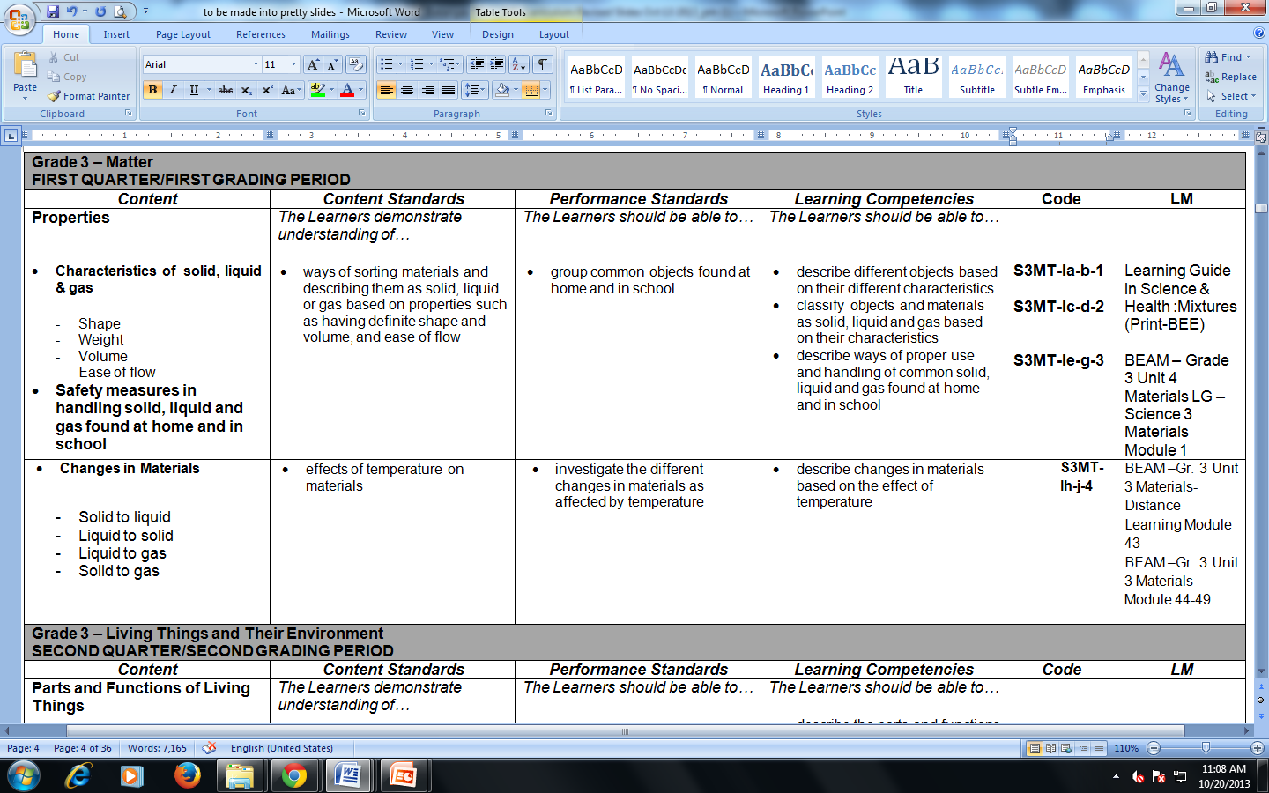
Sample Curriculum Guide
Notes:
Sample curriculum guide for Grade 3 Science

Slide 42
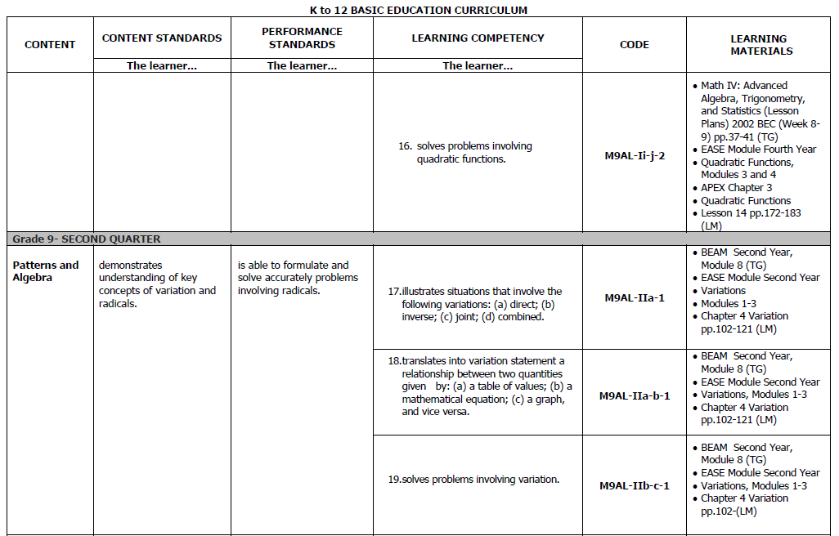
Sample Curriculum Guide
Notes:
Sample curriculum guide for Grade 9 Math

Slide 43
Sample Curriculum Map
HEALTH | QUARTER
Grade | First Quarter | Second Quarter | Third Quarter | Fourth Quarter
Kinder | Kalusugang Pisikal at Pagpapaunlad ng Kakayahang Motor (Pangangalaga sa Sariling Kalusugan at Kaligtasan)
1 | NUTRITION Healthful and less healthful food Consequences of eating less healthful food Good eating habits | PERSONAL HEALTH Health habits and hygiene | FAMILY HEALTH Characteristics of a healthful home environment Keeping a healthful home environment | INJURY PREVENTION, SAFETY AND FIRST AID Personal Information and ways to ask for help Preventing childhood injuries Ways by which people are intentionally helpful or harmful
2 | NUTRITION Healthy food and the body Guide in eating a balanced diet | PERSONAL HEALTH Health habits and hygiene Care of the eyes, ears, nose Care for the mouth/teeth Development of self-management skills | FAMILY HEALTH Healthy family habits and practices Positive expressions of feelings | Safety rights and responsibilities Home safety Hazards at home Safety rules 2. School safety
3 | NUTRITION Good nutrition and health Nutritional guidelines for Filipinos | PREVENTION AND CONTROL OF DISEASES AND DISORDERS Concept of health and wellness Common childhood diseases Preventive measures for common childhood diseases | CONSUMER HEALTH Introduction to consumer education and its components (health information, products and services) Factors that influence the choice of goods and services Skills of a wise consumer Consumer rights Consumer responsibility Sources of reliable health information | INJURY PREVENTION, SAFETY AND FIRST AID Road safety Community safety
DEPARTMENT OF EDUCATION
Notes:
Curriculum map for Health Kinder to Grade 3
Map aids teachers in determining content or coverage of exams, among others

Slide 44
K to 12 Curriculum Guides
Download them at: http://bit.ly/kto12curriculum
DEPARTMENT OF EDUCATION
Notes:
Download curriculum guides at bit.ly/kto12curriculum
Refer to curriculum guides to aid decision making on programs and specializations

Slide 45
The Senior High School (SHS) Curriculum
Notes:
Let’s now discuss the Senior High School or Grades 11 and 12 curriculum.

Slide 46
Senior High School Curriculum
*The Academic track includes four (4) strands: Accountancy, Business and Management (ABM); General Academic; Humanities and Social Science (HUMSS); and Science, Technology, Engineering and Mathematics (STEM).
DEPARTMENT OF EDUCATION
Notes:
8 Learning Areas in the Core Curriculum
4 Tracks

Slide 47
The Proposed Grades 11 and 12 will have 31 80-hour subjects, totalling 2,480 hours.
31 TOTAL SUBJECTS
15
Core Subjects
16
Track Subjects
7
Contextualized Subjects
9
Specialization subjects
Each subject will have 80 hours per semester
P.E. and Health will have 20 hours per semester for 4 semesters
DEPARTMENT OF EDUCATION
Notes:
31 subjects with 80 hours per subject totalling 2,480 hours for all 31
15 Core subjects
16 Track subjects have two categories: 7 Contextualized and 9 specialization subjects.
Core and Contextualized subjects are connected with the new GE Curriculum of CHED

Slide 48
Senior High School Subjects
Core Subjects
same content
same competencies
Contextualized Subjects in the Tracks
different content
same competencies
Specialization Subjects in the Tracks
different content
different competencies
DEPARTMENT OF EDUCATION
Notes:
Core Subjects = same content and competencies for all
Contextualized subjects = different content, same competencies
Specialization subjects = different content different competencies based on tracks

Slide 49
Senior High School Core Subjects
Core Learning Areas and Subjects |  | hours per semester
Language | Oral Communication | 80
 | Reading & Writing | 80
 | Komunikasyon at Pananaliksik sa Wika at Kulturang Pilipino | 80
 | Pagbasa at Pagsusuri ng Iba’t Ibang Teksto Tungo sa Pananaliksik | 80
Humanities | 21st Century Literature from the Philippines and the World | 80
 | Contemporary Philippine Arts from the Regions | 80
Communication | Media & Information Literacy | 80
Mathematics | General Mathematics | 80
 | Statistics & Probability | 80
Science | Earth and Life Science (Lecture and Laboratory) | 80
 | Physical Science (Lecture and Laboratory) | 80
Social Science | Personal Development / Pansariling Kaunlaran | 80
 | Understanding Culture, Society and Politics | 80
Philosophy | Introduction to the Philosophy of the Human Person / Pambungad sa Pilosopiya ng Tao | 80
PE and Health | Physical Education and Health | 80
CORE Total Number of Hours |  | 1,200
TRACK Total Number of Hours |  | 1,280
Total Number of Hours (CORE + TRACK) |  | 2,480
Total Hours (CORE + TRACK) divided by Number of School Days in SHS (400) = average hours/day |  | 6.2 hours/day
DEPARTMENT OF EDUCATION
Notes:
Localization of Core subjects can be done in the regions by the regions.
In the STEM strand, their Science is different from the other tracks and strands.
PE and Health = only subject spread across 4 semesters

Slide 50
Contextualized Track Subjects
Academic, Technical-Vocational-Livelihood, Sports, Arts & Design Tracks
1 | English for Academic and Professional Purposes
2 | Research in Daily Life 1
3 | Research in Daily Life 2
4 | Pagsulat sa Filipino sa Piling Larangan (Akademik, Isports, Sining at Tech-Voc)
5 | Empowerment Technologies (E-Tech): ICT for Professional Tracks
6 | Entrepreneurship
7 | Research Project / Culminating Activity*
Each subject will have 80 hours per semester
*For Finalization
DEPARTMENT OF EDUCATION
Notes:
Research in Daily life 1: Qualitative
Research in Daily life 2: Quantitative
Research: Must be aligned to the track/ strand, for contextualization
Example for E-Tech: Drafting through Autocad, Excel for business
Entrepreneurship is for the graduates’ practical use
Give students enough time to decide what they really want to do

Slide 51
Academic Track Specialized Subjects
Accountancy, Business and Management Strand
8 | ABM Strand 1 | Applied Economics
9 | ABM Strand 2 | Business Ethics and Social Responsibility
10 | ABM Strand 3 | Fundamentals of Accountancy, Business and Management 1
11 | ABM Strand 4 | Fundamentals of Accountancy, Business and Management 2
12 | ABM Strand 5 | Business Math
13 | ABM Strand 6 | Business Finance
14 | ABM Strand 7 | Organization and Management
15 | ABM Strand 8 | Principles of Marketing
16 | ABM Strand 9 | Work Immersion/Research/Career Advocacy/Culminating Activity i.e. Business Enterprise Simulation
Each subject will have 80 hours per semester
DEPARTMENT OF EDUCATION
Notes:
ABM is formerly called BAM, changed to ABM so as not to sound like “bum” or “drop-out”
9th specialized subject is always Work Immersion, Research, Career Advocacy, or Culminating Activity for all track or strand

Slide 52
Senior High School Core Subjects for the STEM Strand
Core Learning Areas and Subjects |  | hours per semester
Language | Oral Communication | 80
 | Reading & Writing | 80
 | Komunikasyon at Pananaliksik sa Wika at Kulturang Pilipino | 80
 | Pagbasa at Pagsusuri ng Iba’t Ibang Teksto Tungo sa Pananaliksik | 80
Humanities | 21st Century Literature from the Philippines and the World | 80
 | Contemporary Philippine Arts from the Regions | 80
Communication | Media & Information Literacy | 80
Mathematics | General Mathematics | 80
 | Statistics & Probability | 80
Science | Earth Science | 80
 | Disaster Readiness and Risk Reduction | 80
Social Science | Personal Development / Pansariling Kaunlaran | 80
 | Understanding Culture, Society and Politics | 80
Philosophy | Introduction to Philosophy of the Human Person / Pambungad sa Pilosopiya ng Tao | 80
PE and Health | Physical Education and Health | 80
CORE Total Number of Hours |  | 1,200
TRACK Total Number of Hours |  | 1,280
Total Number of Hours (CORE + TRACK) |  | 2,480
Total Hours (CORE + TRACK) divided by Number of School Days in SHS (400) = average hours/day |  | 6.2 hours/day
DEPARTMENT OF EDUCATION
DEPARTMENT OF EDUCATION
Notes:
Core Science for STEM strand is different from the other tracks and strands
Earth Science, Disaster Readiness and Risk Reduction

Slide 53
Academic Track
Specialized Subjects
Science, Technology, Engineering and Mathematics Strand
8 | STEM Strand 1 | Pre-Calculus
9 | STEM Strand 2 | Basic Calculus
10 | STEM Strand 3 | General Biology 1
11 | STEM Strand 4 | General Biology 2
12 | STEM Strand 5 | General Physics 1
13 | STEM Strand 6 | General Physics 2
14 | STEM Strand 7 | General Chemistry 1
15 | STEM Strand 8 | General Chemistry 2
16 | STEM Strand 9 | Work Immersion/Research/Career Advocacy/Culminating Activity
Each subject will have 80 hours per semester
DEPARTMENT OF EDUCATION
Notes:
Engineering requires calculus-based physics
For students who wish to pursue technically-related field in math and science, engineering, computer science, etc.

Slide 54
Academic Track Specialized Subjects
Humanities and Social Sciences Strand*
8 | HUMSS Strand 1 | Creative Writing
9 | HUMSS Strand 2 | Creative Nonfiction: The Literary Essay
10 | HUMSS Strand 3 | World Religions and Belief Systems
11 | HUMSS Strand 4 | Trends, Networks and Critical Thinking in the 21st Century
12 | HUMSS Strand 5 | Philippine Politics and Governance
13 | HUMSS Strand 6 | Community Engagement, Social Participation and Citizenship
14 | HUMSS Strand 7 | Disciplines and Ideas in the Social Sciences
15 | HUMSS Strand 8 | Disciplines and Ideas in the Applied Social Sciences
16 | HUMSS Strand 9 | Work Immersion/Research/Career Advocacy/Culminating Activity
Each subject will have 80 hours per semester
*For Finalization
DEPARTMENT OF EDUCATION
Notes:
4 humanities subjects + 4 social science subjects
RA 10533 provides a window of 5 years so that one can get graduates of specialized courses to teach in Basic Education

Slide 55
Academic Track Specialized Subjects
Proposed General Academic Strand*
8 | Strand 1 | Humanities 1
9 | Strand 2 | Humanities 2
10 | Strand 3 | Social Science 1
11 | Strand 4 | Applied Economics
12 | Strand 5 | Organization and Management
13 | Strand 6 | Disaster Readiness and Risk Reduction
14 | Strand 7 | Elective 1 (from any Track/Strand)
15 | Strand 8 | Elective 2 (from any Track/Strand)
16 | Strand 9 | Work Immersion/Research/Career Advocacy/Culminating Activity
Each subject will have 80 hours per semester
*For Finalization
DEPARTMENT OF EDUCATION
Notes:
Most useful for those who are still exploring possibilities for the future
Good incubation for both the school and the student
The electives may be electives for TVL or for Academic ABM or HUMMS, etc.
All these strands come from existing strands

Slide 56
Sports Track Specialized Subjects
Sports Track
8 | Sports Track 1 | Safety and First Aid
9 | Sports Track 2 | Human Movement
10 | Sports Track 3 | Fundamentals of Coaching
11 | Sports Track 4 | Sports Officiating and Activity Management
12 | Sports Track 5 | Fitness, Sports and Recreation Leadership
13 | Sports Track 6 | Psychosocial Aspects of Sports and Exercise
14 | Sports Track 7 | Fitness Testing and Exercise Programming
15 | Sports Track 8 | Practicum (in-campus)
16 | Sports Track 9 | Work Immersion/Research/Career Advocacy/Culminating Activity i.e. Apprenticeship (off-campus)
Each subject will have 80 hours per semester
DEPARTMENT OF EDUCATION
Notes:
Focus more on sports science rather than the sport because the span of an athlete’s career isn’t too long
Leadership and management are included
Human movement = biomechanics
Track 7 is marketable in the spa and wellness industries
“Grow up” programs

Slide 57
Arts and Design Track Specialized Subjects
Arts and Design Track
8 | Arts Track 1 | Creative Industries I: Arts and Design Appreciation and Production
9 | Arts Track 2 | Creative Industries II: Performing Arts
10 | Arts Track 3 | Physical and Personal Development in the Arts
11 | Arts Track 4 | Developing Filipino Identity in the Arts
12 | Arts Track 5 | Integrating the Elements and Principles of Organization in the Arts
13 | Arts Track 6 | Leadership and Management in Different Arts Fields
14 | Arts Track 7 | Apprenticeship and Exploration of Different Arts Fields
15 | Arts Track 8
16 | Arts Track 9 | Work Immersion/Research/Career Advocacy/Culminating Activity Exhibit for Arts Production/ Performing Arts Production
Each subject will have 80 hours per semester except Apprenticeship and Exploration of Different Arts Fields which will have 160 hours
DEPARTMENT OF EDUCATION
Notes:
Focus more on the arts and design related career opportunities rather than just the artist
Understanding of arts industry vital for those in the arts field. This will teach them how to market themselves and earn using their talents/skills.
The track has to be in a form where the instrument and the skill is taught
Work with living artists in communities

Slide 58
Technical-Vocational-Livelihood Track (Table 1) and TESDA Training Regulations-Based Specializations* (Table 2)
Tech-Voc Track
TESDA Training Regulations-Based Specializations
TVL Track Subjects
 | Subjects | Example
8 | Tech-Voc Track 1 | Bread and Pastry Production
9 | Tech-Voc Track 2
10 | Tech-Voc Track 3
11 | Tech-Voc Track 4
12 | Tech-Voc Track 5 | Food and Beverage
13 | Tech-Voc Track 6
14 | Tech-Voc Track 7
15 | Tech-Voc Track 8
16 | Tech-Voc Track 9
HE | ICT | Agri-Fishery Arts | Industrial Arts
Hairdressing Tailoring Caregiving Food and Beverage Services Bread and Pastry Production Housekeeping Tour Guiding Services Travel Services Attractions and Theme Parks Tourism Handicraft a. Fashion Accessories b. Paper Craft c. Woodcraft d. Leathercraft | Computer Programming Medical Transcription Animation | AGRICROP PRODUCTION Horticulture Landscape Installation and Maintenance Organic Agriculture Production Pest Management Rice Machinery Operation | Automotive Servicing Refrigeration and Air-Conditioning Consumer Electronics Servicing Electrical Installation and Maintenance Shielded Metal-Arc Welding Carpentry Plumbing Masonry Tile Setting
 |  | ANIMAL PRODUCTION Artifical Insemmination Raising Large Ruminants (Dairy Cattle and Buffaloes) Raising Swine Slaughtering
 |  | FISH PRODUCTION Fish Nursery Operation Fish or Shrimp Grow Out Operation Fishport/Wharf Operation
Each subject will have 80 hours per semester.
*Aligned with Technology and Livelihood Education (TLE) in Grades 7 to 10.
DEPARTMENT OF EDUCATION
Notes:
Exit to NC II qualifications of TESDA
Aligned with Training Regulations
How TVL can lead to decent jobs in different fields

Slide 59
Agri-Fishery Arts Curriculum Map
DEPARTMENT OF EDUCATION
Notes:
Curriculum map for Agri-Fishery Arts

Slide 60
Home Economics Curriculum Map
* Students cannot take a specialization in Grades 9 and 10 if they have not taken 40 hours of the course in Grades 7 or 8.
** Students may only qualify for an NC II certification if they have taken Caregiving from Grades 7-12. If students only began
taking Caregiving in Grade 11, they will only qualify for a Certificate of Completion (COC).
DEPARTMENT OF EDUCATION
Notes:
Curriculum map for Home Economics

Slide 61
Information Communication and Technology (ICT) Curriculum Map
DEPARTMENT OF EDUCATION
Notes:
Curriculum Map for ICT
Add more specializations

Slide 62
Industrial Arts Curriculum Map
DEPARTMENT OF EDUCATION
Notes:
Curriculum map for Industrial Arts

Slide 63
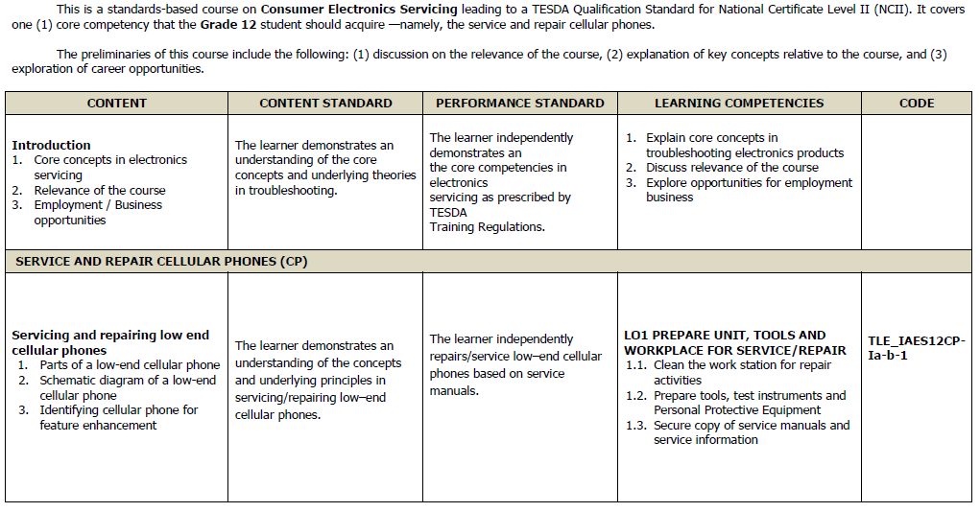
Sample Curriculum Guide
Consumer Electronics Servicing NC II
DEPARTMENT OF EDUCATION
Notes:
Sample curriculum guide for Consumer Electronics Servicing NC II

Slide 64
Sample Curriculum Guide
Grade: 11/12 Semester: 1st Semester
Core Subject Title: Oral Communication in Context No. of Hours/ Semester: 80 hours/ semester
Pre-requisite (if needed):
Core Subject Description: The development of listening and speaking skills and strategies for effective communication in various situations.
CONTENT | CONTENT STANDARD | PERFORMANCE STANDARD | LEARNING COMPETENCIES | CODE
OC11.1 Nature and Elements of Communication Definition The Process of Communication Communication Models Five Elements of Communication Verbal and Non-Verbal Communication Effective Communication Skills Intercultural Communication 6 hours (1 week, 2 days) | The learner... understands the nature and elements of oral communication in context. | The learner… designs and performs effective controlled and uncontrolled oral communication activities based on context. | The learner… Defines communication. | EN11/12OC-Ia-1
 |  |  | Explains the nature and process of communication. | EN11/12OC-Ia-2
 |  |  | Differentiates the various models of communication. | EN11/12OC-Ia-3
 |  |  | Distinguishes the unique feature(s) of one communication process from the other. | EN11/12OC-Ia-4
 |  |  | Explains why there is a breakdown of communication. | EN11/12OC-Ia-5
 |  |  | Uses various strategies in order to avoid communication breakdown. | EN11/12OC-Ia-6
DEPARTMENT OF EDUCATION
Notes:
Sample curriculum guide for Oral Communication
The curriculum guide shows the recommended grade level, no. of hours per semester, and pre-requisite, if needed.
The code is the spine that connects the curriculum to:
assessment
existing materials
development of materials
lesson plans
Code makes it easier to detect which competencies need more elaboration/discussion.

Slide 65
SHS Program Requirements
Work and Contribution to Society
K to 12 Curriculum
Teachers
Materials, Facilities, and Equipment
ICT Environment
Assessment
School Leadership and Management
Schools Divisions Technical Assistance
Community-Industry Relevance and Partnerships
DEPARTMENT OF EDUCATION
Notes:
SHS program requirements = quality standards for:
Teachers
Materials, facilities, and equipment
ICT environment
Assessment
School leadership and management
Schools divisions technical assistance
Community-industry relevance and partnerships

Slide 66
Sample SHS Program Requirements
The full-time teachers handling the courses in the ABM strand must have:
A degree in education with units in an area of the ABM strand or a degree in an ABM related area
A professional teacher license
At least five (5) years of relevant teaching experience
Attended training relevant to the courses in the ABM strand
Relevant experience in ABM workplaces
Teacher Requirements for ABM
DEPARTMENT OF EDUCATION
Notes:
Sample SHS program requirements for ABM Teachers

Slide 67
Sample SHS Program Requirements
The school will identify from the community well-known persons or experts in the field of ABM who can serve as curriculum resource persons or consultants.
Likewise, the school will liaise with the industries and business enterprises so that ABM students can do on-the-job training or immersion in relevant workplaces.
Community-Industry Relevance and Partnerships Requirements for ABM
DEPARTMENT OF EDUCATION
Notes:
Sample SHS program requirements for ABM Community-Industry Relevance and Partnerships

Slide 68
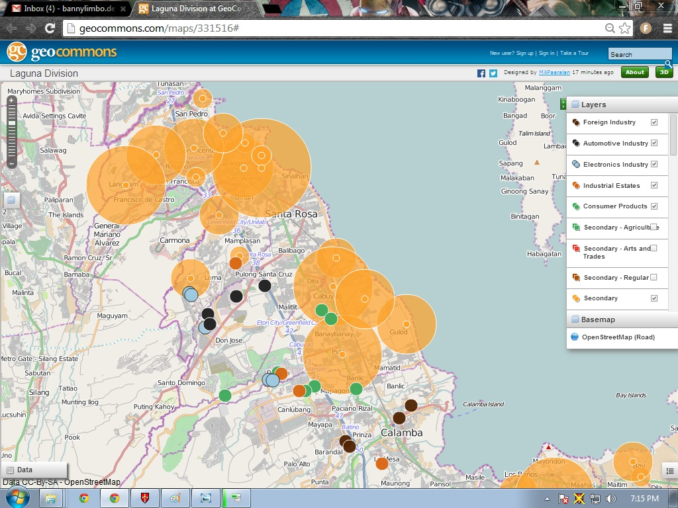
Types of Secondary Schools
Laguna International
Industrial Park 1
Nissan
Asia Brewery
Nestle Philippines
Toyota
Ford Philippines
Light Industry Science Park 1
Silangan Industrial Park
Universal Robina Corp
Honda Cars
Light Industry Science Park 2
Notes:
Plain – Shows the secondary schools and population
Click 1 – Industrial Estates
Click 2 – Automotive Indutries
Click 3 – Food Industry
Click 4 - ALL

Slide 69
Maraming Salamat!
Notes:
Now that we have understood the context, development process, and features of the K to 12 Curriculum, we should be better equipped in making informed decisions and improving learning outcomes.
The best curricula is contextualized by those implementing it.
What has been presented is the INTENDED curriculum. It is now up to us to ensure that this enhanced curriculum truly transforms our schools and communities.
With the best of our abilities, let’s do all that we can for the Filipino learner.
Maraming salamat po!

