Slide 1
BUILDING EMERGENCY
EVACUATION PLAN IN SCHOOLS

Slide 2
LEGAL BASIS
SEC. 8 OF PD 1566 – “Drills and Exercises”
Organizational and community drills shall be conducted and to be repeated periodically. Such drills shall be supervised by the department or agency concerned.
Source: OCD BEEP Training File
MISAMIS ORIENTAL PROVINCIAL DISASTER RISK REDUCTION & MANAGEMENT OFFICE

Slide 3
LEGAL BASIS
SEC. 14. of R.A. No. 10121 -
Integration of Disaster Risk Reduction Education into the School Curricula and Sangguniang Kabataan (SK) Program and Mandatory Training for the Public Sector Employees.
Source: OCD BEEP Training File
MISAMIS ORIENTAL PROVINCIAL DISASTER RISK REDUCTION & MANAGEMENT OFFICE

Slide 4
OBJECTIVES
To ensure the safety of administrators, staff, students, and employees during and after a damaging earthquake;
To help agency administrators and their disaster action groups to design a specific response plan for the workplace;
Source: OCD BEEP Training File
MISAMIS ORIENTAL PROVINCIAL DISASTER RISK REDUCTION & MANAGEMENT OFFICE

Slide 5
OBJECTIVES
To train supervisors, office staffs and personnel on the proper actions and response during an earthquake; and
To test various elements of the response plan designed by the School Disaster Management Committee (SDMC).
Source: OCD BEEP Training File
MISAMIS ORIENTAL PROVINCIAL DISASTER RISK REDUCTION & MANAGEMENT OFFICE

Slide 6
EARTHQUAKE
A weak to violent shaking of the ground produced by the sudden movement of rock materials below the earth’s surface.
Source: OCD BEEP Training File
MISAMIS ORIENTAL PROVINCIAL DISASTER RISK REDUCTION & MANAGEMENT OFFICE

Slide 7
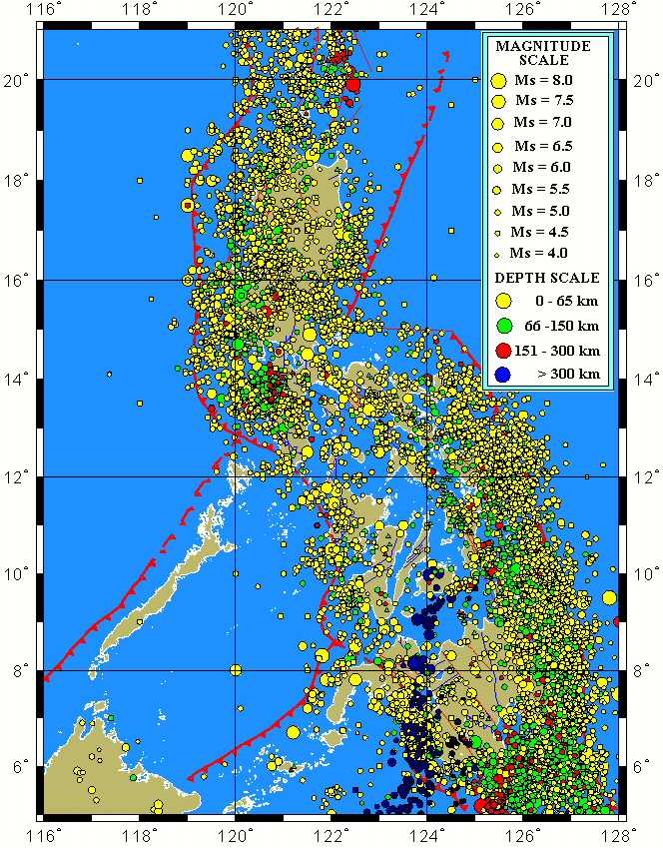
RP EARTHQUAKE SEISMICITY MAP
at least 20 earthquakes per day
4 – 5 felt earthquakes per week
Source: OCD BEEP Training File
MISAMIS ORIENTAL PROVINCIAL DISASTER RISK REDUCTION & MANAGEMENT OFFICE

Slide 8
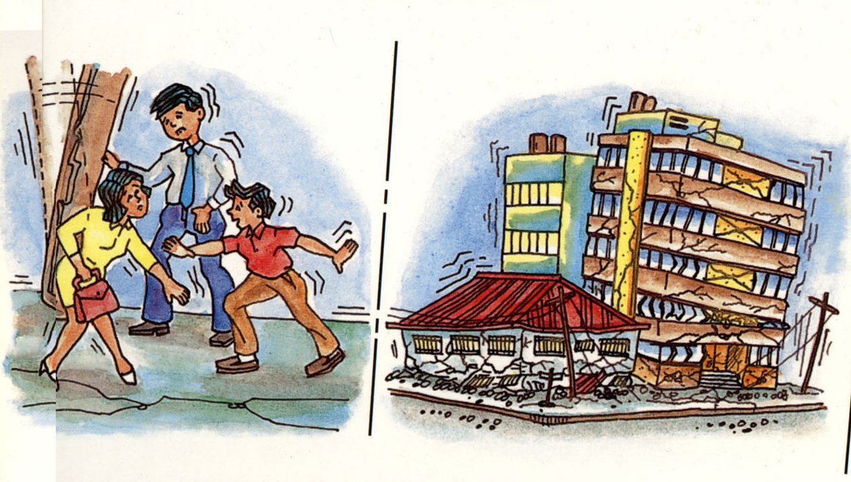
2 WAYS TO DESCRIBE THE EQ’s STRENGTH
1. Intensity
perceived strength of an earthquake based on relative effect to people and structures; generally higher near the epicenter.
Source: OCD BEEP Training File
MISAMIS ORIENTAL PROVINCIAL DISASTER RISK REDUCTION & MANAGEMENT OFFICE

Slide 9
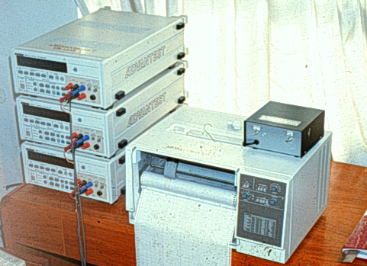
2 WAYS TO DESCRIBE THE EQ’s STRENGTH
2. Magnitude
based on instrumentally derived information and correlates strength with the amount of total energy released at the earthquake’s point of origin.
Source: OCD BEEP Training File
MISAMIS ORIENTAL PROVINCIAL DISASTER RISK REDUCTION & MANAGEMENT OFFICE

Slide 10
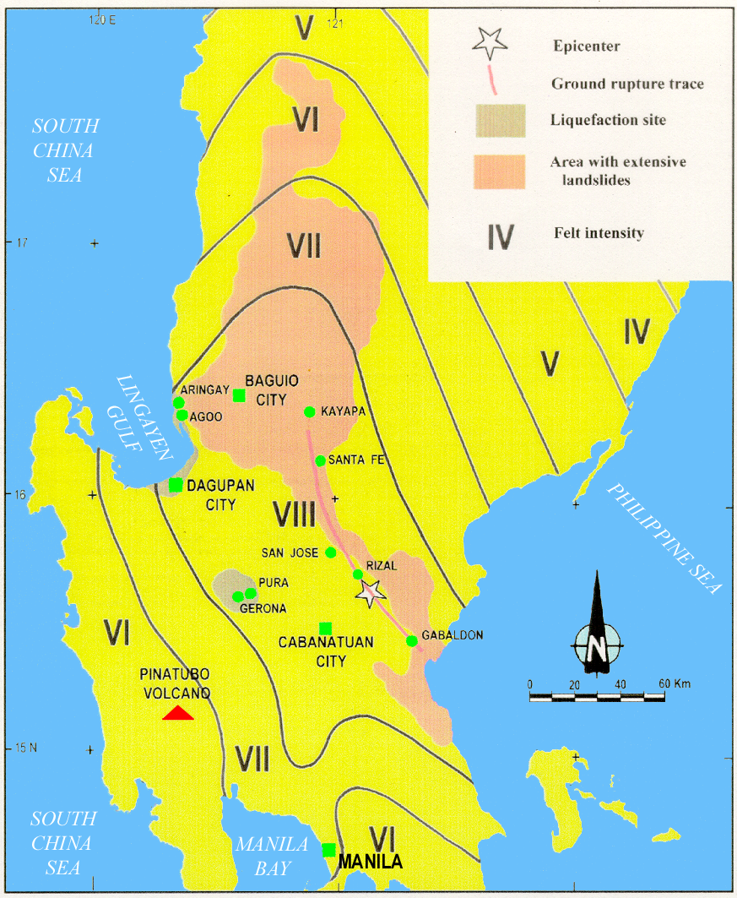
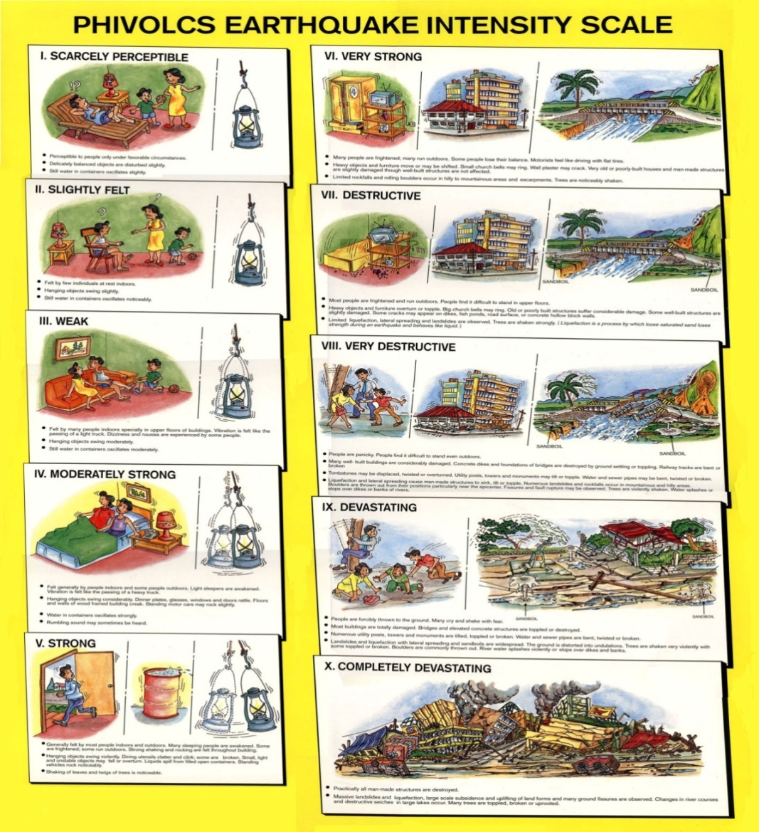
INTENSITY
Source: OCD BEEP Training File
MISAMIS ORIENTAL PROVINCIAL DISASTER RISK REDUCTION & MANAGEMENT OFFICE

Slide 11
PHILIPPINE EQ INTENSITY SCALE
INTENSITY SCALE | DESCRIPTION
I | Scarcely Perceptible - Perceptible to people under favorable circumstances. Delicately balanced objects are disturbed slightly. Still Water in containers oscillates slowly.
II | Slightly Felt - Felt by few individuals at rest indoors. Hanging objects swing slightly. Still Water in containers oscillates noticeably.
III | Weak - Felt by many people indoors especially in upper floors of buildings. Vibration is felt like one passing of a light truck. Dizziness and nausea are experienced by some people. Hanging objects swing moderately. Still water in containers oscillates moderately.
Source: OCD BEEP Training File
MISAMIS ORIENTAL PROVINCIAL DISASTER RISK REDUCTION & MANAGEMENT OFFICE

Slide 12
PHILIPPINE EQ INTENSITY SCALE
INTENSITY SCALE | DESCRIPTION
IV | Moderately Strong - Felt generally by people indoors and by some people outdoors. Light sleepers are awakened. Vibration is felt like a passing of heavy truck. Hanging objectsswing considerably. Dinner, plates, glasses, windows and doors rattle. Floors and walls of wood framed buildings creak. Standing motor cars may rock slightly. Liquids in containers are slightly disturbed. Water in containers oscillate strongly. Rumbling sound may sometimes be heard.
Source: OCD BEEP Training File
MISAMIS ORIENTAL PROVINCIAL DISASTER RISK REDUCTION & MANAGEMENT OFFICE

Slide 13
PHILIPPINE EQ INTENSITY SCALE
INTENSITY SCALE | DESCRIPTION
V | Strong - Generally felt by most people indoors and outdoors. Many sleeping people are awakened. Some are frightened, some run outdoors. Strong shaking and rocking felt throughout building. Hanging objects swing violently. Dining utensils clatter and clink; some are broken. Small, light and unstable objects may fall or overturn. Liquids spill from filled open containers. Standing vehicles rock noticeably. Shaking of leaves and twigs of trees are noticeable.
Source: OCD BEEP Training File
MISAMIS ORIENTAL PROVINCIAL DISASTER RISK REDUCTION & MANAGEMENT OFFICE

Slide 14
PHILIPPINE EQ INTENSITY SCALE
INTENSITY SCALE | DESCRIPTION
VI | Very Strong - Many people are frightened; many run outdoors. Some people lose their balance. motorists feel like driving in flat tires. Heavy objects or furniture move or may be shifted. Small church bells may ring. Wall plaster may crack. Very old or poorly built houses and man-made structures are slightly damaged though well-built structures are not affected. Limited rockfalls and rolling boulders occur in hilly to mountainous areas and escarpments. Trees are noticeably shaken.
Source: OCD BEEP Training File
MISAMIS ORIENTAL PROVINCIAL DISASTER RISK REDUCTION & MANAGEMENT OFFICE

Slide 15
PHILIPPINE EQ INTENSITY SCALE
INTENSITY SCALE | DESCRIPTION
VII | Destructive - Most people are frightened and run outdoors. People find it difficult to stand in upper floors. Heavy objects and furniture overturn or topple. Big church bells may ring. Old or poorly-built structures suffer considerably damage. Some well-built structures are slightly damaged. Some cracks may appear on dikes, fish ponds, road surface, or concrete hollow block walls. Limited liquefaction, lateral spreading and landslides are observed. Trees are shaken strongly. (Liquefaction is a process by which loose saturated sand lose strength during an earthquake and behave like liquid).
Source: OCD BEEP Training File
MISAMIS ORIENTAL PROVINCIAL DISASTER RISK REDUCTION & MANAGEMENT OFFICE

Slide 16
PHILIPPINE EQ INTENSITY SCALE
INTENSITY SCALE | DESCRIPTION
VIII | Very Destructive - People panicky. People find it difficult to stand even outdoors. Many well-built buildings are considerably damaged. Concrete dikes and foundation of bridges are destroyed by ground settling or toppling. Railway tracks are bent or broken. Tombstones may be displaced, twisted or overturned. Utility posts, towers and monuments mat tilt or topple. Water and sewer pipes may be bent, twisted or broken. Liquefaction and lateral spreading cause man- made structure to sink, tilt or topple. Numerous landslides and rockfalls occur in mountainous and hilly areas. Boulders are thrown out from their positions particularly near the epicenter. Fissures and faults rapture may be observed. Trees are violently shaken. Water splash or stop over dikes or banks of rivers.
Source: OCD BEEP Training File
MISAMIS ORIENTAL PROVINCIAL DISASTER RISK REDUCTION & MANAGEMENT OFFICE

Slide 17
PHILIPPINE EQ INTENSITY SCALE
INTENSITY SCALE | DESCRIPTION
IX | Devastating - People are forcibly thrown to ground. Many cry and shake with fear. Most buildings are totally damaged. bridges and elevated concrete structures are toppled or destroyed. Numerous utility posts, towers and monument are tilted, toppled or broken. Water sewer pipes are bent, twisted or broken. Landslides and liquefaction with lateral spreadings and sandboils are widespread. the ground is distorted into undulations. Trees are shaken very violently with some toppled or broken. Boulders are commonly thrown out. River water splashes violently on slops over dikes and banks.
Source: OCD BEEP Training File
MISAMIS ORIENTAL PROVINCIAL DISASTER RISK REDUCTION & MANAGEMENT OFFICE

Slide 18
PHILIPPINE EQ INTENSITY SCALE
INTENSITY SCALE | DESCRIPTION
X | Completely Devastating - Practically all man-made structures are destroyed. Massive landslides and liquefaction, large scale subsidence and uplifting of land forms and many ground fissures are observed. Changes in river courses and destructive seiches in large lakes occur. Many trees are toppled, broken and uprooted.
Source: OCD BEEP Training File
MISAMIS ORIENTAL PROVINCIAL DISASTER RISK REDUCTION & MANAGEMENT OFFICE

Slide 19
ACTIVE FAULTS and TRENCHES IN RP
Source: OCD BEEP Training File
MISAMIS ORIENTAL PROVINCIAL DISASTER RISK REDUCTION & MANAGEMENT OFFICE

Slide 20
DISTRIBUTION OF ACTIVE FAULTS IN MINDANAO
Source: OCD BEEP Training File
MISAMIS ORIENTAL PROVINCIAL DISASTER RISK REDUCTION & MANAGEMENT OFFICE

Slide 21
WHAT TO DO BEFORE AN EARTHQUAKE?
The key to effective disaster prevention is PLANNING.
Determine if site is along an active fault and/or prone to liquefaction or landslide.
Use proper structural design and engineering practice when constructing a house or building.
Evaluate structural soundness of buildings and important infrastructures; strengthen or retrofit if found necessary.
Source: OCD BEEP Training File
MISAMIS ORIENTAL PROVINCIAL DISASTER RISK REDUCTION & MANAGEMENT OFFICE

Slide 22
WHAT TO DO BEFORE AN EARTHQUAKE?
Familiarize yourself with your place of work and residence.
Identify relatively strong parts of the building where you can take refuge during an earthquake:
door jambs
elevator shafts
sturdy tables
Source: OCD BEEP Training File
MISAMIS ORIENTAL PROVINCIAL DISASTER RISK REDUCTION & MANAGEMENT OFFICE

Slide 23
WHAT TO DO BEFORE AN EARTHQUAKE?
Learn to use fire extinguishers, first aid kits, alarms and emergency exits.
These should be accessible; conveniently located and properly marked.
Source: OCD BEEP Training File
MISAMIS ORIENTAL PROVINCIAL DISASTER RISK REDUCTION & MANAGEMENT OFFICE

Slide 24
WHAT TO DO BEFORE AN EARTHQUAKE?
Prepare your place of work and residence for the event.
Strap heavy furniture to walls to prevent sliding or toppling.
Store breakable items, harmful chemicals and flammable materials in lower most shelves and secure firmly.
Turn off gas tanks when not in use.
Source: OCD BEEP Training File
MISAMIS ORIENTAL PROVINCIAL DISASTER RISK REDUCTION & MANAGEMENT OFFICE

Slide 25
WHAT TO DO BEFORE AN EARTHQUAKE?
Keep heavy materials in lower shelves.
Check stability of hanging objects.
Maintain an earthquake survival kit.
Source: OCD BEEP Training File
MISAMIS ORIENTAL PROVINCIAL DISASTER RISK REDUCTION & MANAGEMENT OFFICE

Slide 26
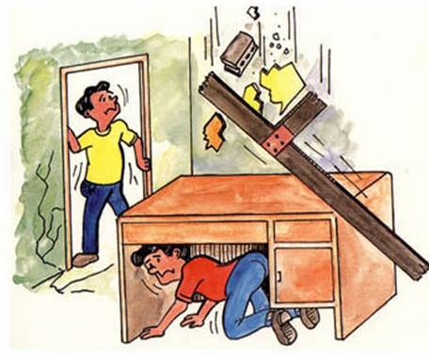
WHAT TO DO DURING AN EARTHQUAKE?
If inside a structurally sound building, stay there!
Protect your body from falling debris by bracing yourself in a doorway or by getting under a sturdy desk or table.
Source: OCD BEEP Training File
MISAMIS ORIENTAL PROVINCIAL DISASTER RISK REDUCTION & MANAGEMENT OFFICE

Slide 27
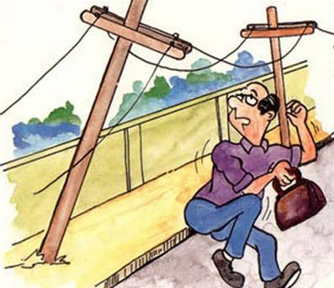
WHAT TO DO DURING AN EARTHQUAKE?
If outside, move to an open area.
Get away from power lines, posts, walls and other structures that may fall or collapse.
Source: OCD BEEP Training File
MISAMIS ORIENTAL PROVINCIAL DISASTER RISK REDUCTION & MANAGEMENT OFFICE

Slide 28
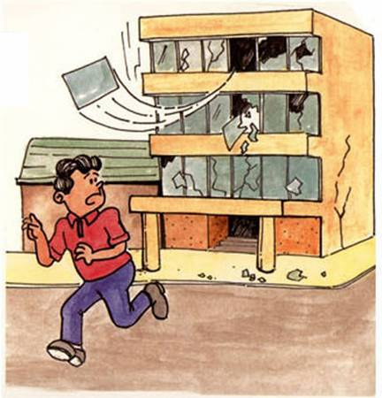
WHAT TO DO DURING AN EARTHQUAKE?
If outside, move to an open area.
Stay away from buildings with glass panes.
Source: OCD BEEP Training File
MISAMIS ORIENTAL PROVINCIAL DISASTER RISK REDUCTION & MANAGEMENT OFFICE

Slide 29
WHAT TO DO DURING AN EARTHQUAKE?
If along the shore and you feel an earthquake, strong enough to make standing difficult.
Run away from the shore toward higher ground.
Source: OCD BEEP Training File
MISAMIS ORIENTAL PROVINCIAL DISASTER RISK REDUCTION & MANAGEMENT OFFICE

Slide 30
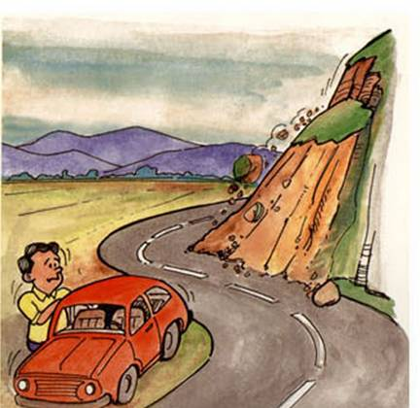
WHAT TO DO DURING AN EARTHQUAKE?
If on a mountain, or near a steep hill slope, move away from steep escarpments which may be affected by landslides
Source: OCD BEEP Training File
MISAMIS ORIENTAL PROVINCIAL DISASTER RISK REDUCTION & MANAGEMENT OFFICE

Slide 31
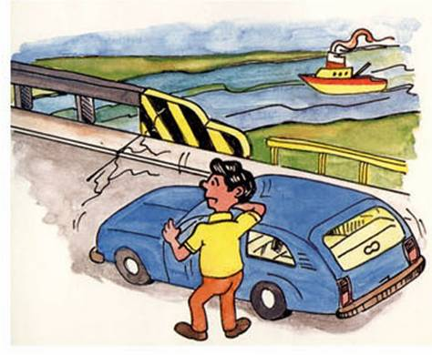
WHAT TO DO DURING AN EARTHQUAKE?
When driving a vehicle, pull to the side of the road and stop.
Do not attempt to cross bridges or overpasses which may have been damaged.
Source: OCD BEEP Training File
MISAMIS ORIENTAL PROVINCIAL DISASTER RISK REDUCTION & MANAGEMENT OFFICE

Slide 32
WHAT TO DO AFTER AN EARTHQUAKE?
If inside an old, weak structure, take the Fastest and safest way out!
Get out calmly in an orderly manner. Do not rush to the exit.
Use the stairs. Do not use elevators.
Check yourself and others for injuries.
Source: OCD BEEP Training File
MISAMIS ORIENTAL PROVINCIAL DISASTER RISK REDUCTION & MANAGEMENT OFFICE

Slide 33
WHAT TO DO AFTER AN EARTHQUAKE?
Check surroundings.
Clean up chemical spills, toxic flammable materials to avoid any chain of unwanted events.
Check for fire and if any, have it controlled.
Check water and electrical lines for defects. If any damage is suspected, turn the system off in the main valve or switch.
Source: OCD BEEP Training File
MISAMIS ORIENTAL PROVINCIAL DISASTER RISK REDUCTION & MANAGEMENT OFFICE

Slide 34
WHAT TO DO AFTER AN EARTHQUAKE?
If you must evacuate your residence, leave a message stating where you are going.
Take with you your earthquake survival kit, which should contain all necessary items for your protection and comfort.
Source: OCD BEEP Training File
MISAMIS ORIENTAL PROVINCIAL DISASTER RISK REDUCTION & MANAGEMENT OFFICE

Slide 35
WHAT TO DO AFTER AN EARTHQUAKE?
Help reduce the number of casualties from the earthquake
Don’t enter partially damaged building, strong aftershocks may cause these to collapse.
Gather information and disaster prevention instruction from battery-operated radios.
Obey public safety precautions.
Source: OCD BEEP Training File
MISAMIS ORIENTAL PROVINCIAL DISASTER RISK REDUCTION & MANAGEMENT OFFICE

Slide 36
PRE-EARTHQUAKE DRILL PROCEDURES
Follow guidelines on what to do before an earthquake;
Conduct a building watching exercise to identify safe and unsafe spots;
Prepare earthquake crisis evacuation routes; and
Prepare a master plan for earthquake crisis with definition of roles of different committees
Source: OCD BEEP Training File
MISAMIS ORIENTAL PROVINCIAL DISASTER RISK REDUCTION & MANAGEMENT OFFICE

Slide 37
ORGANIZATIONAL CHART
Overall Coordinator
Site Security
Head
Evacuation
Head
First Aid
Head
Fire Safety
Head
Communication
Head
Search &
Rescue Head
Ground
Maintenance
Head
Assistants
Marshalls
Perimeter
Guards
Source: OCD BEEP Training File
MISAMIS ORIENTAL PROVINCIAL DISASTER RISK REDUCTION & MANAGEMENT OFFICE

Slide 38
SPECIFIC TASKS
Overall Coordinator – confirms emergency situation and coordinates with all crew heads.
Source: OCD BEEP Training File
MISAMIS ORIENTAL PROVINCIAL DISASTER RISK REDUCTION & MANAGEMENT OFFICE

Slide 39
SPECIFIC TASKS
Site Security Head – gives instructions to guards and make sure only authorized personnel are allowed to enter premises for the search/rescue/salvage operation.
a. Assistants – assume position of Site Security Head in case latter is not available.
b. Perimeter Guards – cordon and guard properties left behind.
Source: OCD BEEP Training File
MISAMIS ORIENTAL PROVINCIAL DISASTER RISK REDUCTION & MANAGEMENT OFFICE

Slide 40
SPECIFIC TASKS
Evacuation Head – takes charge of final head count.
a. Marshalls – direct the flow of evacuation.
First Aid Head – provides first aid treatment and coordinates with the hospital.
Fire Safety Head – instructs crew members of the necessary response.
Communication Head – coordinated with the Overall Coordinator and crew heads in sending out the alarm.
Source: OCD BEEP Training File
MISAMIS ORIENTAL PROVINCIAL DISASTER RISK REDUCTION & MANAGEMENT OFFICE

Slide 41
SPECIFIC TASKS
Search & Rescue Head – takes charge of rescue and retrieval.
a. Search – searches for dead bodies
b. Rescue – rescues the injured
c. Salvage – retrieves property
Ground Maintenance Head – gives instructions to crew members.
a. Genset Power Operator – turns off power lines
b. Ground Clearing – clears the ground for debris
Source: OCD BEEP Training File
MISAMIS ORIENTAL PROVINCIAL DISASTER RISK REDUCTION & MANAGEMENT OFFICE

Slide 42
FIRE DRILL VS. EARTHQUAKE DRILL
FIRE DRILL
EARTHQUAKE DRILL
Siren/Bell Alarm
( Fire )
Siren/Bell Alarm
( Earthquake )
Duck, Cover, and Hold
While the siren/bell is
ongoing
Evacuate the building
while the siren/bell is
ongoing
Evacuate after the
siren/bell
Source: OCD BEEP Training File
MISAMIS ORIENTAL PROVINCIAL DISASTER RISK REDUCTION & MANAGEMENT OFFICE

Slide 43
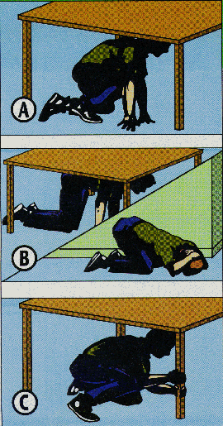
EARTHQUAKE DRILL PROCEDURE
1. ALARM PHASE:
Continuous ringing of siren/bell for one minute simulates ongoing earthquake.
RESPONSE:
DUCK, COVER and HOLD
Source: OCD BEEP Training File
MISAMIS ORIENTAL PROVINCIAL DISASTER RISK REDUCTION & MANAGEMENT OFFICE

Slide 44
EARTHQUAKE DRILL PROCEDURE
2. EVACUATION PHASE
=> alarm/siren stops (stop of shaking)
RESPONSE:
drill participants should:
start to evacuate the building;
proceed through predetermined routes; and
gather outside in a designated evacuation area.
Source: OCD BEEP Training File
MISAMIS ORIENTAL PROVINCIAL DISASTER RISK REDUCTION & MANAGEMENT OFFICE

Slide 45
EARTHQUAKE DRILL PROCEDURE
3. ASSEMBLY PHASE:
At the assembly area, groups from each floor must stay together.
4. HEADCOUNT PHASE:
During this phase, every section head/leader must determine if everyone is present or accounted for.
absent = casualty
Source: OCD BEEP Training File
MISAMIS ORIENTAL PROVINCIAL DISASTER RISK REDUCTION & MANAGEMENT OFFICE

Slide 46
EARTHQUAKE DRILL PROCEDURE
5. EVALUATION:
Must have evaluators to identify:
snags in the drill
problem areas or potential problem areas to rectify these problems for future earthquake drills or in actual earthquake scenario.
Source: OCD BEEP Training File
MISAMIS ORIENTAL PROVINCIAL DISASTER RISK REDUCTION & MANAGEMENT OFFICE

Slide 47
WHEN IS THE RIGHT TIME TO EVACUATE?
After a very strong earthquake with observed or felt Intensity of VI or higher in the area.
As need arises or as declared by authorities.
Source: OCD BEEP Training File
MISAMIS ORIENTAL PROVINCIAL DISASTER RISK REDUCTION & MANAGEMENT OFFICE

Slide 48
THANK YOU!!!

