Slide 1
COACHING

Slide 2
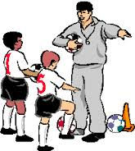

Slide 3
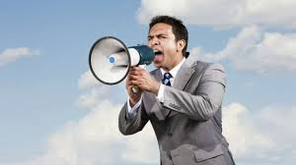

Slide 5
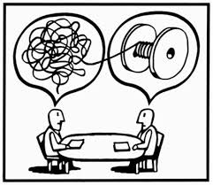

Slide 6
OBJECTIVES:
internalize the meaning of coaching and its relation to work;
apply coaching to the recent S2S PP; and
construct S2S coaching plan

Slide 7
Coaching Model for DepEd
Coach for Work Improvement
Know when to Coach
Application Opportunities
Coach for Maximum Performance
Coach to Strengthen Skills, Competencies and Behaviors
Build Awareness
Move to Action

Slide 8
Coach for Work Improvement
SMALL GROUP DISCUSSION
Coach for Maximum Performance
Coach to Strengthen Skills, Competencies and Behaviors
Notes:
Cite ways and instances in which you can COACH for/to…

Slide 9
WHAT IS COACHING?
Coaching is a useful way of developing people’s skills and abilities, and of boosting performance.

Slide 10
Coach for
Work Improvement

Slide 11
COACH FOR WORK IMPROVEMENT
Identify Performance Gaps – Performance Gaps are the difference between a current performance and what is required.
Behavior or skill or both?

Slide 12
Start with a GOAL
How Coaching Works?
by Ashley Guberman
CURRENT REALITY
I want…
I need…
It is my intention to…
I would like to….
Why can’t I…
How do I…
Notes:
DYAD…

Slide 13
Start with a GOAL
How Coaching Works?
by Ashley Guberman
CURRENT REALITY
DESIRED REALITY
I want…
I need…
It is my intention to…
I would like to….
Why can’t I…
How do I…
Fitness
Relationship
Spirituality
Teamwork
Effectiveness
Leadership
Vision

Slide 14
Start with a GOAL
How Coaching Works?
by Ashley Guberman
CURRENT REALITY
DESIRED REALITY
GAP
I want…
I need…
It is my intention to…
I would like to….
Why can’t I…
How do I…
Fitness
Relationship
Spirituality
Teamwork
Effectiveness
Leadership
Vision

Slide 15
Start with a GOAL
How Coaching Works?
by Ashley Guberman
CURRENT DESIRED REALITY
I want…
I need…
It is my intention to…
I would like to….
Why can’t I…
How do I…
Fitness
Relationship
Spirituality
Teamwork
Effectiveness
Leadership
Vision

Slide 16
Start with a GOAL
How Coaching Works?
by Ashley Guberman
CURRENT DESIRED REALITY
I want…
I need…
It is my intention to…
I would like to….
Why can’t I…
How do I…
Fitness
Relationship
Spirituality
Teamwork
Effectiveness
Leadership
Vision

Slide 17
WHAT IS COACHING?
Coaching is a process that aims to improve performance and focuses on the ‘here and now’ rather than in the distant past or future.

Slide 18
COACHING – MENTORING - COUNSELLING
Learning Method | COACHING | MENTORING | COUNSEL-LING
The Question | How | What | Why
The Focus | The present | The future | The past
Aim | Improving skills | Developing and committing to learning goals | Overcoming psychological barriers
Objective | Raising competence | Opening horizons | Building self-understanding
skillsyouneed.com

Slide 19
COACHING IS
“a process that enables learning and development to occur and thus performance to improve…requires a knowledge and understanding of process as well as the variety of styles, skills and techniques that are appropriate to the context in which the coaching takes place”
Eric Parsloe, The Manager as Coach and Mentor (1999)

Slide 20
MENTORING IS
“off-line help by one person to another in making significant transitions in knowledge, work or thinking”
“a professional relationship in which a more-experienced (usually older) person helps a less-experienced (usually younger) person develop knowledge and skills that will help his professional and personal growth.”
David Clutterbuck & David Megginson are both founder members of The European Mentoring and Coaching Council

Slide 21
Coach for Maximum Performance

Slide 22
WHY AND WHEN DO WE DO IT?
For continuous performance improvement
For special assignments

Slide 23
WHY AND WHEN DO WE DO IT?
For developmental plans and promotion
For succession planning
For career development

Slide 24
Strengthening Skills, Competencies and Behaviors

Slide 25
WHY DO WE DO IT?
Develop closer working relationship between the coach and coachee
Boost morale and confidence of employees
Opportunity to develop new skills

Slide 26
WHY DO WE DO IT?
Cultivate and raise the level of culture of performance
Recognize outstanding performance
Leave a legacy for performance excellence

Slide 28
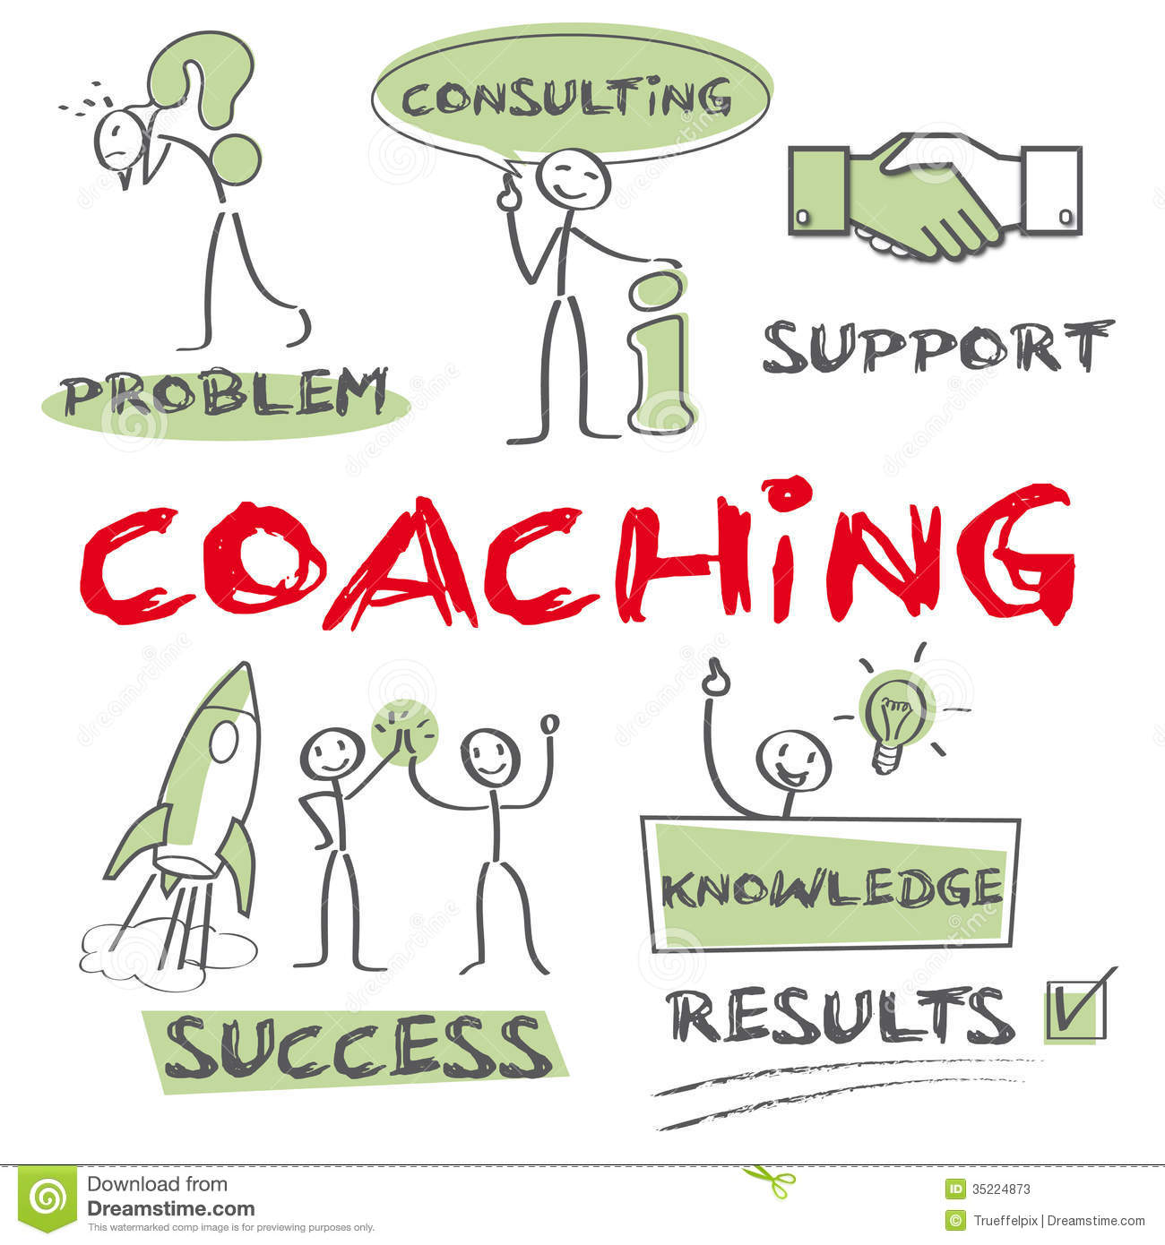

Slide 29
COACHING focuses on:
Exploring
Facilitating
Partnership
Long-term improvement
Many possible outcomes

Slide 30
Performance Coaching is NOT
advice giving and does not involve the coach sharing their experience or opinions
a one time process
fault finding and put the employee down

Slide 31
COMPETENCIES OF AN EFFECTIVE COACH
Self-clarity
Communication
Critical thinking
Build relationships and inspire

Slide 32
4-Step Process of Coaching

Slide 33
4-STEP PROCESS OF COACHING
OBSERVATION – identifies a performance gap or an opportunity to improve
DISCUSSION and AGREEMENT – Coach and coachee agree on (1) problems to be fixed (2) an opportunity to move job performance two notches higher.
ACTIVE COACHING – Coach and coachee create and agree on the action plan to address the gap
FOLLOW-UP – Setting follow-up sessions to check on the status of the agreed on action plan.

Slide 34
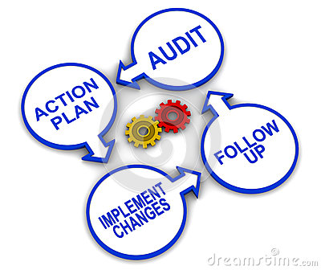
WHY FOLLOW-UP?
It provide opportunities to remind about goals and the importance of these goals
Periodic checks give you a chance to offer positive feedback about the good things that he/she do
These checks can help spot small problems before they become large ones.

Slide 35
More Guidelines and Tips in Coaching

Slide 36
ASK THE RIGHT QUESTIONS
Asking the right questions will help the coach to understand the coachee and get to the bottom of performance problems.
Two Forms of Questions:
Open-ended
Closed-ended

Slide 37
OPEN-ENDED QUESTIONS
These questions invite participation and idea sharing. These helps the coach to know the coachee’s feelings, views and deeper thoughts on the problem, and in turn help to formulate better advice.

Slide 38
OPEN-ENDED QUESTIONS
To explore alternatives: “What would happen if…?”
To uncover attitudes: “How do you feel about our progress to date?”
To establish priorities and allow elaboration: “What do you think the major issues are with this project?”

Slide 39
CLOSED-ENDED QUESTIONS
These questions lead to “YES” or “NO” answers
To focus the response:
“Is the program / plan on schedule?”
To confirm what the other person has said:
“So, your big problem is scheduling your time?”

Slide 40
ELEMENTS OF ACTION PLANS
A statement of the current situation
Specific goals
Timeline (Milestones of Progress)
Action steps
The coach’s and coachee’s role

Slide 41
SKILLS BUILDING – COACHING PLAN
Coach:
Coachee:
Current Reality
Desired Reality
WHY? | HOW? | WHO? | WHEN? | WHAT? | Measure of Success

Slide 43
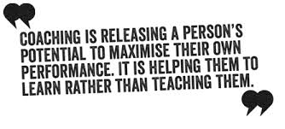

Slide 44
REFERENCES
Brown, D. (2011). An experiential approach to organization development. Boston, MA: Prentice Hall.
Clutterback, D. (2009). Coaching and mentoring in support of management development. In S. Armstrong & C. Fukami (Eds.) The SAGE Handbook of Management Learning, Education and Development (pp. 476-497). London: Sage Publications Ltd.
Emerson, B. & Loehr, A. (2008). A manager’s guide to coaching: Simple and effective ways to get the best out of your employees. New York: AMACOM.
Hechanova, M.R., Teng-Calleja, M. & Villaluz, V. (Eds.) Understanding the filipino worker and organization. Quezon City: Ateneo de Manila University Press.
Kotter, J. & Rathgeber, H. (2006). Our iceberg is melting: Changing and succeeding under any conditions. New York: St. Martin's Press.
Kouzes, J. & Posner, B. (2012). The leadership challenge: How to make extraordinary things happen in organizations (5th ed.). San Francisco, CA: Jossey-Bass.
Lawler, E. & Worley, C. (2006). Built to change: How to achieve sustained organizational effectiveness. San Francisco, CA: Jossey-Bass.
Middelberg, T. (2012). Transformational executive coaching: A relationship-based model for sustained change. Austin, TX: River Grove Books.
Neitlich, Andrew (2006). Elegant leadership: Simple strategies, remarkable results. San Anselmo, California: Chatham Business Press.
Ortigas, C. (2008). Group process and the inductive method: Theory and practice in the Philippines. Quezon City: Ateneo de Manila University Press.
Somers, Matt (2012). Successful coaching in a week: Teach yourself. Hachette, United Kingdom: Hodder.

Slide 45
REFERENCES
Video References:
Painless Performance Improvement – Purchased from http://www.media partners.com/coaching_training_videos/painless_performance_improvement.htm
How Coaching Works – https://www.youtube.com/watch?v=UY75MQte4RU
Coaching in the Workplace – https://www.youtube.com/watch?v=eKC6qNvI3Kw
Others:
A Manager’s Guide to Coaching: Simple and Effective Ways to Get the Best out of Your Employees [Abstract]. (2010). Retrieved from http://www.getabstract.com/en/summary/leadership-and-management/a-managers-guide-to-coaching/14459/

