Slide 1
Contingency planning
For
schools
MISAMIS ORIENTAL PROVINCIAL DISASTER RISK REDUCTION & MANAGEMENT OFFICE

Slide 2
CONTINGENCY PLANNING
UN High Commissioner for Refugees:
“A forward planning process, in a state of uncertainty, in which scenarios and objectives are agreed, managerial and technical actions defined, and potential response systems put in place in order to prevent or better respond to, an emergency or critical situation.”
MISAMIS ORIENTAL PROVINCIAL DISASTER RISK REDUCTION & MANAGEMENT OFFICE

Slide 3
CONTINGENCY PLANNING
Republic Act No. 10121:
“A management process that analyzes specific potential events in a state of uncertainty and establishes response arrangements in advance to enable timely, effective and appropriate responses to such events and situations.”
MISAMIS ORIENTAL PROVINCIAL DISASTER RISK REDUCTION & MANAGEMENT OFFICE

Slide 4
CONTINGENCY PLANNING
• A scenario- based plan for a specific and projected natural and/or human- induced hazard.
• Aims to address the impacts of the hazard and/or to prevent the occurrence of emerging threats by arranging well coordinated responses and enabling efficient management of resources.
• Contingency plan is the document resulting from the conduct of CP.
MISAMIS ORIENTAL PROVINCIAL DISASTER RISK REDUCTION & MANAGEMENT OFFICE

Slide 5
IMPORTANCE OF CP
• Helps ensure availability of resources
• Contributes to enhancing networking and coordination
• Helps to protect lives
MISAMIS ORIENTAL PROVINCIAL DISASTER RISK REDUCTION & MANAGEMENT OFFICE

Slide 6
WHEN IS THE BEST TIME TO CONDUCT
CONTINGENCY PLANNING?
MISAMIS ORIENTAL PROVINCIAL DISASTER RISK REDUCTION & MANAGEMENT OFFICE

Slide 7
ELEMENTS OF CP
When is the best time to conduct CP?
1. As early as NOW
2. LATER, when we have more information?
3. JUST BEFORE, the event to maximize information?
4. RIGHT AFTER the exact damage is known
MISAMIS ORIENTAL PROVINCIAL DISASTER RISK REDUCTION & MANAGEMENT OFFICE

Slide 8
ELEMENTS OF CP
What events needs CP?
Natural hazards
Human- induced hazards
Crises
Planned events
Sudden increase of displaced population
Sudden shortage of funding
Epidemic
MISAMIS ORIENTAL PROVINCIAL DISASTER RISK REDUCTION & MANAGEMENT OFFICE

Slide 9
ELEMENTS OF CP
Actors in CP?
MISAMIS ORIENTAL PROVINCIAL DISASTER RISK REDUCTION & MANAGEMENT OFFICE

Slide 10
ELEMENTS OF CP
Actors in CP?
• DRRM Focal Persons
• Relevant technical experts
• Relevant CSOs and private sector groups
• Private sector managers or individuals willing to commit resources, services or any other form of assistance
MISAMIS ORIENTAL PROVINCIAL DISASTER RISK REDUCTION & MANAGEMENT OFFICE

Slide 11
ELEMENTS OF CP
Actors in CP?
• Division/Unit Heads
Finance Officers
Planning Officers
Logistics Officers
Operation Officers
Human Resource Officers
Disaster Control Group members
MISAMIS ORIENTAL PROVINCIAL DISASTER RISK REDUCTION & MANAGEMENT OFFICE

Slide 12
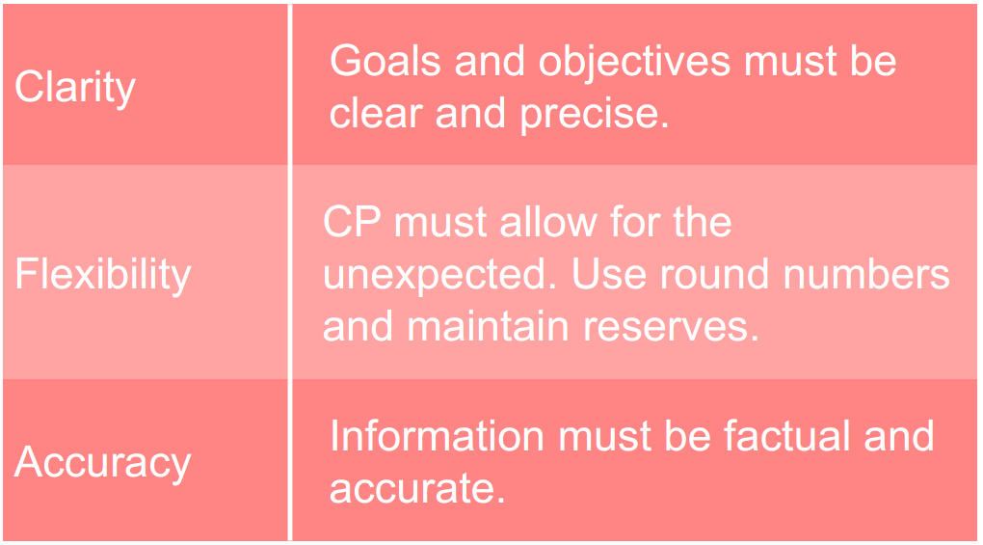
CRITERIA FOR A GOOD CP
MISAMIS ORIENTAL PROVINCIAL DISASTER RISK REDUCTION & MANAGEMENT OFFICE

Slide 13
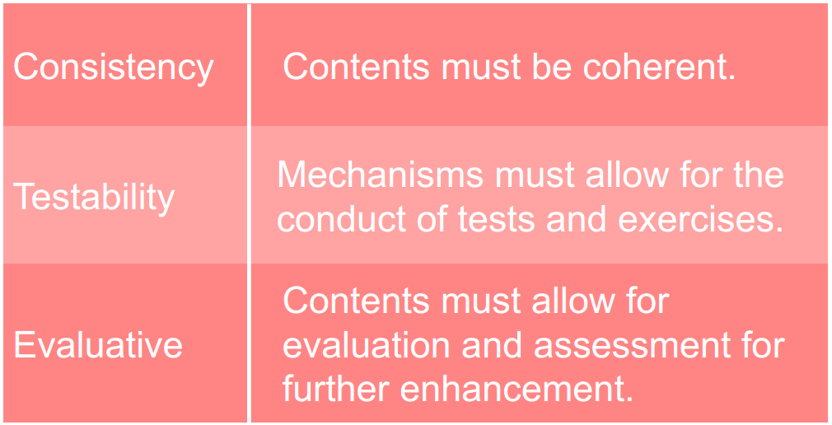
CRITERIA FOR A GOOD CP
MISAMIS ORIENTAL PROVINCIAL DISASTER RISK REDUCTION & MANAGEMENT OFFICE

Slide 14
COORDINATION
MISAMIS ORIENTAL PROVINCIAL DISASTER RISK REDUCTION & MANAGEMENT OFFICE

Slide 15
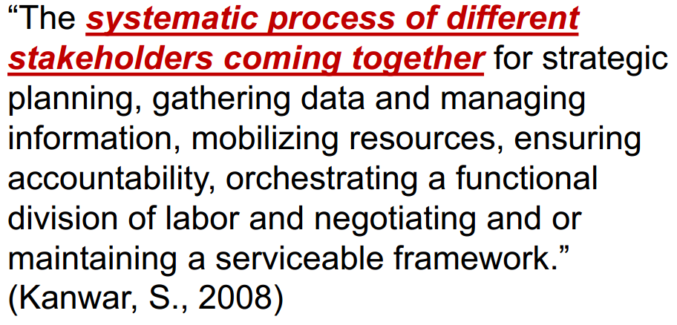
COORDINATION
MISAMIS ORIENTAL PROVINCIAL DISASTER RISK REDUCTION & MANAGEMENT OFFICE

Slide 16
BARRIERS TO COORDINATION
Threat to autonomy
Lack of trust
Fragmentation
Highly centralized and bureaucratic organization
Lack of CP skills, knowledge and experience and authority
Staff turnover
Ineffectual or inappropriate leadership
MISAMIS ORIENTAL PROVINCIAL DISASTER RISK REDUCTION & MANAGEMENT OFFICE

Slide 17
REMEMBER
MISAMIS ORIENTAL PROVINCIAL DISASTER RISK REDUCTION & MANAGEMENT OFFICE

Slide 18
DRRM
The systematic process of using administrative directives, organizations, and operational skills and capacities to implement strategies, policies and improved coping capacities in order to lessen the adverse impacts of hazards and the possibility of disaster
MISAMIS ORIENTAL PROVINCIAL DISASTER RISK REDUCTION & MANAGEMENT OFFICE

Slide 19
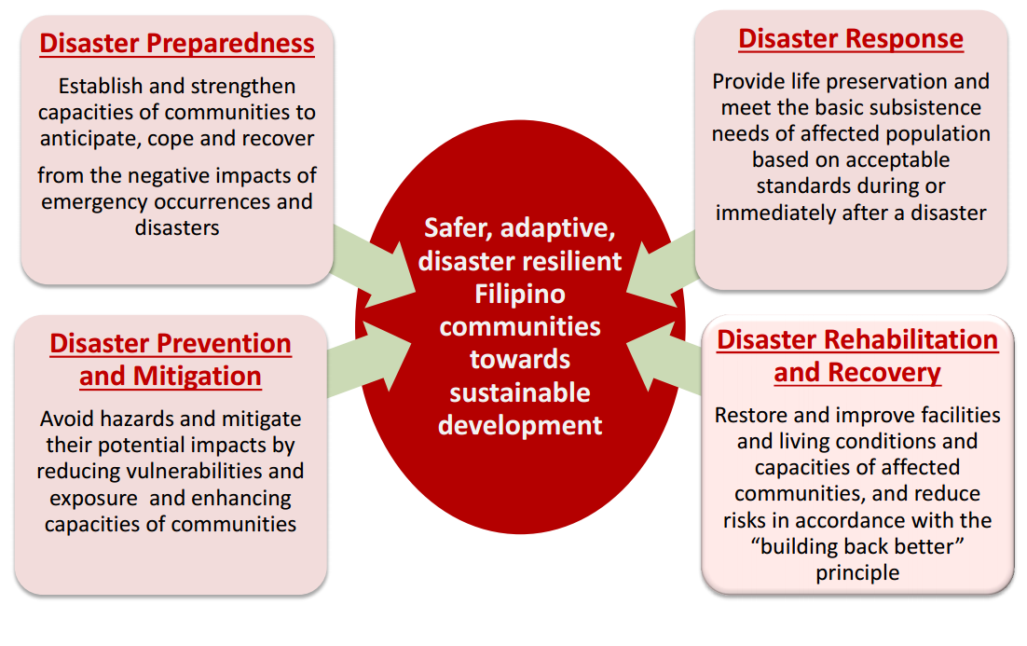
DRRM THEMATIC AREAS
MISAMIS ORIENTAL PROVINCIAL DISASTER RISK REDUCTION & MANAGEMENT OFFICE

Slide 20
EARLY WARNING SIGNS
Early warning signs are valuable indicators that allow prediction of a developing disaster or crisis.
MISAMIS ORIENTAL PROVINCIAL DISASTER RISK REDUCTION & MANAGEMENT OFFICE

Slide 21
EARLY WARNING SIGNS
Factors related to early warning signs:
• Root Causes– the underlying natural or human-induced causes of the hazard.
• Triggering Factors– factors that could trigger the unfolding of an event.
MISAMIS ORIENTAL PROVINCIAL DISASTER RISK REDUCTION & MANAGEMENT OFFICE

Slide 22
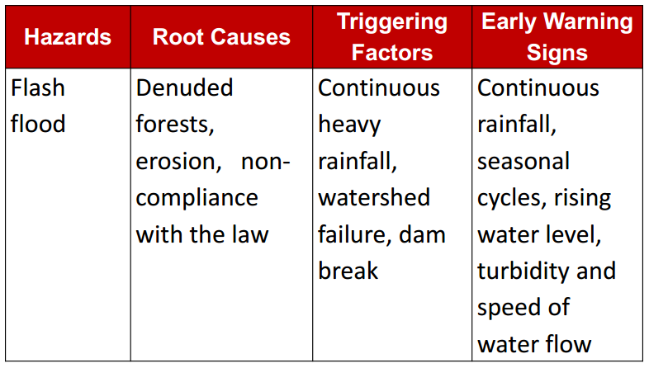
EARLY WARNING SIGNS
MISAMIS ORIENTAL PROVINCIAL DISASTER RISK REDUCTION & MANAGEMENT OFFICE

Slide 23
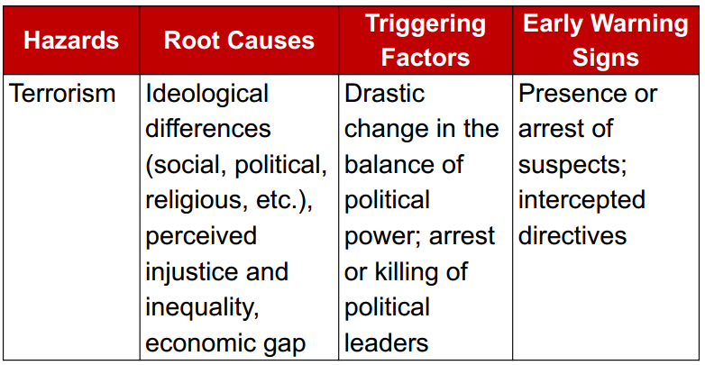
EARLY WARNING SIGNS
MISAMIS ORIENTAL PROVINCIAL DISASTER RISK REDUCTION & MANAGEMENT OFFICE

Slide 24
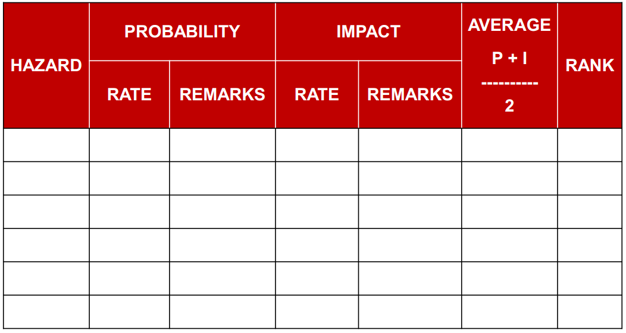
HAZARD IDENTIFICATION
MISAMIS ORIENTAL PROVINCIAL DISASTER RISK REDUCTION & MANAGEMENT OFFICE

Slide 25
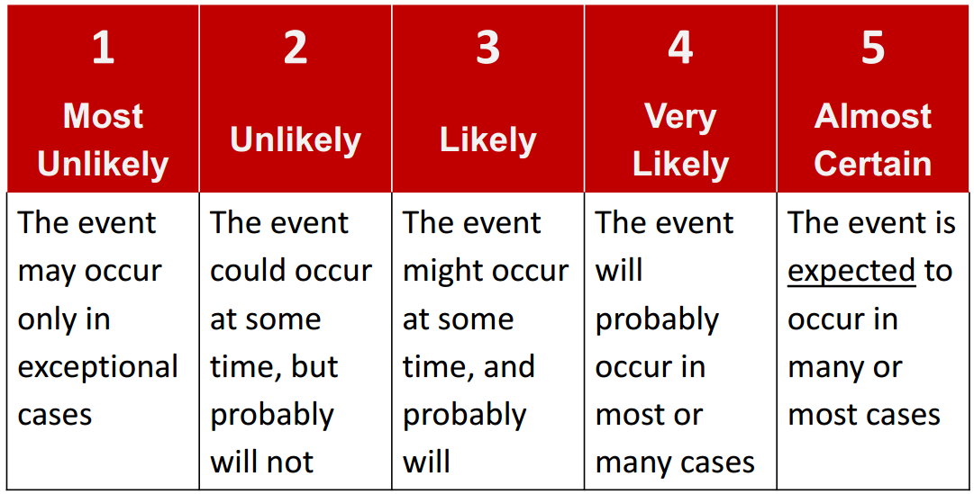
SAMPLE PROBABILTY SCALE
MISAMIS ORIENTAL PROVINCIAL DISASTER RISK REDUCTION & MANAGEMENT OFFICE

Slide 26
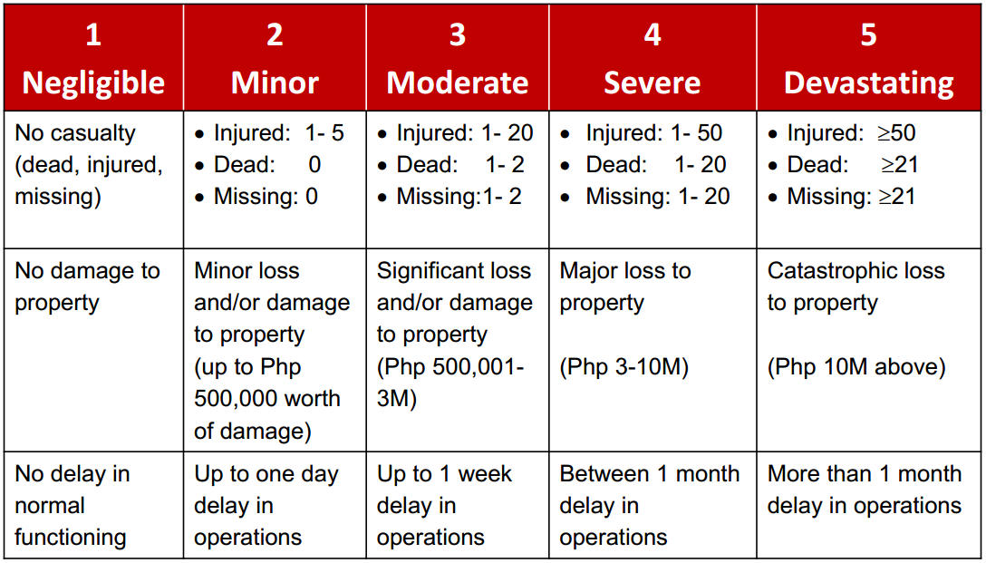
SAMPLE IMPACT SCALE
MISAMIS ORIENTAL PROVINCIAL DISASTER RISK REDUCTION & MANAGEMENT OFFICE

Slide 27
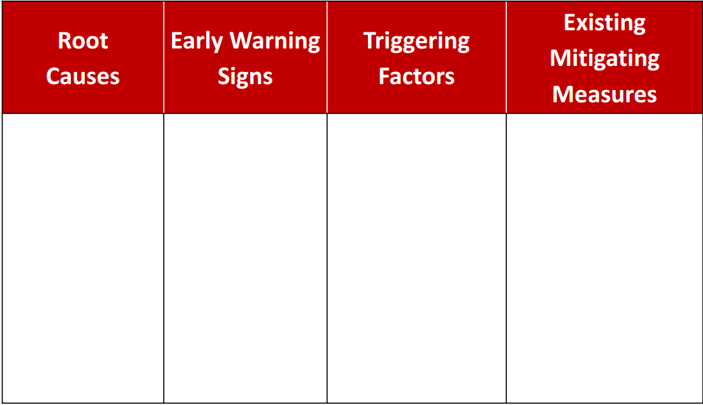
ANATOMY OF THE HAZARD
MISAMIS ORIENTAL PROVINCIAL DISASTER RISK REDUCTION & MANAGEMENT OFFICE

Slide 28
GOALS AND OBJECTIVES
State the overall goal(s) of the Contingency Plan, or the end state that a Contingency Plan aims to achieve.
MISAMIS ORIENTAL PROVINCIAL DISASTER RISK REDUCTION & MANAGEMENT OFFICE

Slide 29
GOALS AND OBJECTIVES
Enumerate the general objective(s) of the Contingency Plan to achieve the desired goal.
MISAMIS ORIENTAL PROVINCIAL DISASTER RISK REDUCTION & MANAGEMENT OFFICE

Slide 30
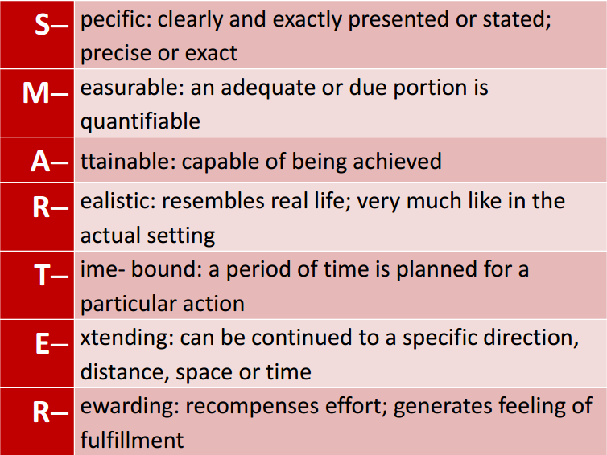
SMARTER OBJECTIVES
MISAMIS ORIENTAL PROVINCIAL DISASTER RISK REDUCTION & MANAGEMENT OFFICE

Slide 31
IMPORTANT
CP goal and objectives must be:
• Anchored to the relevant policies • Humanitarian in nature • Non- controversial • Beneficial to all end- users
MISAMIS ORIENTAL PROVINCIAL DISASTER RISK REDUCTION & MANAGEMENT OFFICE

Slide 32
COORDINATION COMMAND AND CONTROL
Overall Coordinator
Site Security
Head
Evacuation
Head
First Aid
Head
Fire Safety
Head
Communication
Head
Search &
Rescue Head
Ground
Maintenance
Head
Assistants
Marshalls
Perimeter
Guards
MISAMIS ORIENTAL PROVINCIAL DISASTER RISK REDUCTION & MANAGEMENT OFFICE

Slide 33
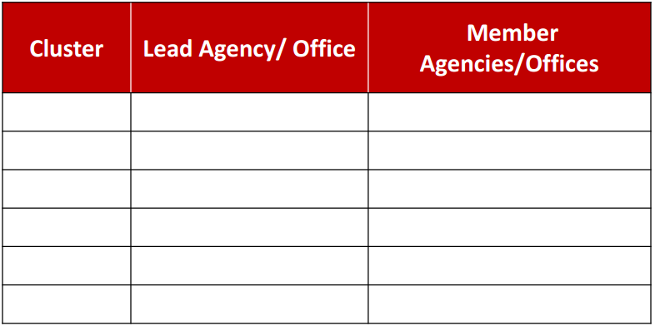
CLUSTER IDENTIFICATION
MISAMIS ORIENTAL PROVINCIAL DISASTER RISK REDUCTION & MANAGEMENT OFFICE

Slide 34
IMPORTANT
Not all of the clusters need to be activated.
Use of clusters depends on the local situation.
New clusters can be formed based on the actual need.
MISAMIS ORIENTAL PROVINCIAL DISASTER RISK REDUCTION & MANAGEMENT OFFICE

Slide 35
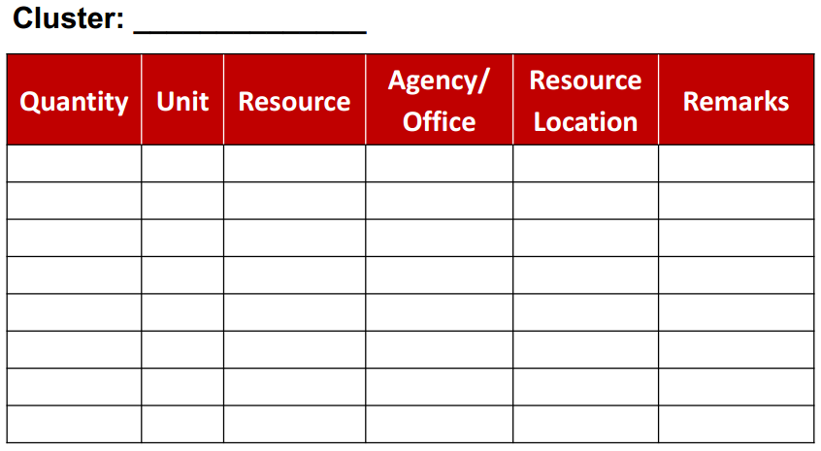
RESOURCE INVENTORY
MISAMIS ORIENTAL PROVINCIAL DISASTER RISK REDUCTION & MANAGEMENT OFFICE

Slide 36
INCIDENT COMMAND SYSTEM
The ICS is an on- scene response tool that shall be used to execute command and control functions to manage the consequences of natural and human- induced hazards.
MISAMIS ORIENTAL PROVINCIAL DISASTER RISK REDUCTION & MANAGEMENT OFFICE

Slide 37
INCIDENT MANAGEMENT TEAM
• Implementing arm of the Clusters
• Supported by Clusters in terms of resources
• Established based on incident size, complexity, and specific hazards
MISAMIS ORIENTAL PROVINCIAL DISASTER RISK REDUCTION & MANAGEMENT OFFICE

Slide 38
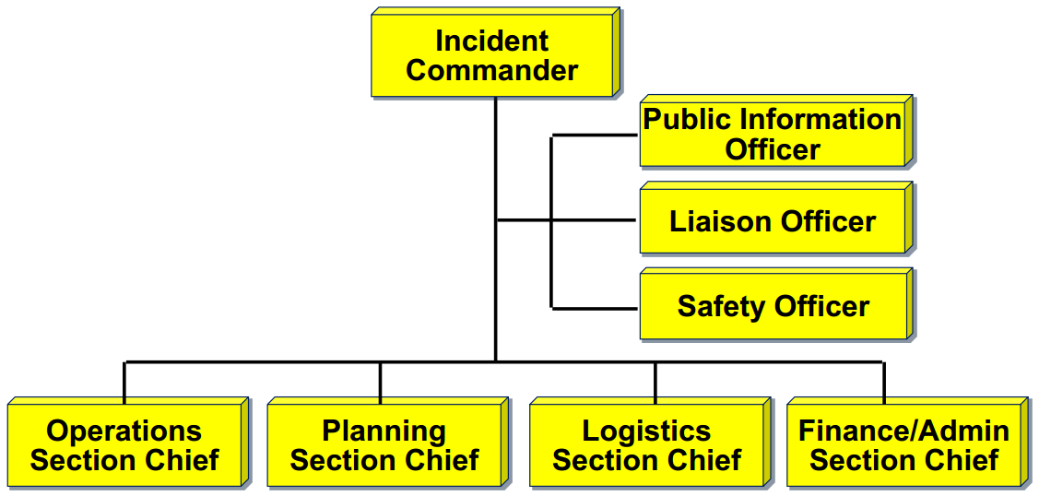
INCIDENT MANAGEMENT TEAM
MISAMIS ORIENTAL PROVINCIAL DISASTER RISK REDUCTION & MANAGEMENT OFFICE

Slide 39
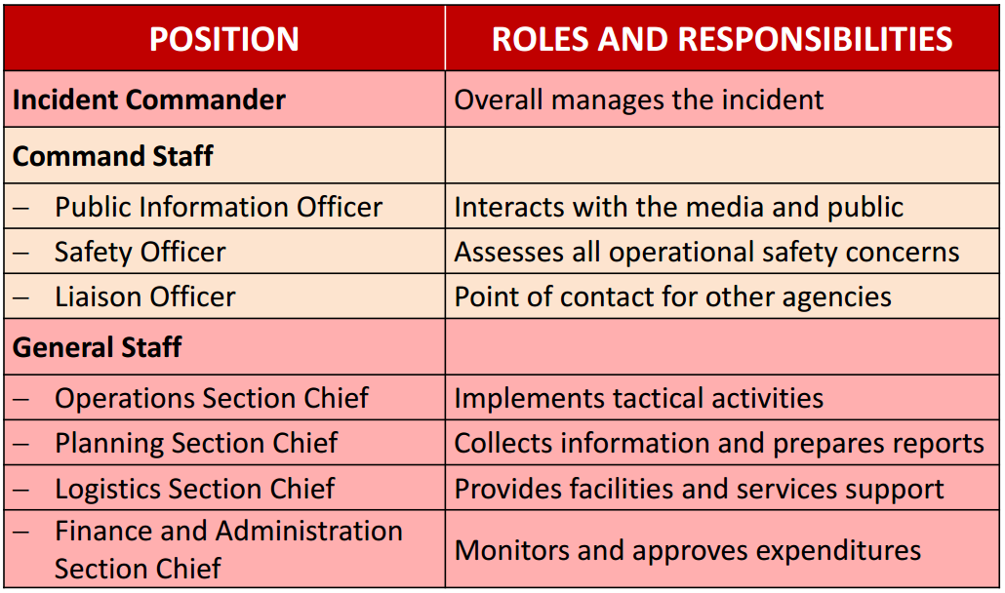
IMT ROLES AND RESPONSIBILITIES
MISAMIS ORIENTAL PROVINCIAL DISASTER RISK REDUCTION & MANAGEMENT OFFICE

Slide 40
ACTIVATION AND DE-ACTIVATION
Activation and De- activation:
Draw a flow chart to indicate how the Contingency Plan will be activated for implementation and de- activated after the operation.
2. Write a narrative to further describe the important components of the flow chart.
MISAMIS ORIENTAL PROVINCIAL DISASTER RISK REDUCTION & MANAGEMENT OFFICE

Slide 41
DAGHANG SALAMAT!!!
MISAMIS ORIENTAL PROVINCIAL DISASTER RISK REDUCTION & MANAGEMENT OFFICE

