Slide 1


Philippine 18-Day Campaign: November 25 to December 12
Global 16-Day of Activism against VAW: Nov 25 – Dec 10

Slide 2

HUMAN RIGHTS
WOMEN’S RIGHTS ARE
Image sourced from google.com .

Slide 3

There is unequal gender relations between women and men in society.
Subordination
Gender
Stereotyping
Marginalization
Multiple
Burden
Gender-Based Violence
DIMINISHED
PERSONHOOD

Slide 4

From gender issues to GAD Issues
Gender Stereotypes
Economic Marginalization
Multiple Burden
GENDER ROLES
Political Subordination
Violence against Women

Slide 5
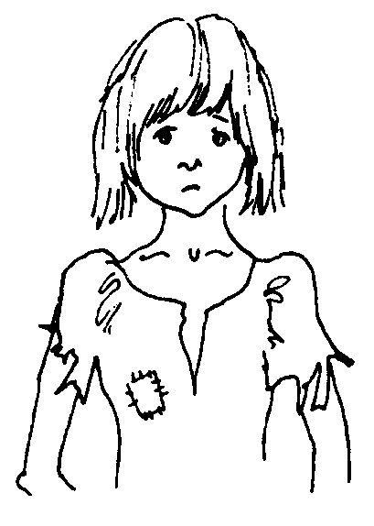
Traditional gender roles result in women and girls having less access to and control over resources and decision-making processes, compared to men and boys.
Have implications for life choices and chances.

Slide 6

Intersectionality of Discrimination
Trafficked
Old
Child
Internally-displaced
Indigenous people
Physical attributes
Language limitation
Non-literate
Minority Religion
Migrant
Disabled
Poor

Slide 7
Norms & Institutions
Resources

Slide 8



School
Church
Family
Government
Workplace
Mass Media
Gender roles are learned beginning in childhood through socialization. They are sanctioned, maintained and reinforced by social institutions.

Slide 9

RA 9710
An Act Providing for the the Magna Carta of Women

Slide 10
SEMINAR-ORIENTATION ON
The Magna Carta of Women
for DepEd Division of Misamis Oriental
5 December 2016
Lorelie S. Astrera

Slide 11
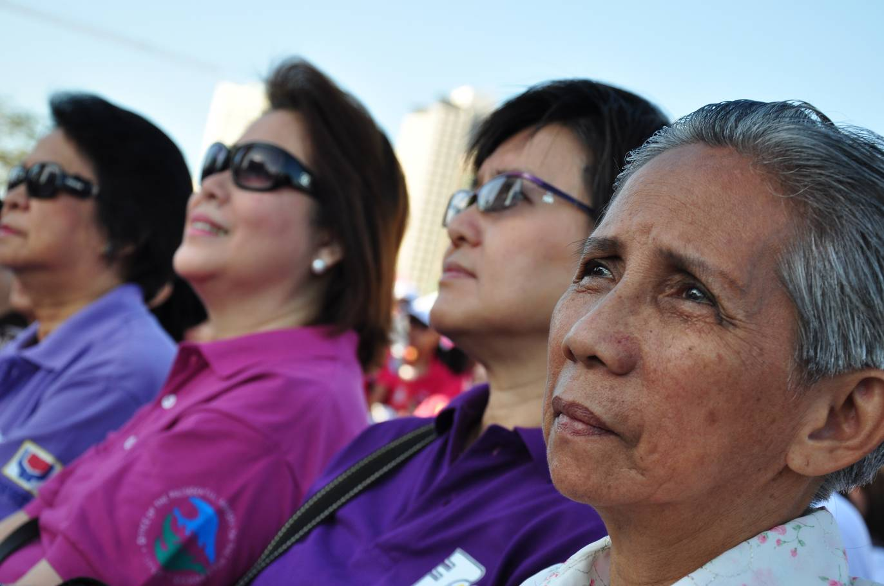
What’s In It For You?
Know your rights so you can enjoy them!
Know your rights and the accompanying responsibilities so you can partake in the promotion, protection and fulfillment of such rights!
  As individuals
  As citizens
  As civil servants

Slide 12
How can we make
this happen in the Philippines?
We all hold the key.
Notes:
12
12

Slide 13
Plan of Talk
The Policy Context: International and National Laws and Mandates on Women
Rights of Women under the Magna Carta of Women (general Rights and Rights of the Marginalized Women)
Institutional Mechanisms for the Implementation of the Magana Carta of Women
Monitoring the Progress of Implementation
Penalties
Open Forum
Notes:
13

Slide 14
The Convention on the Elimination of All Forms of Discrimination against Women (CEDAW)
adopted in 1979 by the UN General Assembly
often described as an international bill of rights for women, consisting of a preamble and 30 articles
defines what constitutes discrimination against women
sets up an agenda for national action to end such discrimination.

Slide 15
The Convention on the Elimination of All Forms of Discrimination against Women (CEDAW)
discrimination against women is "...any distinction, exclusion or restriction made on the basis of sex which has the effect or purpose of impairing or nullifying the recognition, enjoyment or exercise by women, irrespective of their marital status, on a basis of equality of men and women, of human rights and fundamental freedoms in the political, economic, social, cultural, civil or any other field."

Slide 16
The Convention on the Elimination of All Forms of Discrimination against Women (CEDAW)
States commit themselves…
to incorporate the principle of equality of men and women in their legal system, abolish all discriminatory laws and adopt appropriate ones prohibiting discrimination against women;
to establish tribunals and other public institutions to ensure the effective protection of women against discrimination; and
to ensure elimination of all acts of discrimination against women by persons, organizations or enterprises.

Slide 17

The Convention on the Elimination of All Forms of Discrimination against Women (CEDAW)
the only human rights treaty which affirms the reproductive rights of women
targets culture and tradition as influential forces shaping gender roles and family relations.

Slide 18

Beijing Platform for Action a framework for change to advance the human rights of women following the Fourth World Conference on Women in September 1995.
Women and the economy
Women and poverty
Education and training of women
Women and health
Human rights of women
Violence against women
The girl child
Women in power and decision-making
Women and the media
Women and armed conflict
Women and the environment
Institutional mechanisms for the advancement of women

Slide 19
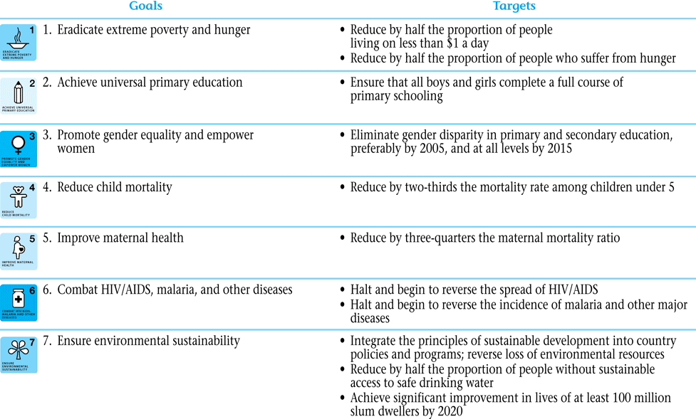
Millennium Development Goals (2000-2015)

Slide 20

1987 Philippine Constitution
(Art. II, Sec. 14)
“The State recognizes the role of women in nation-building and shall ensure the fundamental equality before the law of women and men.”
Notes:
20

Slide 21
Philippine Laws on Women before the Magna Carta
RA 7192 Women in Nation-Building Act of 1991
RA 7877 Anti-Sexual Harassment Act of 1995
RA 8353 Anti-Rape Act of 1997
RA 8505 Rape Victims Assistance Act of 1998
RA 9208 Anti-Trafficking in Persons Act of 2003
RA 9262 Anti-Violence against Women and Their Children Act of 2004
Annual General Appropriations Act
RA 9710 Magna Carta of Women of 2009
RA 10354 Reproductive Health Law of 2012
Notes:
21

Slide 22
The Magna Carta of Women
a comprehensive law that seeks to eliminate discrimination against women by recognizing, protecting, fulfilling and promoting the rights of Filipino women, especially those in the marginalized sectors.
It took effect on 15 September 2009.

Slide 23
Discrimination Against Women
  any gender-based distinction, exclusion, or restriction which has the effect or purpose of impairing or nullifying the recognition, enjoyment, or exercise by women of human rights and fundamental freedoms in the political, economic, social, cultural, civil or any other field irrespective of their marital status, on a basis of equality of men and women;
  any act or omission, including by law, policy, administrative measure, or practice, that directly or indirectly excludes or restricts women in the recognition and promotion of their rights and their access to and enjoyment of opportunities, benefits, or privileges;

Slide 24
Discrimination Against Women
  a measure or practice of general application that fails to provide for mechanisms to offset or address sex or gender-based disadvantages or limitations of women; and
  discrimination compounded by or intersecting with other grounds, status, or condition, such as ethnicity, age, poverty, or religion.

Slide 25
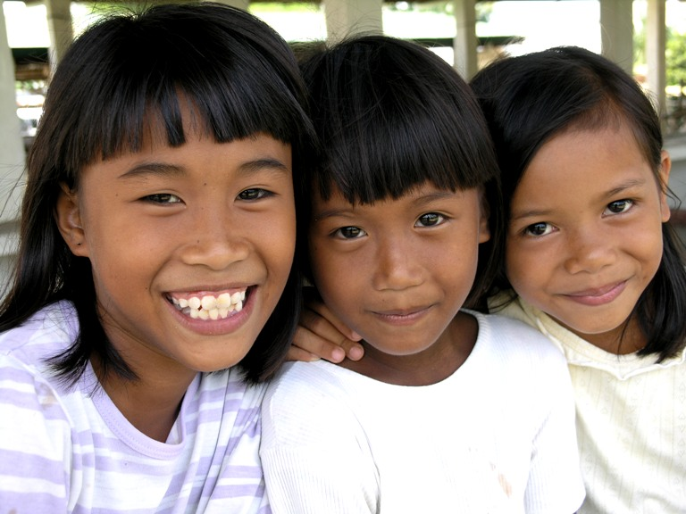
Women’s Rights in the MCW
Human Rights of Women include all rights in the Constitution and those rights recognized under international instruments duly signed and ratified by the Philippines, in consonance with Philippine law, which shall be enjoyed without discrimination.

Slide 26
The Magna Carta of Women (MCW) has 6 Chapters and 47 Sections
I. General Provisions
II. Definition of Terms
III. Duties Related to the Human Rights of Women
IV. Rights and Empowerment
V. Rights and Empowerment of Marginalized Sectors
VI. Institutional Mechanisms
Notes:
26

Slide 27

Coverage of the IRR
National Government Agencies
Government bodies, instrumentalities, including Government-Owned and Controlled Corporations
Local Government Units
Private and State Universities and Colleges
        Private and Public Schools
        Equivalent units in the autonomous regions
        Private entities
Notes:
27

Slide 28

The Magna Carta of Women spells out every woman's right to:
Protection from all forms of violence, including those committed by the State.
Calls for incremental increase in the recruitment and training of women in government services that cater to women victims of gender-related offenses.
ensures mandatory training on human rights and gender sensitivity to all government personnel involved in the protection and defense of women against gender-based violence, and mandates local government units to establish a Violence Against Women Desk in every barangay to address violence against women cases;

Slide 29

The Magna Carta of Women spells out every woman's right to:
Protection and security in times of disaster, calamities and other crisis situations, especially in all phases of relief, recovery, rehabilitation and construction efforts, including protection from sexual exploitation and other sexual and gender-based violence.
Participation and representation, including undertaking temporary special measures and affirmative actions to accelerate and ensure women's equitable participation and representation in the third level civil service, development councils and planning bodies, as well as political parties and international bodies, including the private sector.

Slide 30
The Magna Carta of Women spells out every woman's right to:
Non-discrimination in employment in the field of military, police and other similar services. This includes according the same promotional privileges and opportunities as their men counterpart, including pay increases, additional benefits, and awards, based on competency and quality of performance. The dignity of women in the military, police and other similar services shall always be respected, they shall be accorded with the same capacity as men to act in and enter into contracts, including marriage, as well as be entitled to leave benefits for women such as maternity leave, as provided for in existing laws;

Slide 31


The Magna Carta of Women spells out every woman's right to:
Equal treatment before the law, including the State's review and when necessary amendment or repeal of existing laws that are discriminatory to women;
Equal access and elimination of discrimination against women in education, scholarships and training. This includes revising educational materials and curricula to remove gender stereotypes and images, and outlawing the expulsion, non-readmission, prohibiting enrollment and other related discrimination against women students and faculty due to pregnancy outside of marriage;

Slide 32


The Magna Carta of Women spells out every woman's right to:
Equal participation in sports. This includes measures to ensure that gender-based discrimination in competitive and non-competitive sports is removed so that women and girls can benefit from sports development;
Non-discriminatory and non-derogatory portrayal of women in media and film to raise the consciousness of the general public in recognizing the dignity of women and the role and contribution of women in family, community, and the society through the strategic use of mass media;

Slide 33

The Magna Carta of Women spells out every woman's right to:
Comprehensive health services and health information and education covering all stages of a woman's life cycle, and which addresses the major causes of women's mortality and morbidity, including access to among others, maternal care, responsible, ethical, legal, safe and effective methods of family planning, and encouraging healthy lifestyle activities to prevent diseases;
Leave benefits of two (2) months with full pay based on gross monthly compensation, for women employees who undergo surgery caused by gynecological disorders, provided that they have rendered continuous aggregate employment service of at least six (6) months for the last twelve (12) months;

Slide 34

The Magna Carta of Women spells out every woman's right to:
Equal rights in all matters relating to marriage and family relations. The State shall ensure the same rights of women and men to:
  enter into and leave marriages, freely choose a spouse,
  decide on the number and spacing of their children,
  enjoy personal rights including the choice of a profession,
  own, acquire, and administer their property, and
  acquire, change, or retain their nationality.
It also states that the betrothal and marriage of a child shall have no legal effect.

Slide 35

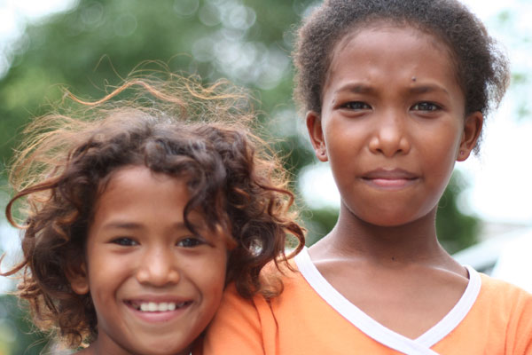

The Magna Carta of Women also guarantees the civil, political and economic rights of women in the marginalized sectors, who include but not limited to:
Small farmers and rural workers, Fisherfolk, Urban poor, Workers in the formal economy, Workers in the informal economy, Migrant workers, Indigenous Peoples, Moro, Children, Senior citizens, Persons with disabilities, and Solo parents.
National GAD Resource Program
Philippine Commission on Women

Slide 36

The Magna Carta of Women guarantees the rights of women in the marginalized sectors, particularly their right to:
Food security and resources for food production, including equal rights in the titling of the land and issuance of stewardship contracts and patents;
Localized, accessible, secure and affordable housing;
Employment, livelihood, credit, capital and technology;
Social protection;

Slide 37

The Magna Carta of Women guarantees the rights of women in the marginalized sectors, particularly their right to:
Skills training, scholarships, especially in research and development aimed towards women friendly farm technology;
Access to information regarding policies on women, including programs, projects and funding outlays that affect them;

Slide 38
The Magna Carta of Women guarantees the rights of women in the marginalized sectors, particularly their right to:
Representation and participation in policy-making or decision-making bodies in the regional, national, and international levels;
Inclusion in discussions on peace and development;
Recognition and preservation of cultural identity and integrity provided that these cultural systems and practices are not discriminatory to women;

Slide 39

The Magna Carta of Women guarantees the rights of women in the marginalized sectors, particularly their right to:
Services and interventions for women in especially difficult circumstances or WEDC;
Protection of girl-children against all forms of discrimination in education, health and nutrition, and skills development; and
Protection of women senior citizens.

Slide 40
Making MCW Real in Women’s Lives:
Institutional Mechanisms for the Implementation of the Magna Carta of Women

Slide 41

Sec. 37: Gender Mainstreaming as a Strategy for Implementing the Magna Carta of Women
All government agencies , offices , bureaus, instrumentalities, SUCs, GOCCs and LGUs shall pursue the adoption of gender mainstreaming as a a strategy to promote and fulfill women’s human rights and eliminate gender discrimination in their systems, structure, policies, programs, processes and procedures.

Slide 42
Creation and /or Strengthening of the GAD Focal Points (GFPs)
All government department including their attached agencies, offices, bureaus, SUCs, GOCCs, LGUs and other government instrumentalities shall establish or strengthen their GFP System or a similar GAD mechanisms to catalyze and accelerate gender mainstreaming within the agency;
The head of agencies shall sign appropriate issuances to institutionalize the creation of he GFP in their respective agencies.
The tasks and functions of the members of the GFP shall form part of their regular key result areas and shall be given due consideration in their performance evaluation.

Slide 43
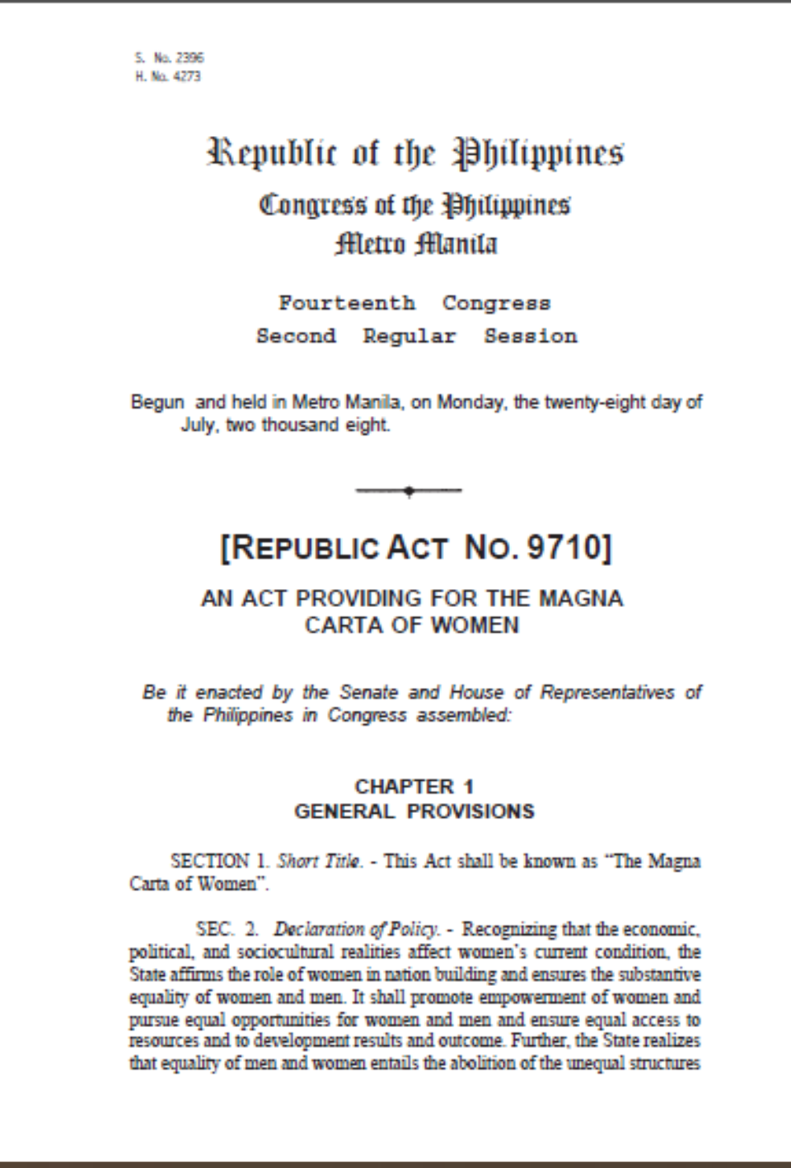
GAD Planning and Budgeting
“GAD programs addressing gender issues and concerns shall be designed and implemented based on the mandate of government agencies… Republic Act No. 7192, gender equality agenda of the government and other GAD-related legislation, policies, and commitments (Section 36a).
Notes:
43

Slide 44

The agency priority gender issues may be derived from:
Formulating the GAD Plan and Budget
1
a review of national GAD-related policies and plans;
the result of gender analysis using sex-disaggregated data or information from major programs or services of the agency for its clients and gender gaps or issues faced by their women and men employees;
the results of programs, projects and evaluation findings; and
a review of the agency GAD funds audit results and previous year’s GPBs and GAD Accomplishment Reports

Slide 45
What can be charged to the GAD Budget?
  Approved PPAs included in the PCW-endorsed GAD Plan with detailed budgetary expenditure requirements
  Capacity Development on GAD
  Activities related to the establishment of enabling mechanisms which support GAD efforts of agencies (e.g. creation and strengthening the GAD Focal Point System, setting-up and maintenance of GAD database)

Slide 46

What can be charged to the GAD Budget?
  Salaries of agency personnel assigned to plan, implement and monitor GAD PAPs on a full time basis, following the rules in hiring and creating positions. This provision does not apply to those who were given extra assignment on GAD and are already regular employees.
  Overtime work rendered in doing GAD PAPs may be compensated through a compensatory time off, following the government accounting rules and regulations.

Slide 47

What can be charged to the GAD Budget?
  Programs to address women’s practical and strategic needs, (e.g. daycare center, breastfeeding rooms, etc.) provided these have been previously approved by the Philippine Commission on Women (PCW) and are clearlyreflected in the annual GAD Plan and Budget
  Consultation workshops to gather inputs for GAD Plan and other GAD mechanisms and processes, including conduct of gender audit.

Slide 48
What can be charged to the GAD Budget?
  Professional fees and honoraria of external GAD experts for trainings and related activities
  Development, printing and dissemination of information and education campaign materials which support GAD PAPs
  Women’s Month activities which are clearly aligned to the yearly theme determined by the PCW Board and GAD advocacy
  IEC activities (development, printing and dissemination) that support the GAD PAPs and objectives of the agency.

Slide 49
What cannot be charged to the GAD Budget?
PPAs which are not in the GAD Plan and not endorsed by PCW
Personal services and honoraria of GAD Focal Point System members and other GAD employees assigned to do GAD work
Physical, mental and health fitness including purchase of equipment, recreation and social activities, religious and cultural projects, construction expense, supplies and materials for general use, study tour, Christmas and yearend celebrations and meetings, except if these can be justified as clearly addressing specific gender issues.

Slide 50

Monitoring the GAD Plan and Budget
16
The agency GFPS shall annually monitor and evaluate the utilization and outcome of the GAD budget in terms of its success in influencing the gender- responsive implementation of PPAs funded by the remaining 95% of the agency budget

Slide 51
COA Guidelines
Compliance with existing laws and regulations on gender and development particularly on the setting aside of at least five per cent (5%) of their total budget appropriations to cover the implementation of, among others, the preparation of GAD plan, submission of required reports, and the like;
Seeing to it that the agency' s plans, programs, projects and activities on GAD are aligned to the agency's mandate, the PPGD for 1995-2025 and other laws on GAD;
Monitoring the use of GAD funds for the purpose for which they have been appropriated; and
Determining whether gender issues are effectively addressed by GAD interventions in the agency.
Notes:
Pursuant to Section 36 of the MCW, The Commission on Audit
(COA) shall conduct an annual audit on the use of the GAD budget
for the purpose of determining its judicious use and the efficiency
and effectiveness of interventions in addressing gender issues
towards the realization of the objectives of the country’s
commitments, plans, and policies on women’s empowerment,
gender equality and GAD.

Slide 52

COA Guidelines: I I E E U U
I = Illegal
I = Irregular
E = Extravagant
E = Excessive
U = Unnecessary
U = Unconsciounable

Slide 53
Monitoring Progress and Implementation and Impact of the Act
National agencies to submit progress report to the PCW
All agencies shall conduct their own monitoring of the effectiveness of their programs
At the Regional/Local levels, the existing mechanisms like the regional/local development councils are engaged for the implementation and monitoring of this act.

Slide 54
Penalties
If the violation is committed by a government agency or any government office, including government-owned and controlled corporations and local government units, the person directly responsible for the violation, as well as the head of the agency or shall be held liable under the Magna Carta of Women. The sanctions under administrative law, civil service or other appropriate laws shall be recommended by the Commission on Human Rights to the Civil Service Commission and the Department of the Interior and Local Government.
Notes:
Further, in cases where violence has been proven to be perpetrated by agents of the State, such shall be considered aggravating offenses with corresponding penalties depending on the severity of the offenses.
If the violation is committed by a private entity or individual, the person directly responsible for the violation shall be liable to pay damages.
Further, the offended party can also pursue other remedies available under the law and can invoke any of the other provisions of existing laws, especially those that protect the rights of women.

Slide 55


DELIBERATE PUBLIC ACTION IS NEEDED.

Slide 56
THE EDUCATION SYSTEM IS CRUCIAL IN ACHIEVING GENDER EQUALITY.
Notes:
Educate –educare to rear
From Educere to lead forth

Slide 57
OUR COMMITMENTS to Gender Equality
in Education
UNESCO Convention against Discrimination in Education, 1960
World Declaration on Education for All, 1990
Universal Declaration of Human Rights, 1948
Education for all!
Convention on the Rights of the Child, 1989
Dakar Framework for Action, 2000
Governance of Basic Education Act, 2001
Convention on the Elimination of All Forms of Discrimination
Against Women, 1979
UN
Sustainable Development Goals, 2015
Beijing Declaration and Platform for Action, 1995
RA 9710 Magna Carta of Women, 2009
Others relevant mandates and policies

Slide 58
THE SCHOOLS ARE POWERFUL AGENTS OF GENDER SOCIALIZATION.
© Lorelie S. Astrera 2016

Slide 59
The Magna Carta of Women (RA 9710)
equal access to and elimination of discrimination in education, scholarships, and training.
ensure gender stereotypes and images in educational materials and curricula are adequately and appropriately revised and gender-sensitive language is used at all times.

Slide 60
The Magna Carta of Women (RA 9710)
implementation of capacity-building programs on GAD, peace and human rights, and education for teachers and all those involved in the education sector
establishment of linkages and partnerships between and among stakeholders of the education sector, including the private sector, churches, and faith-based organizations.

Slide 61
The Magna Carta of Women (RA 9710)
enrollment of women in nontraditional skills training at the vocational and tertiary levels.
proscribes the expulsion and non-admission of female students and faculty due to pregnancy outside of marriage.

Slide 62
Any questions?
THANK YOU FOR LISTENING!
Images sourced from www.google.com unless otherwise indicated.

