Slide 1
Starting Windows Especially Designed
for the Electronic SBM Validation Tool

Slide 2
Electronic SBM
Validation Tool
By: Ariel B. Montecalbo, PhD.
Division of Bukidnon

Slide 3
Activity:
Spell Out the Acronyms
Notes:
In our manual, we contextualized some of the Performance Indicators to suit to our needs in our Region. In the same scenario, some of our acronyms are spell-out in contextualized version. In short it is called operational terms used.

Slide 4
SBM
School –Based Management

Slide 5
DOD
Documentary-Analysis, Observation and Discussion
Notes:
DepEd Order No. 83, 2012

Slide 6
GER
Gross Enrolment Rate

Slide 7
NAT
National Achievement Test

Slide 8
MPS
Mean Percentage Score

Slide 9
DR
Drop-out Rate

Slide 10
CM
Community Mapping

Slide 11
RR
Repetition Rate

Slide 12
ER
Enrolment Rate

Slide 13
PrP
Promotion Rate

Slide 14
MOV
Means of Verification

Slide 15
SIP
School Improvement Plan

Slide 16
AIP
Annual Improvement Plan

Slide 17
SMEA
School Monitoring, Evaluation and Adjustment

Slide 18
L & D
Learning and Development

Slide 19
IPPD
Individual Plan for Professional Development

Slide 20
SPPD
School Plan for Professional Development

Slide 21
MOOE
Maintenance and Other Operating Expenses

Slide 22
Training Objectives
At the end of this training, participants will be able to:
1. Optimize accuracy in computing and keeping the record of the school’s performance level of practice,
2. Assist the school and SBM validators in computing and keeping the record of the school’s performance level of practice, and
3. Utilize the Electronic SBM Validation Tool.
Notes:
Note to facilitator:
This slide is for National Facilitators (to show during the Regional training).
Regional Facilitators, kindly remove this slide.
Talking point/s:
This training was designed to be sufficient to equip trainers to train (in terms of content and facilitation)

Slide 25
If this message displays, click the enable content button

Slide 27
Click the drop down button and select the school year to be validated

Slide 29
Steps to Accomplish the Thematic Area
1. Click the drop down button to select the baseline year,
2-4. Enter the 3 years baseline data (Gross Enrolment),
5-7. Enter the 3 years baseline data (No. of school-aged children in the community not enrolled)
8-10. Enter the 3 years baseline data (No. of school-aged children in the community enrolled in other schools private/public)
11-13. Enter the 3 years baseline data (No. of school-aged children within the community),
14-16. Enter the 3 years baseline data (No. of drop-outs)
17-19. Enter the 3 years baseline data (No. of repeaters)
20-22. Enter the 3 years baseline data (No. of Retained)
23-25. Enter the 3 years baseline data (NAT MPS if available)
1
2
5
8
11
3
6
9
12
4
7
10
13
14
15
16
17
20
18
21
19
22
23
24
25
Notes:
School Leaver- learners who passed/failed within a year but not enrolled succeeding school year.
Repeaters- learners who failed in the previous school and enrolled in the same grade level in the current school year
Retained- failure of grades/did not meet the criteria in at least 3 academic subjects in the current year
Drop-out- drop within the school year

Slide 30
Enter the Names of Validators

Slide 31
Click the Maintenance Menu if your school ID is not found and update the data

Slide 33
If you want to return to the Main Menu, click this arrow

Slide 34
To view the score, point the pointer of your mouse and click
Steps to Accomplish this Sub-Menu
1. You may choose the highest score from the six options. The score 1.5 and above under 60%’s column will qualify for the Documentary-Analysis, Observation and Discussion (DOD) process.
2. Click the arrow to open the DOD menu and validate the indicators based on the Means of Verification (MOV’s) presented.
3. Enter the comments/ suggestions/ recommendations/ technical assistance given.
4. Click the drop down button to select the best option.
5. Click the drop down button to select the level of validation.
6. Go back to the Option’s Menu and click the best option to open the generated SBM Validation Form and then print.
1
6
2
2
3
4
5
Notes:
DOD is a means of evaluating the validity or truthfulness of the evidence.

Slide 35
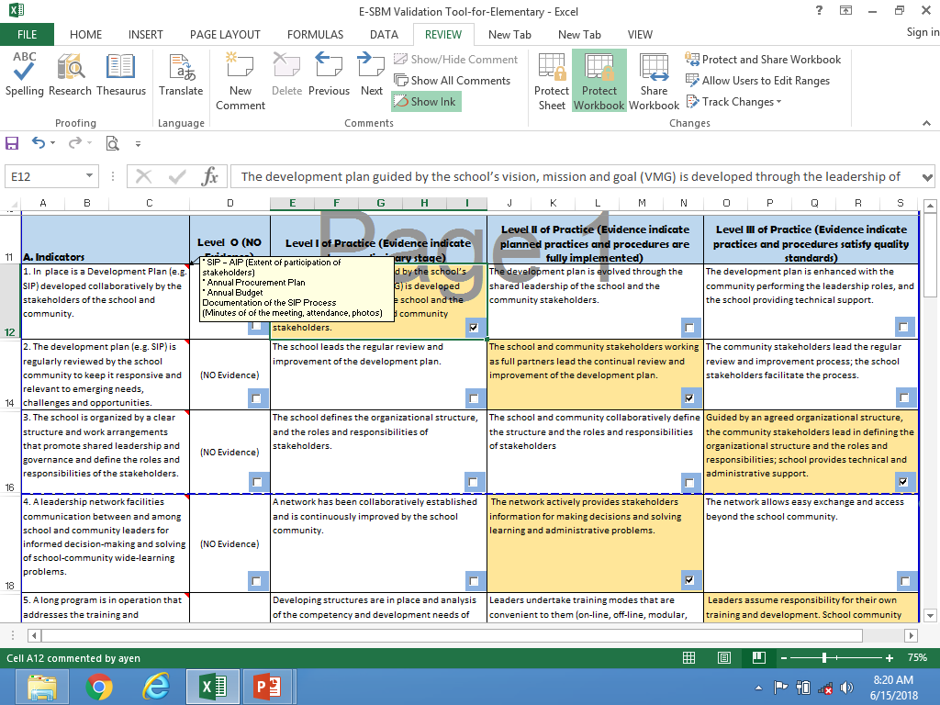
Level-III- Roles and functions of every individual/group/organization are established and the school head is functioning as CEO. Systems, mechanisms, and processes and Continuous Improvement are institutionalized.
Level I-School Head seen as an evident figure in planning, implementation, monitoring, evaluation and re planning
Systems, mechanisms, and processes are introduced
Level II- Stakeholders are now seen taking leadership in planning, implementation, monitoring, evaluation and re planning.
Systems, mechanisms, and processes are now running
Notes:
Level I-School Head seen as an evident figure in planning, implementation, monitoring, evaluation and re planning
Systems, mechanisms, and processes are introduced
Level II- Stakeholders are now seen taking leadership in planning, implementation, monitoring, evaluation and re planning
Systems, mechanisms, and processes are now running
Level-III- Roles and functions of every individual/group/organization are established and the school head is functioning as CEO. Systems, mechanisms, and processes are institutionalized. Continuous Improvement Principles and processes are institutionalized

Slide 36
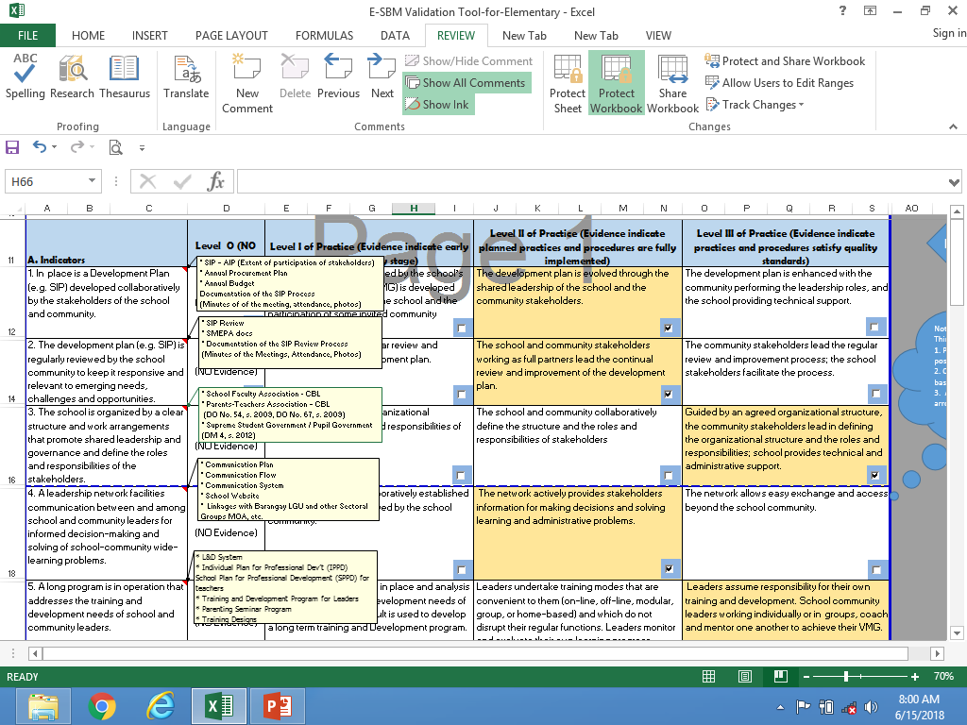

Slide 39
Click the option of which the highest score is shown

Slide 40
Sample Output

Slide 41
What are the output to be printed:
Main Screen where you entered your input/baseline data.
SBM Validation Result reflecting your best option
DOD Assessment Result.

Slide 42
After printing the necessary documents, return to the Main Screen, Save and Exit

Slide 43
Something to live by...
DEPARTMENT OF EDUCATION

Slide 44
Workshop on the Utilization of the Electronic SBM Validation Tool

