Slide 1
LECTURE ON LIS BOSY 2016 FOR CLASS ADVISERS (PUBLIC AND PRIVATE)
BY
ALFREDO C. MEDRANO
Planning Officer III
ILOCOS NORTE DIVISION

Slide 2
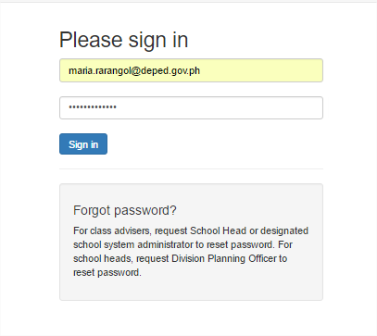
LOGIN TO lis.deped.gov.ph
Log in as Adviser, but please be sure that you are already set as adviser in your class/section before logging in.

Slide 3
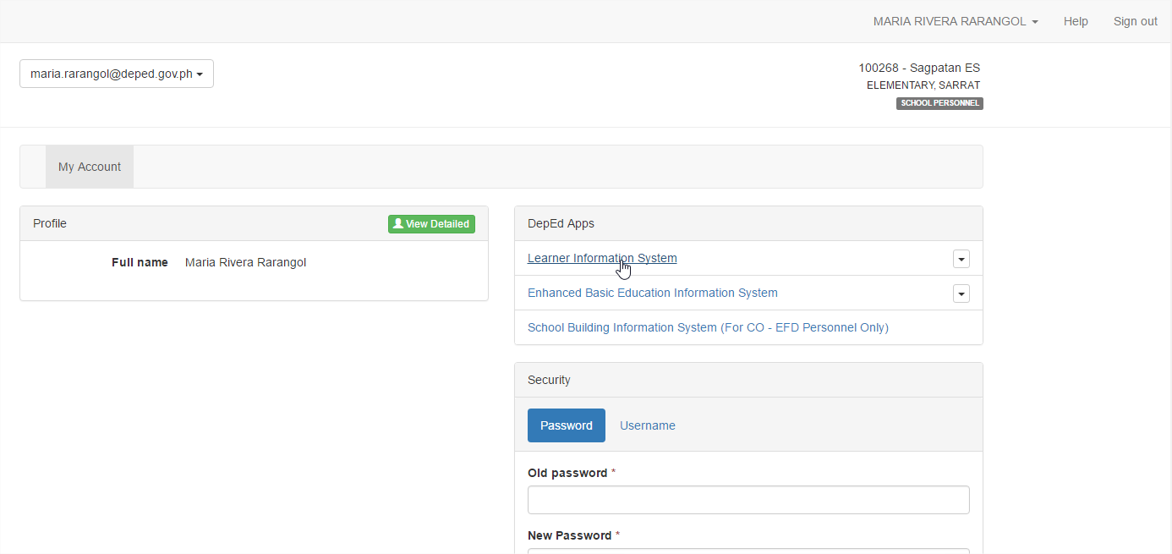
Click

Slide 4
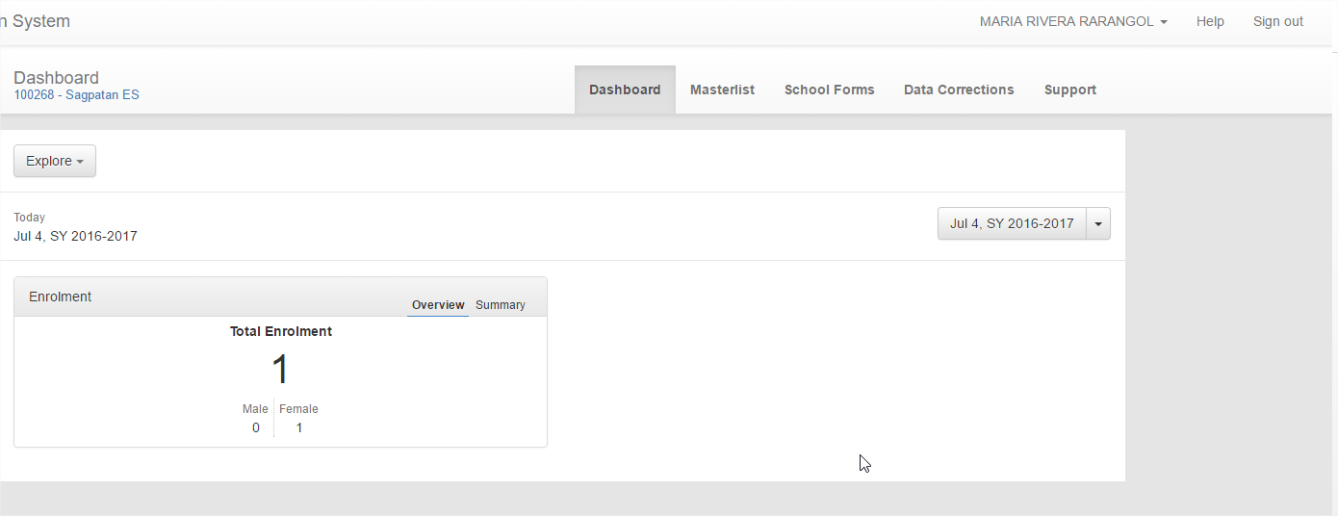
Click
IN THE DASHBOARD, CLICK MASTERLIST

Slide 5
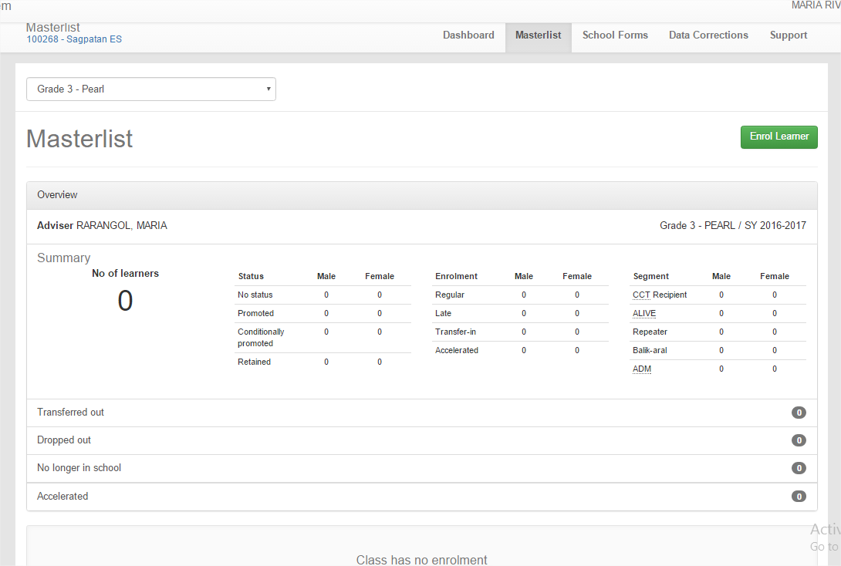
ENROLLING LEARNER
Click
CLICK ENROL LEARNER

Slide 6
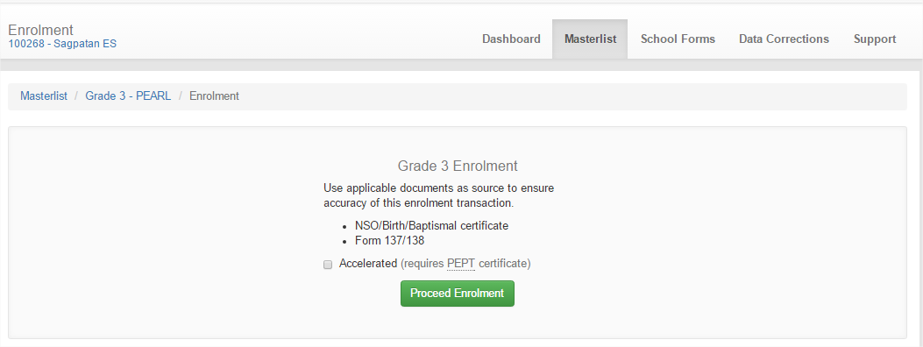
Click Proceed Enrolment

Slide 7
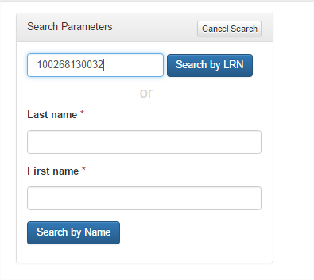
Type the LRN of the pupil if you know then click Search by LRN
Type the Last name and First Name if no LRN then Click Search by Name

Slide 8
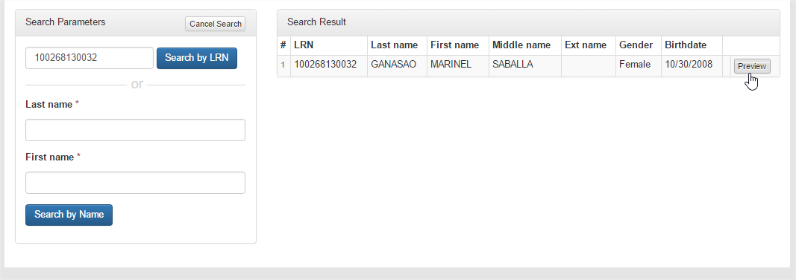
Click

Slide 9
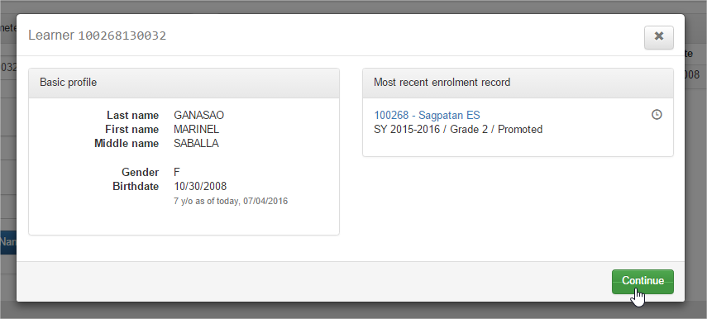
Click

Slide 10
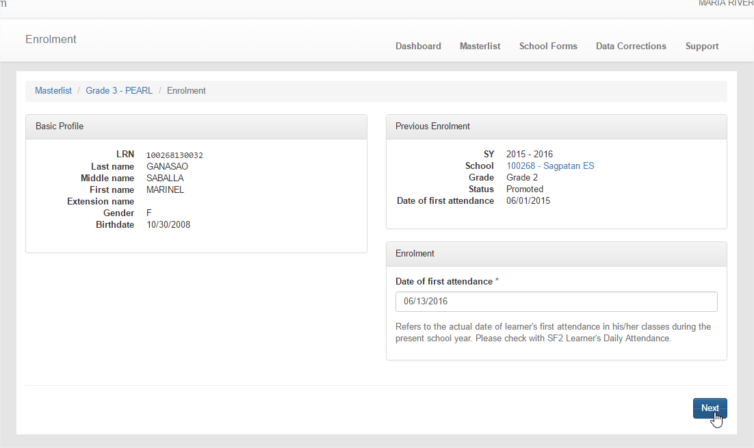
Type the First Attendance
Type the Date of First Attendance – please be careful
Click

Slide 11
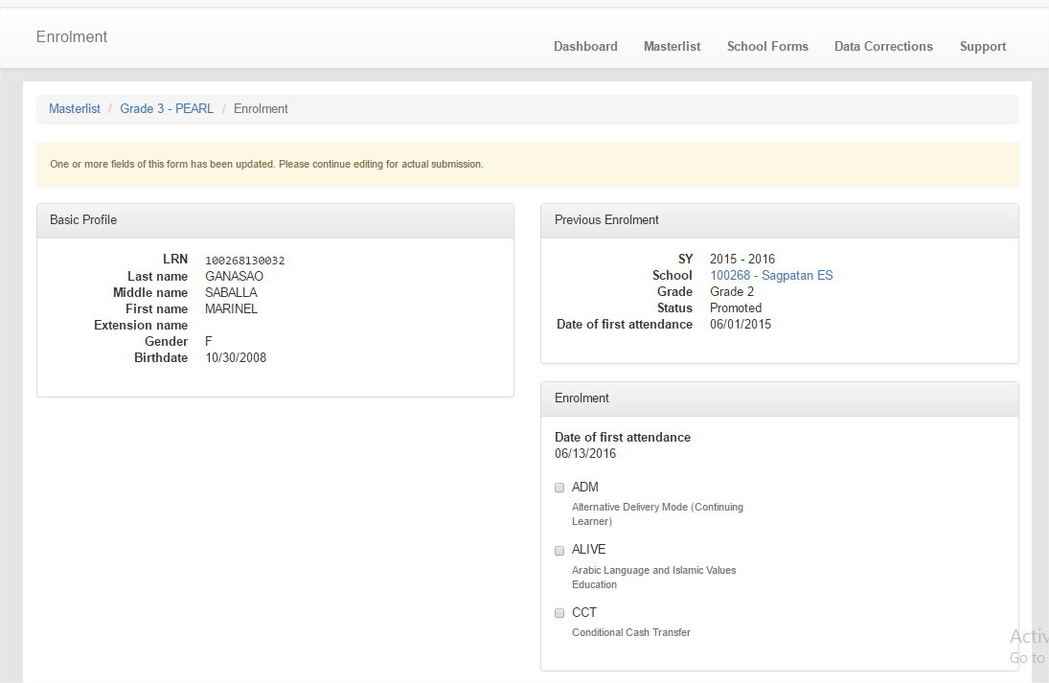

Slide 12
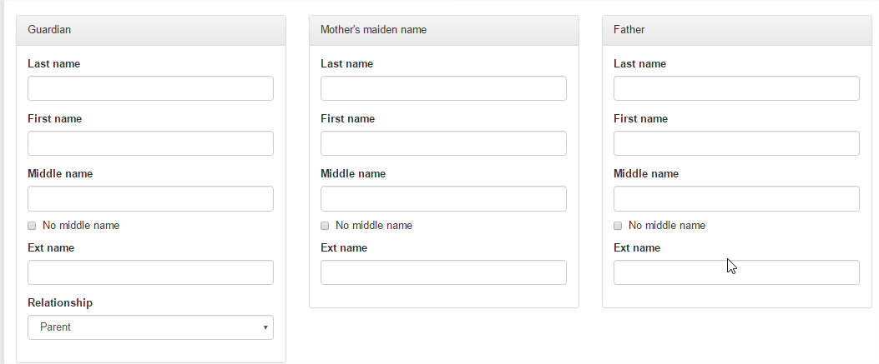
Fill up the required data

Slide 13
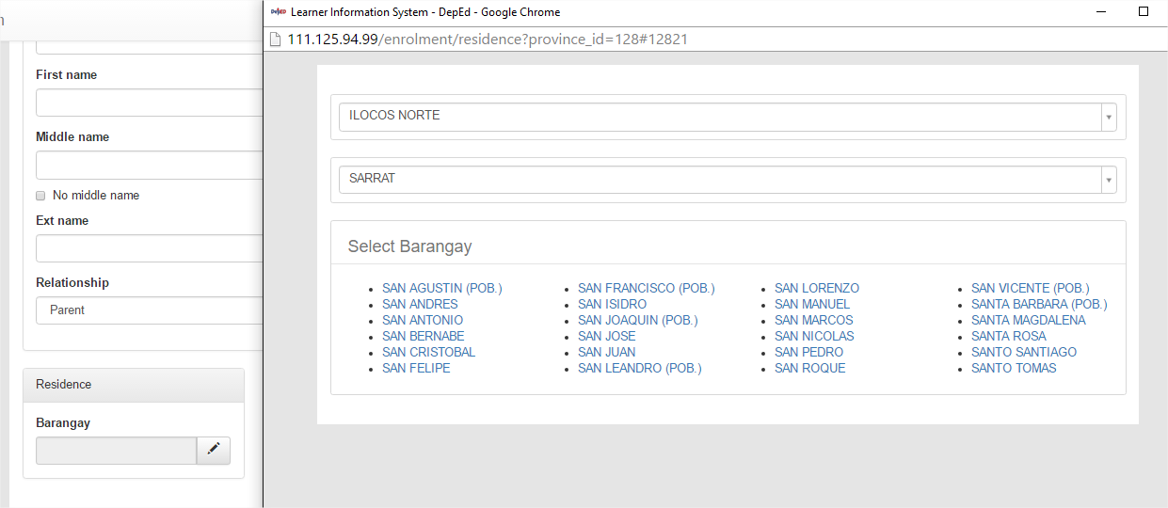
Select Barangay
Click

Slide 14
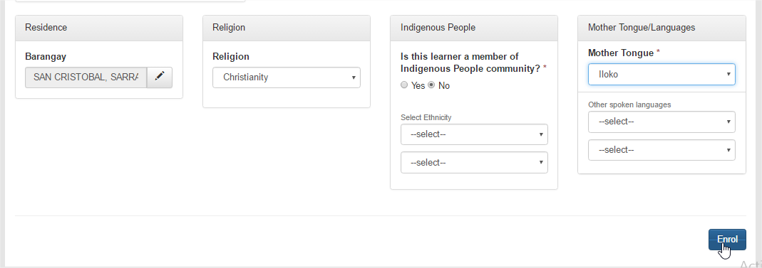
Fill up the Address, Religion, IP and Mother Tongue then Click Enrol

Slide 15
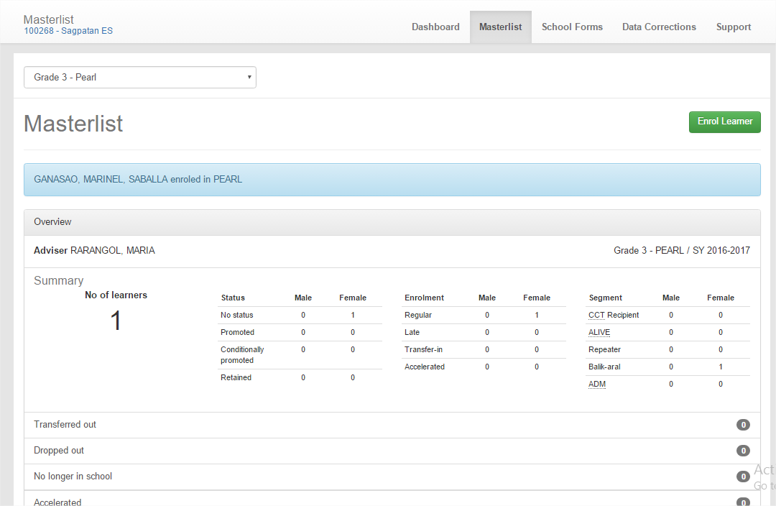
Please read
CLICK AGAIN ENROL LEARNER AND FOLLOW THE STEPS UNTIL ALL PUPILS ARE ENROLLED

Slide 16
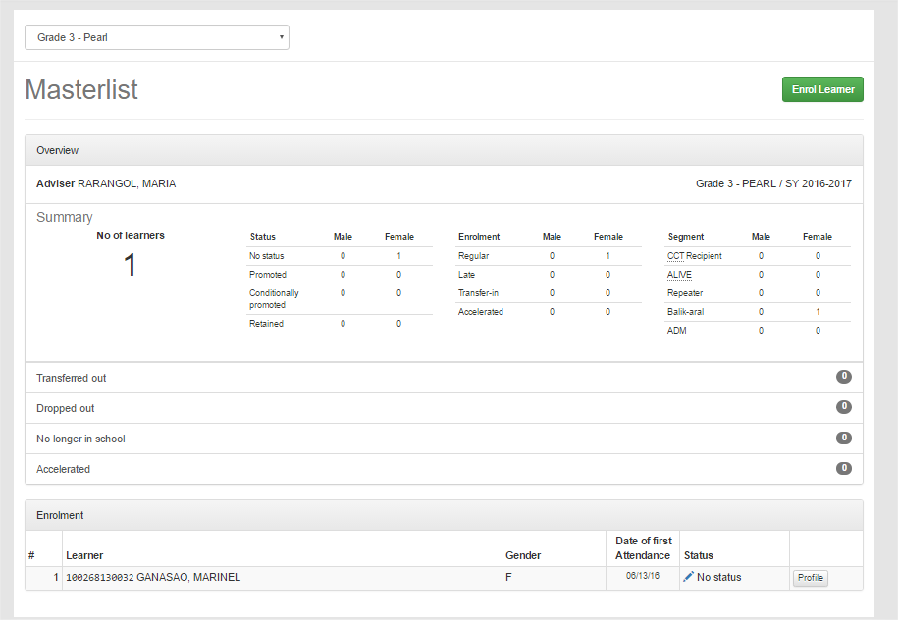
ENROLMENT BY NAME (NO LRN)
Click

Slide 17
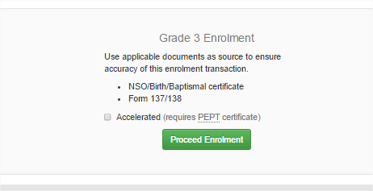
Click

Slide 18
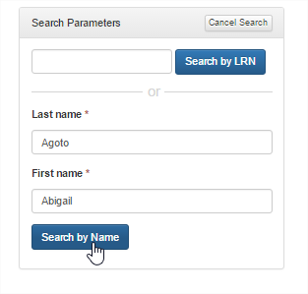
Type the Last Name and First Name and click Search by Name

Slide 19
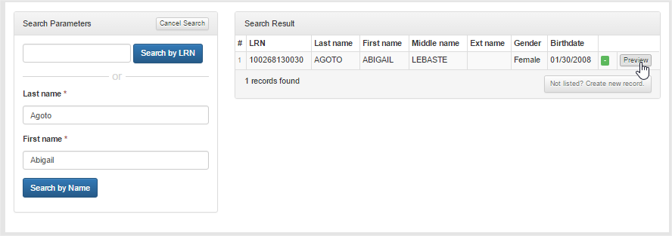
If found, click Preview, if not, Create New Record

Slide 20
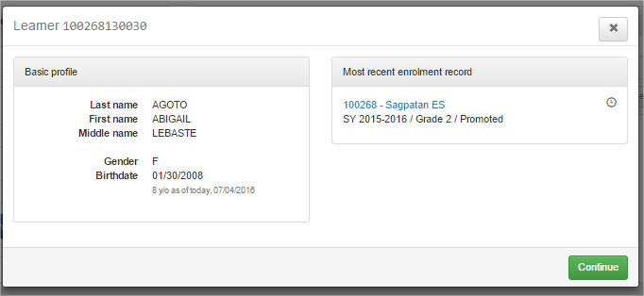
Click

Slide 21
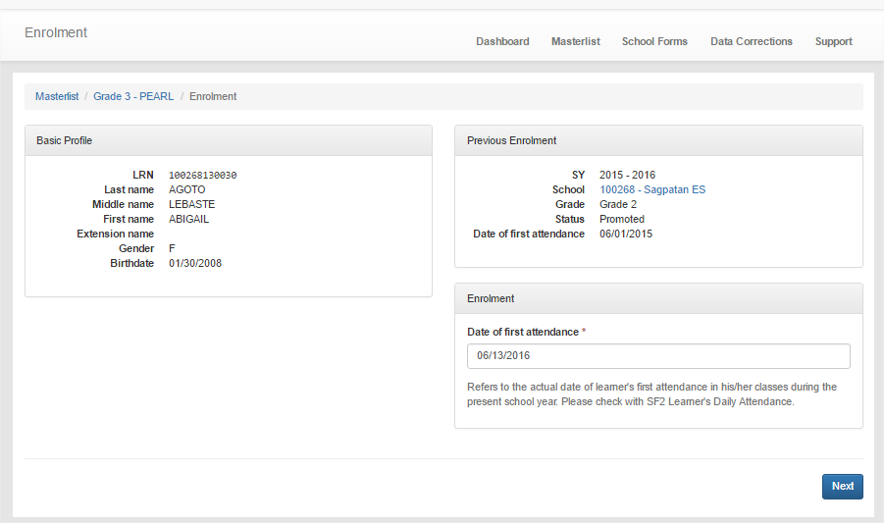
Date of First Attendance (mm/dd/yyyy)
Click

Slide 22
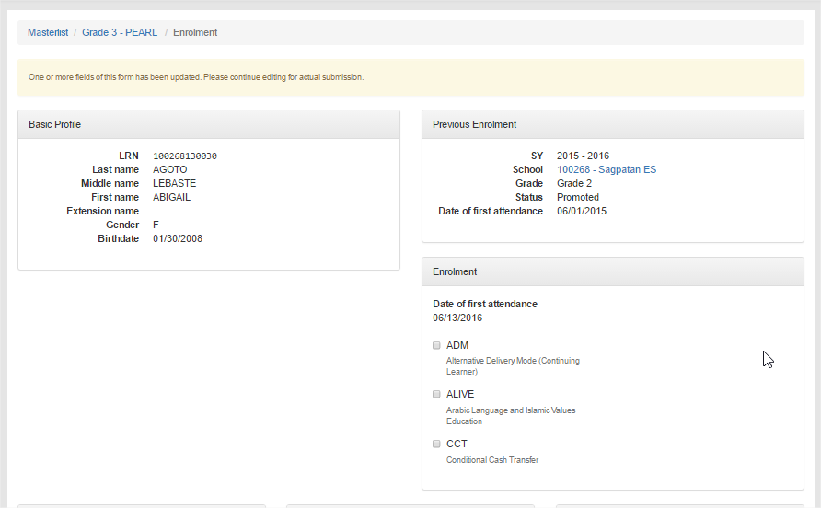
Click if 4Ps

Slide 23
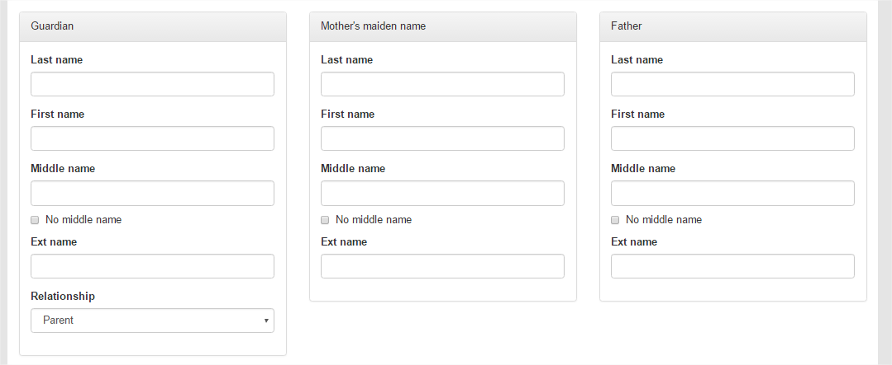
Fill up the required data

Slide 24
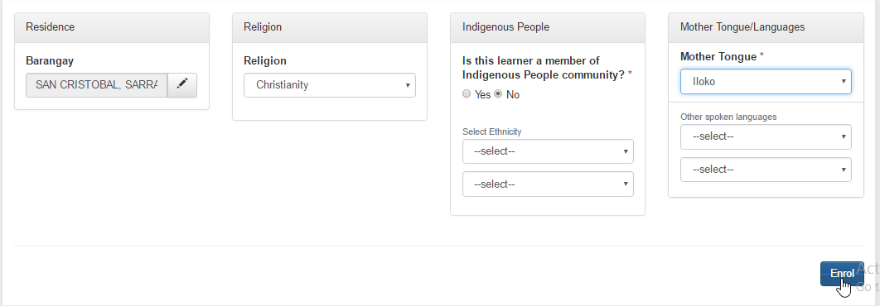
Fill up the Residence, Religion, IP and Mother Tongue and Click Enrol

Slide 25
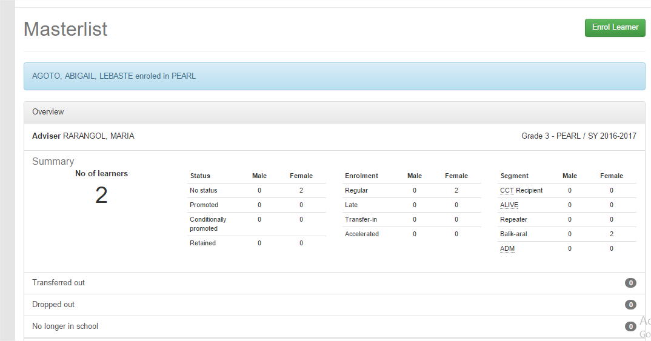
CLICK AGAIN ENROL LEARNER AND FOLLOW THE STEPS UNTIL ALL PUPILS ARE ENROLLED

Slide 26
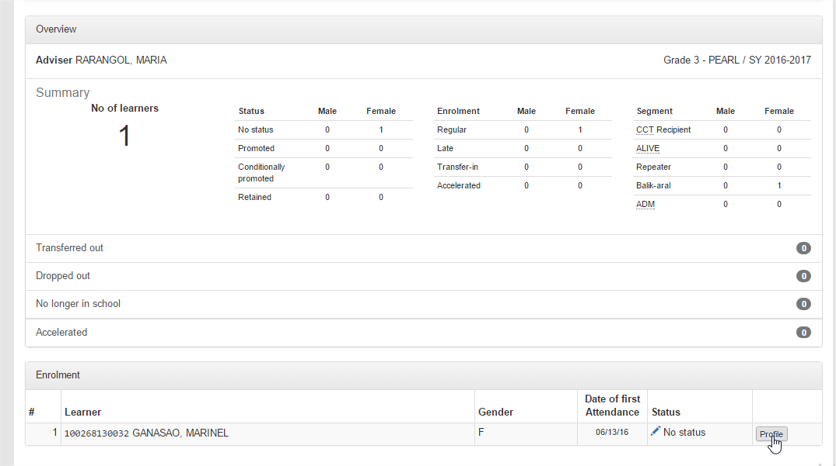
HOW TO DISPLAY PROFILE OF LEARNER
Click Profile

Slide 27
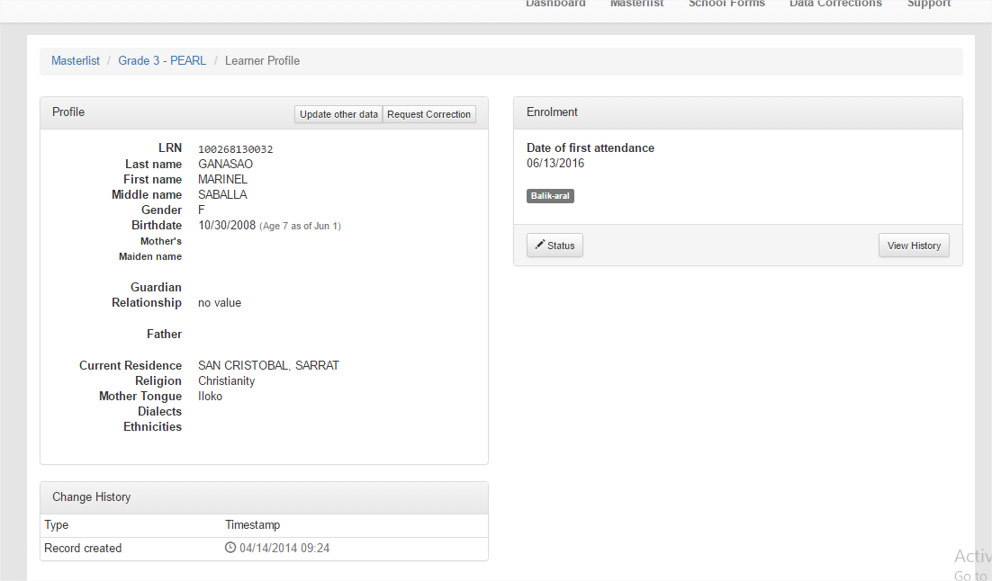
Edit Basic data
Edit Parent, Residence, religion, Etc
View Enrolment History
Tag as No Longer in School, CCT

Slide 28
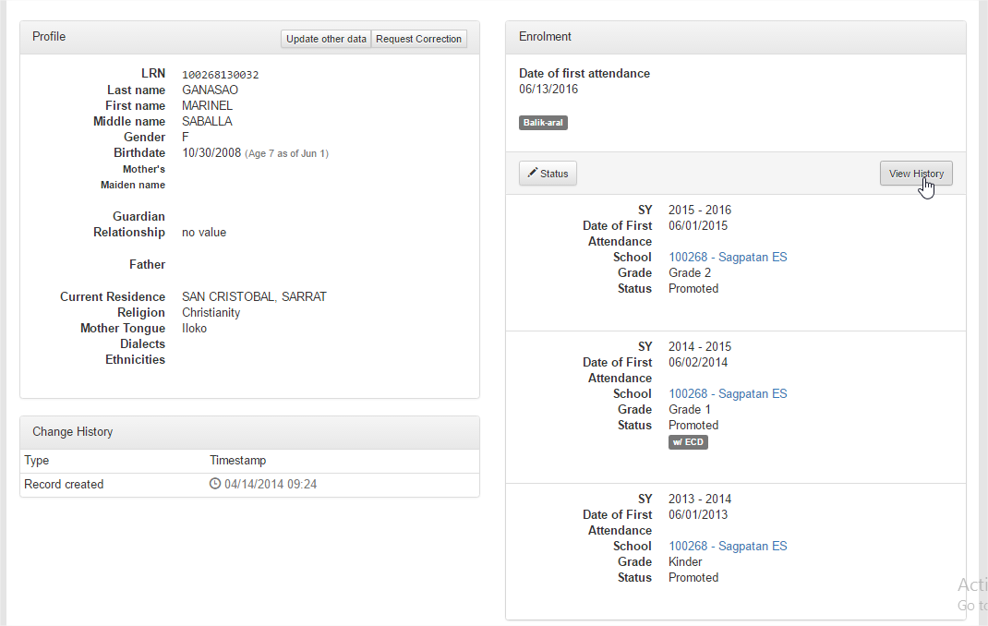
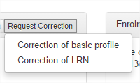
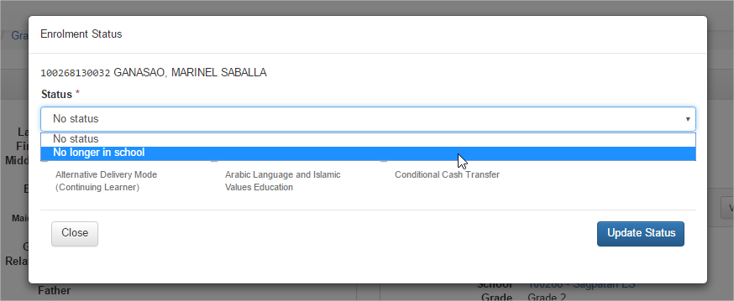

Slide 29
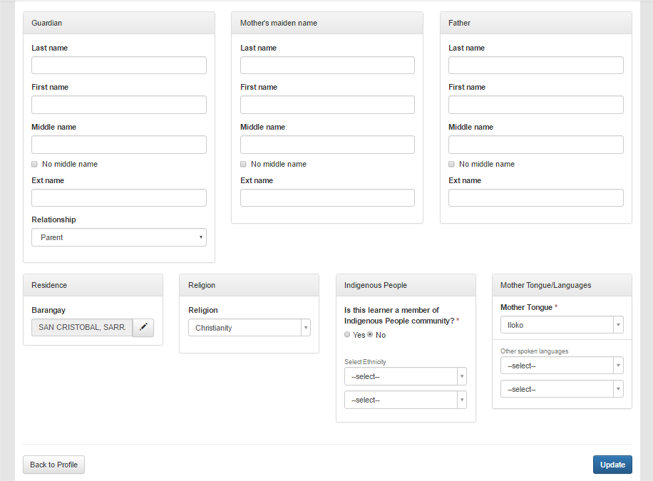
Update other data

Slide 30
THANK YOU!!!!

