Slide 1
LECTURE ON LIS BOSY 2016 using School System Admin or School Head Account
(Public and Private – Elem and JHS)
By
ALFREDO C. MEDRANO
Planning Officer III
ILOCOS NORTE DIVISION

Slide 2
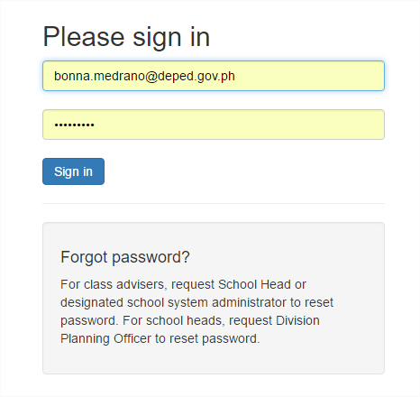
LOGIN TO lis.deped.gov.ph it will redirect to
Please use School System Admin or School Head Account to organize classes for LIS BOSY 2016

Slide 3
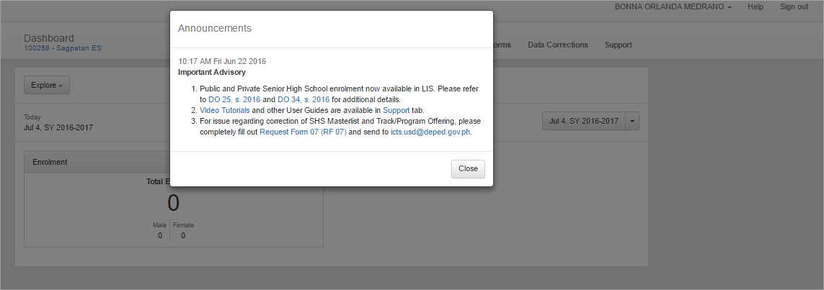
CLICK CLOSE

Slide 4
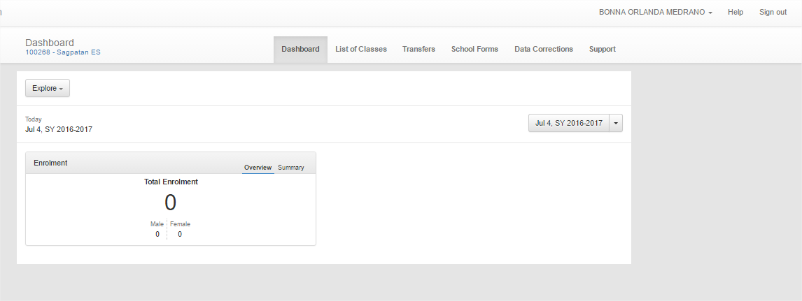
Click
CLICK LIST OF CLASSES

Slide 5
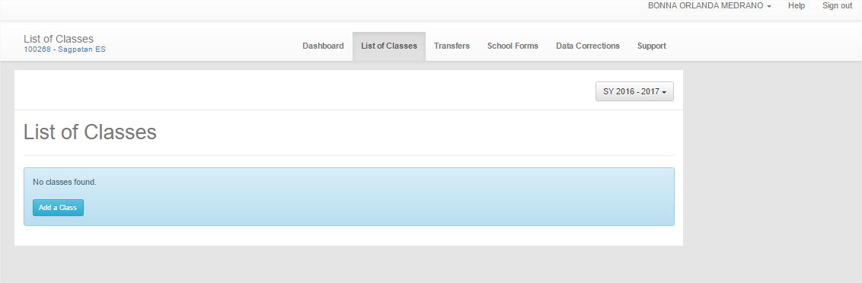
Click
Click the School Year to display the Previous School Year and to display the List of Classes

Slide 6
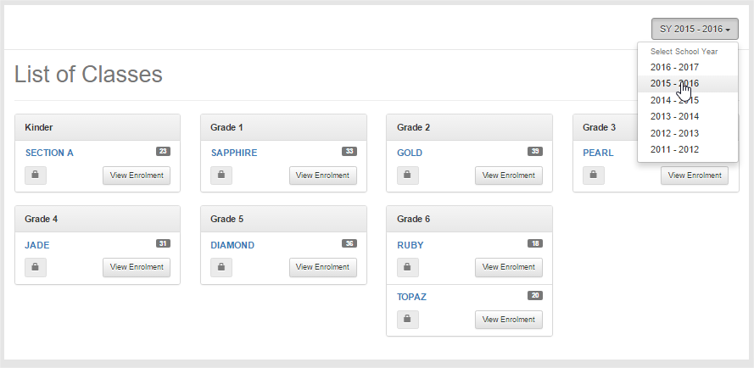
LIST OF CLASSES FOR THE PREVIOUS SCHOOL YEAR FOR REFERENCE

Slide 7
Click
Click Add a Class

Slide 8
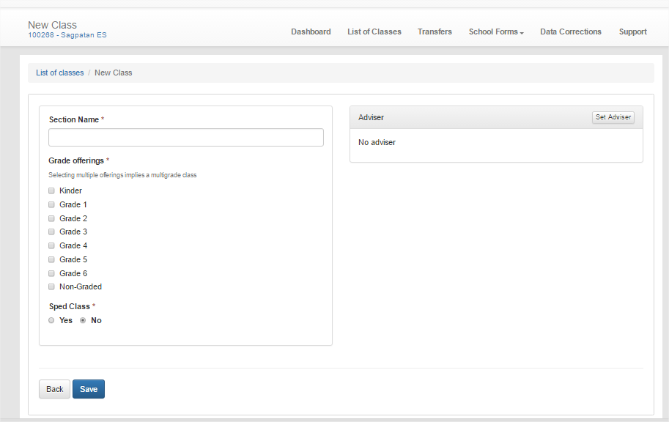
Type Section Name (1)
Click (3)
Tick the Grade Level (for multigrade) click multiple Grade Offerings (2)
For Private Schools – Disabled for Set Adviser

Slide 9
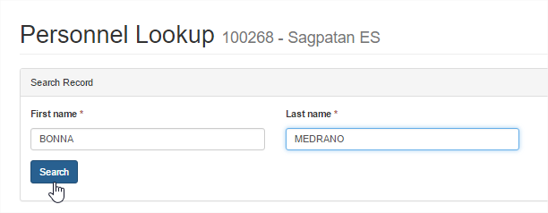
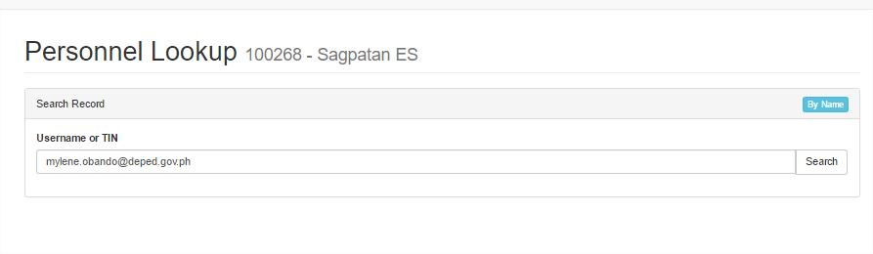
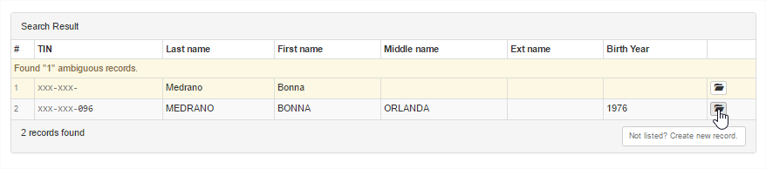
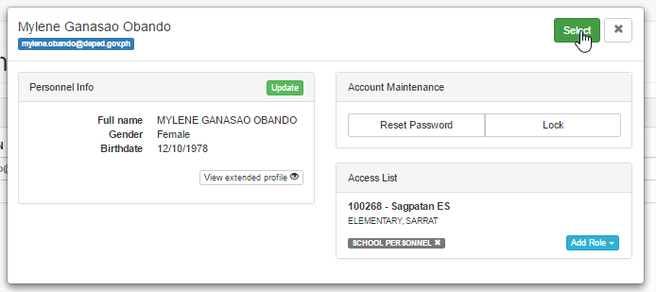
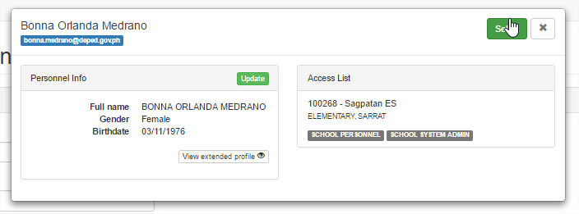
By Username
By Name
Type the username (1)
Type the First name and Last name then click Search
Click (2)
Click
(3)Click
Click

Slide 10
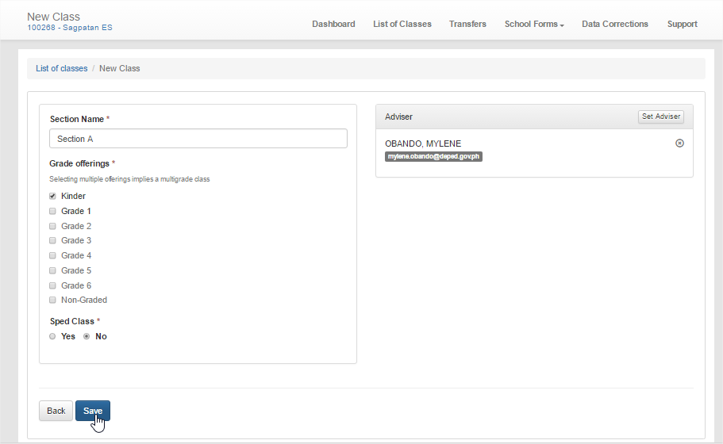
After assigning Section name, selecting / ticking Grade level and Setting Adviser, Click Save

Slide 11
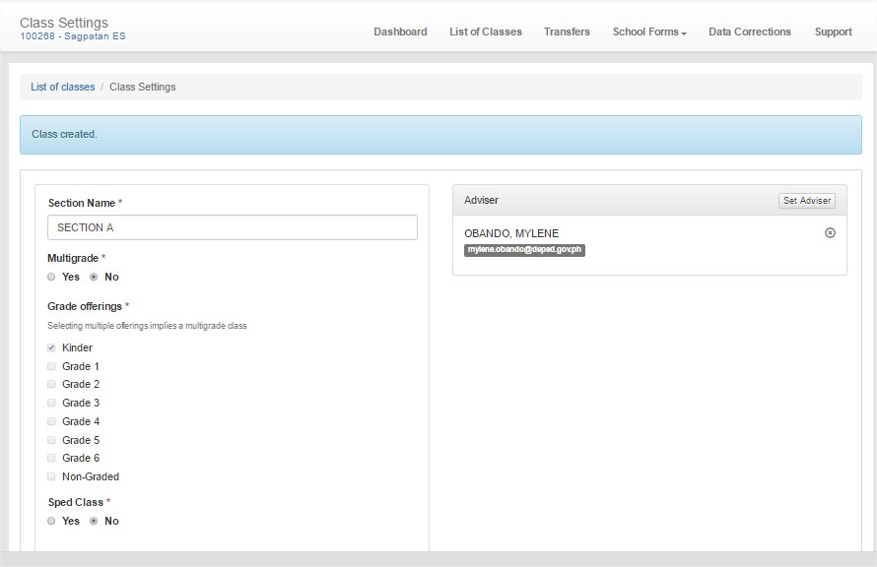
Click
Please Read
Click List of Classes to add a Class again

Slide 12
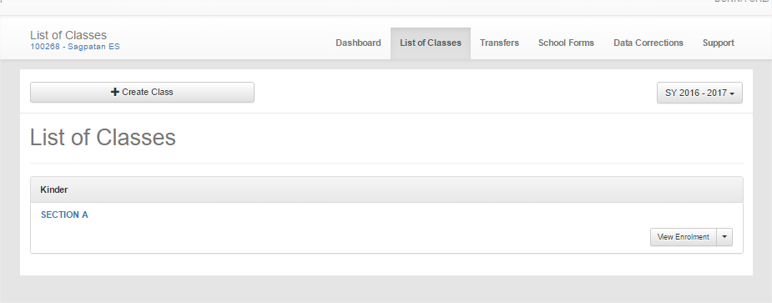
One class Created

Slide 13
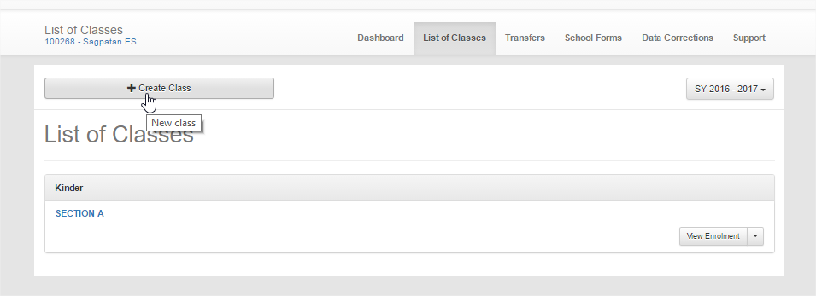
CREATING ANOTHER CLASS
Click

Slide 14
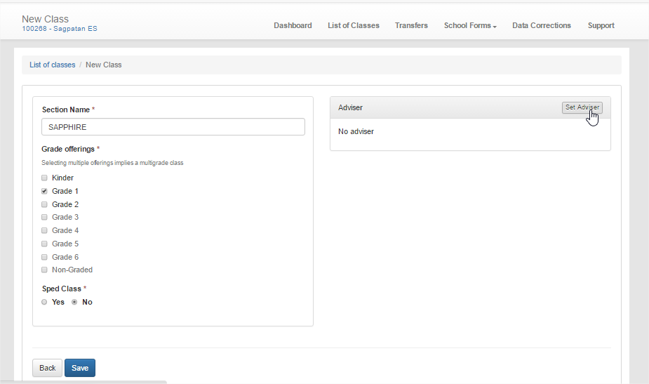
Type Section Name (1)
Click (3)
Tick the Grade Level (for multigrade) click multiple Grade Offerings (2)

Slide 15
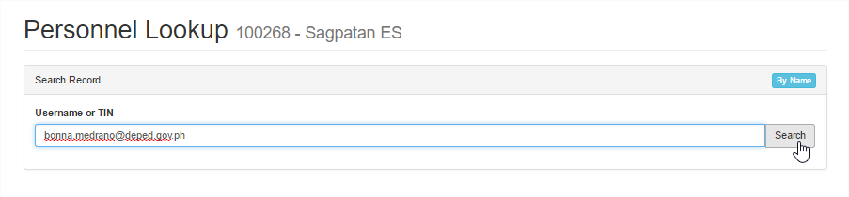
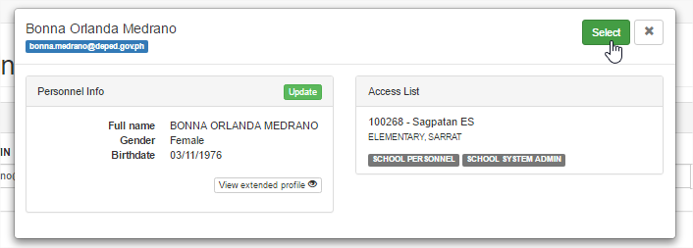
Type the username (1)
Click (2)
(3)Click

Slide 16
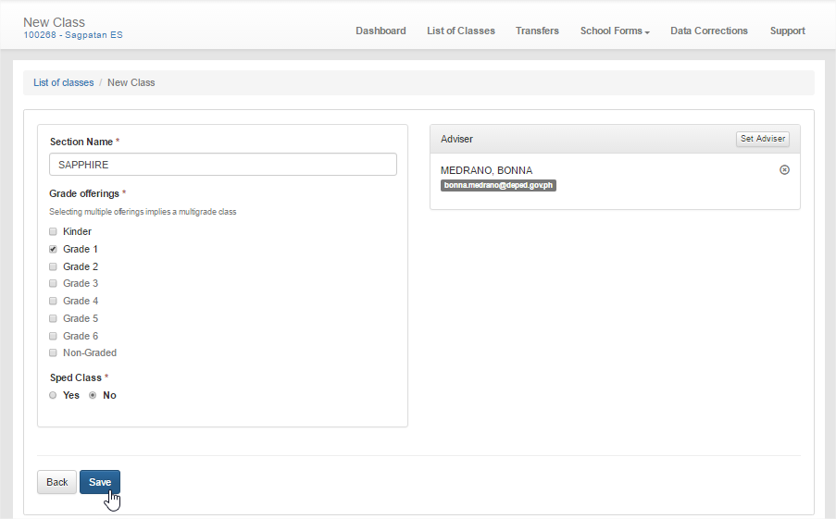
After assigning Section name, selecting / ticking Grade level and Setting Adviser, Click Save

Slide 17
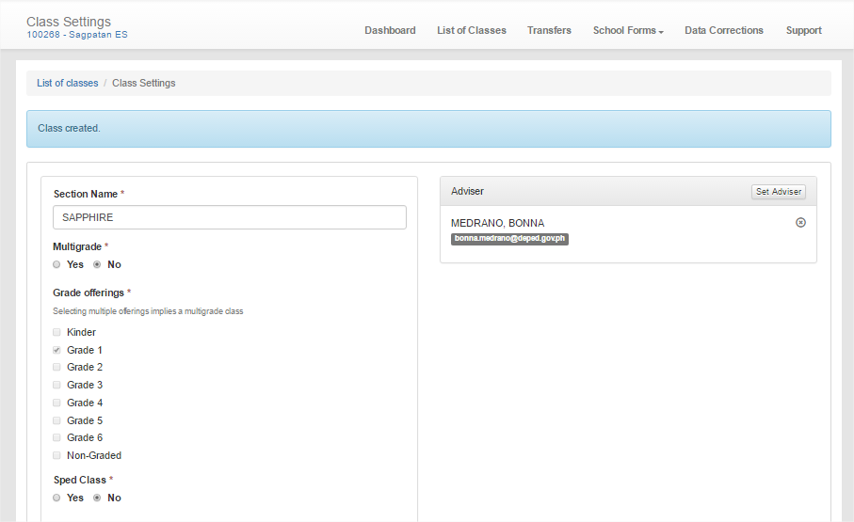
Please Read
Follow the steps in creating class until you have organize all the classes in your school

Slide 18
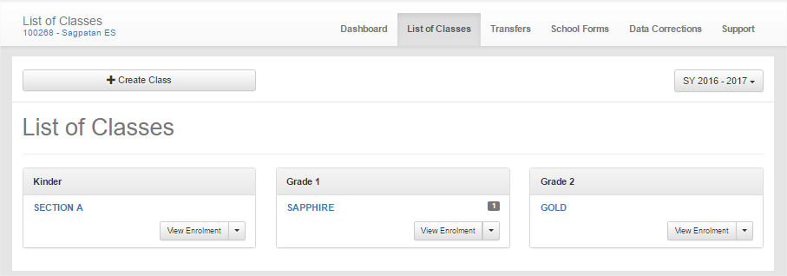

Slide 19
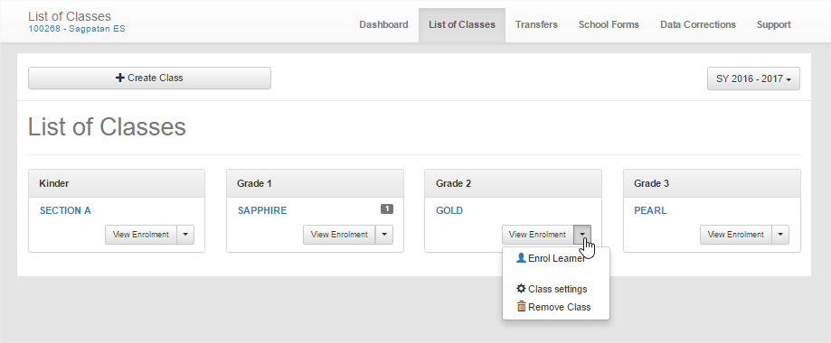
CLASS MANAGEMENT
Click
To update Section name or Adviser or Grade level
To remove class (empty) no enrolment

Slide 20
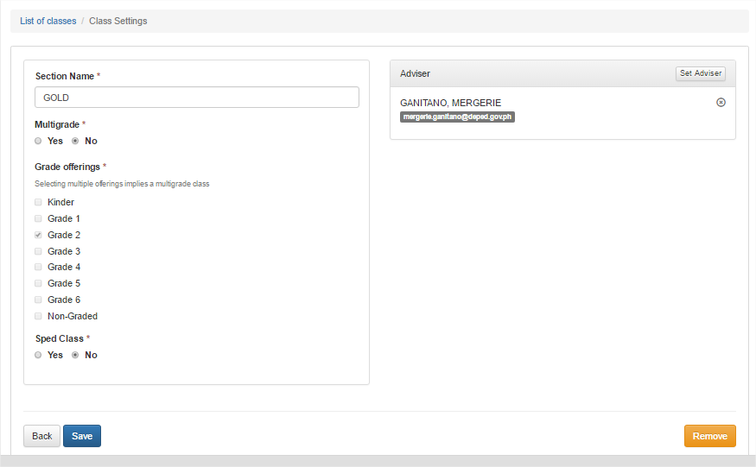
You can edit/update Section Name, Set Adviser (Public Only) but not Grade Level – so be careful
Click Save

Slide 21
How to Enroll Learner in a Class
Click
In the List of Classes, Click View Enrolment

Slide 22
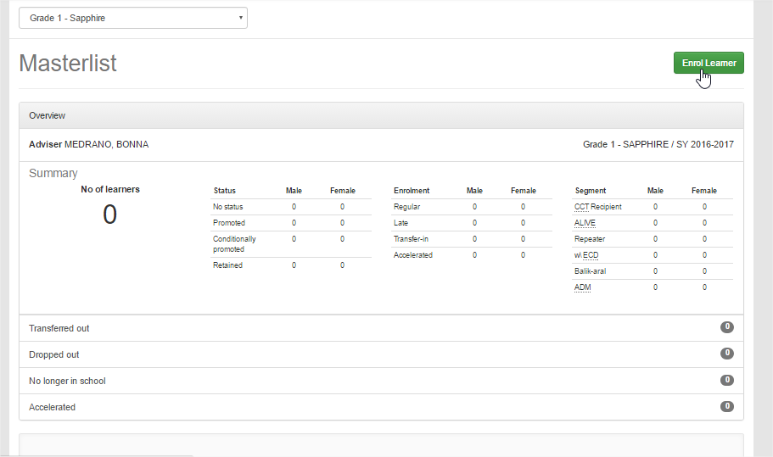
Click
Click Enrol Learner

Slide 23
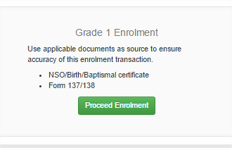
Click

Slide 24
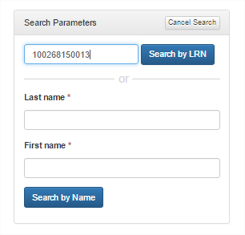
Type the LRN of the pupil if you know then click Search by LRN
Type the Last name and First Name if no LRN then Click Search by Name

Slide 25
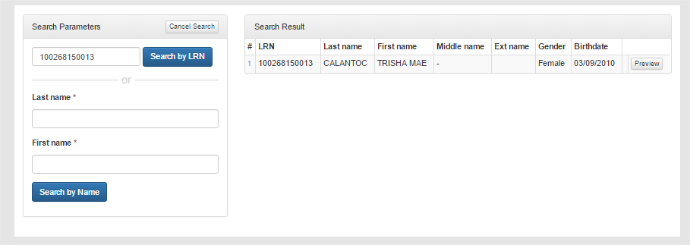
Click

Slide 26
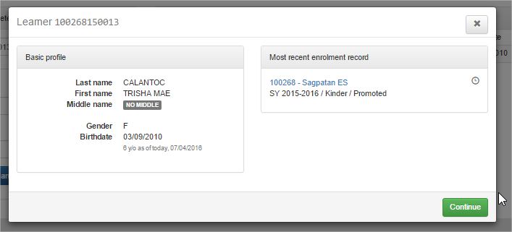
Click

Slide 27
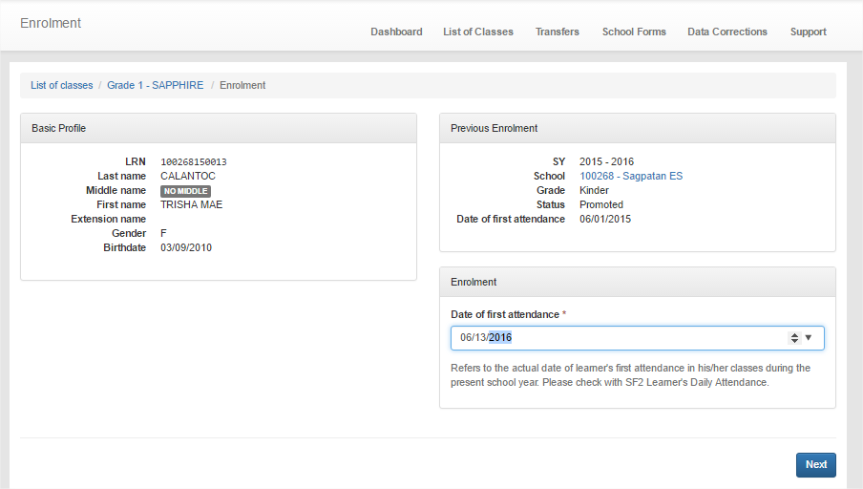
Type the First Attendance
Type the Date of First Attendance – please be careful
Click

Slide 28
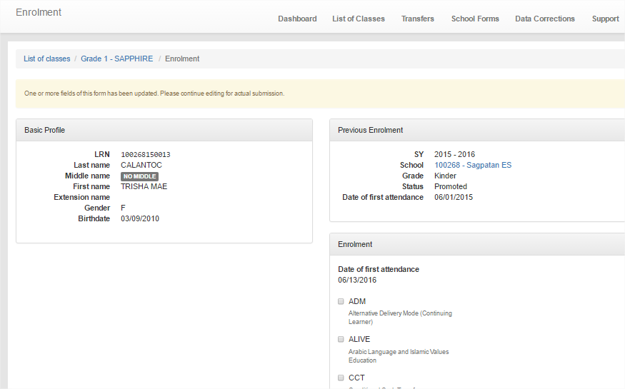

Slide 29
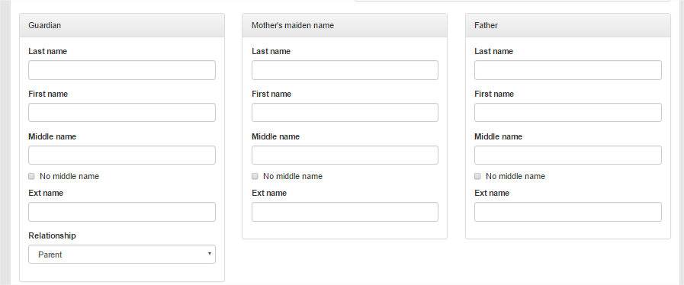
Fill up the required data

Slide 30
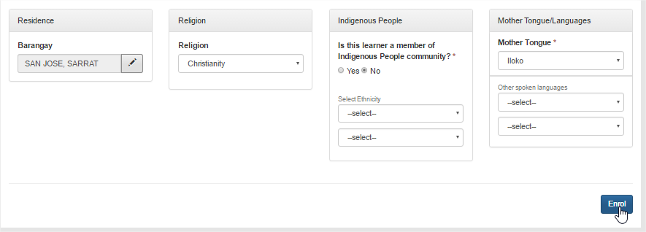
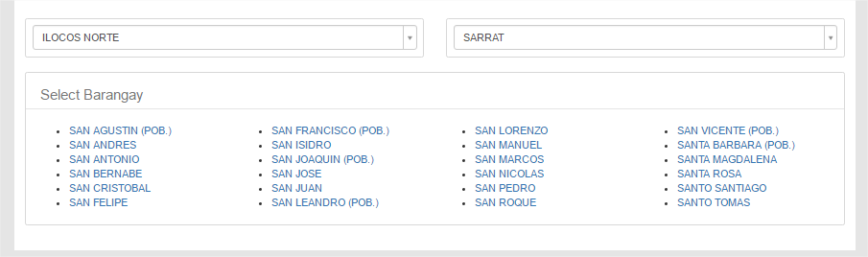
Fill up the Address, Religion, IP and Mother Tongue then Click Enrol

Slide 31
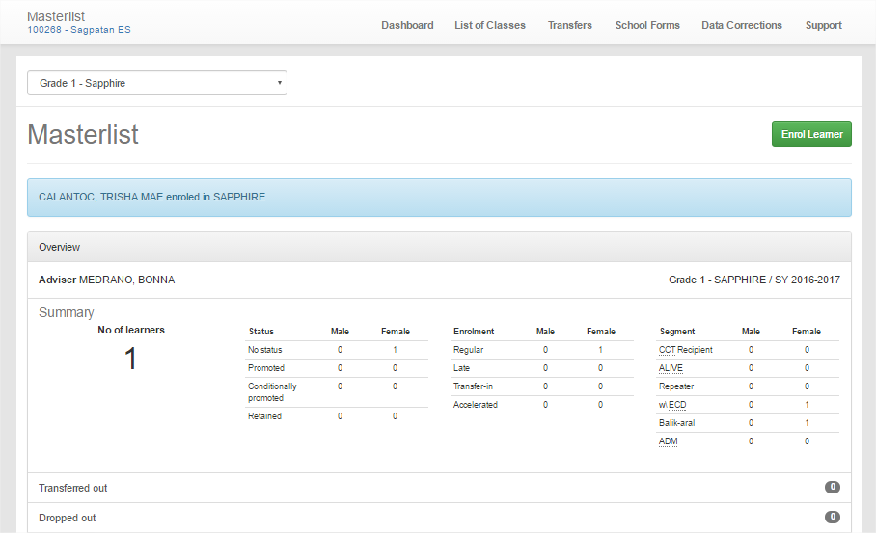
Click
Please read
Click List of Classes

Slide 32
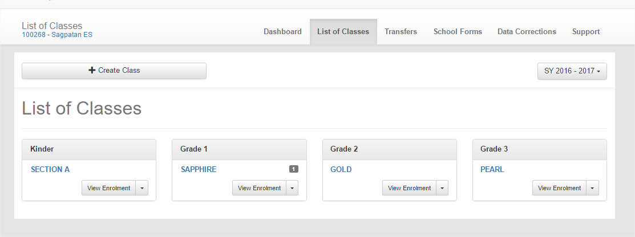
Click

Slide 33
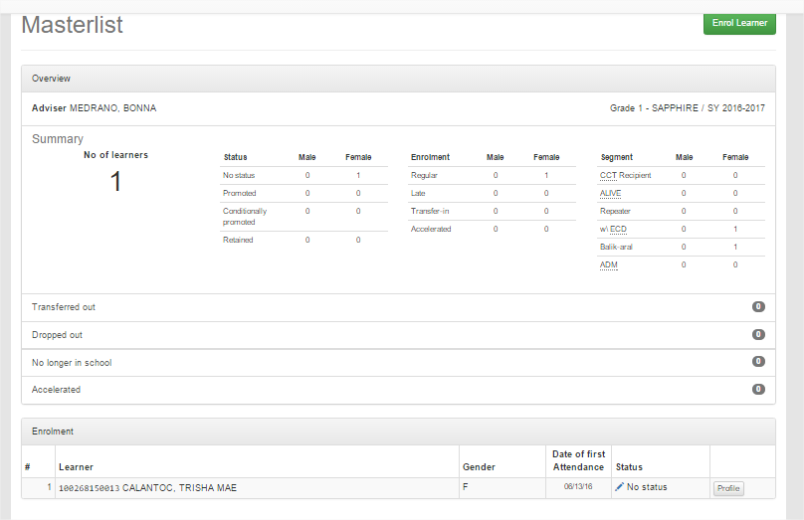
Click Enrol Learner to Enrol Another follow the previous steps

Slide 34
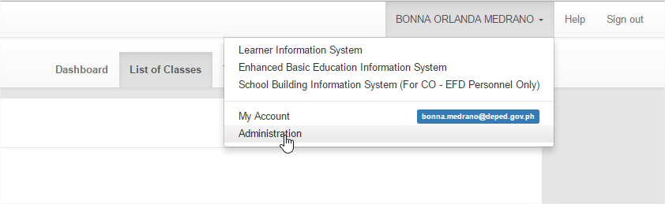
HOW TO RESET PASSWORD OF PERSONNEL
Click (1)
Click (2)

Slide 35
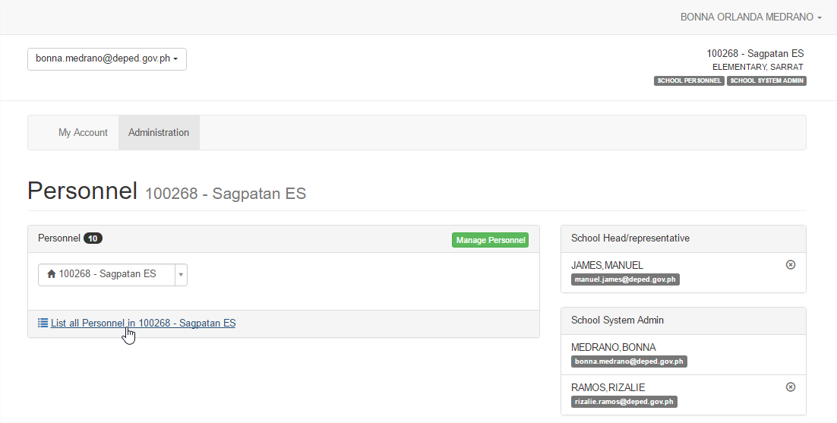
Click

Slide 36
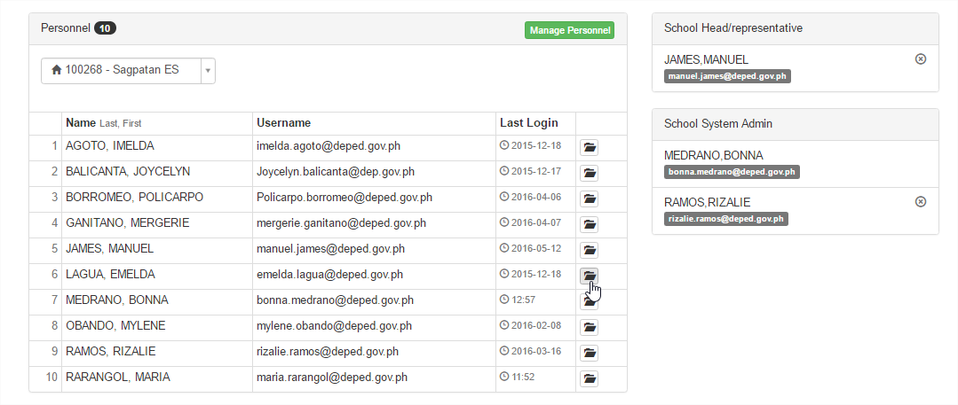
Click

Slide 37
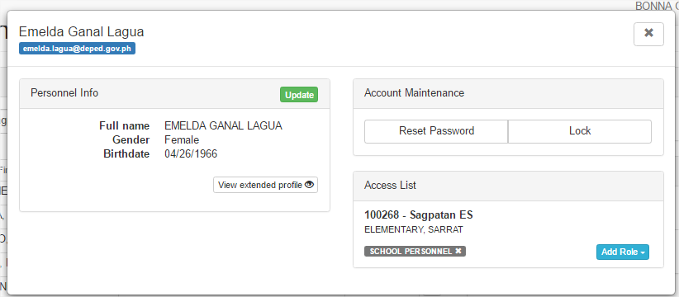
To Reset
To Lock/Unclock
To remove personnel

Slide 38
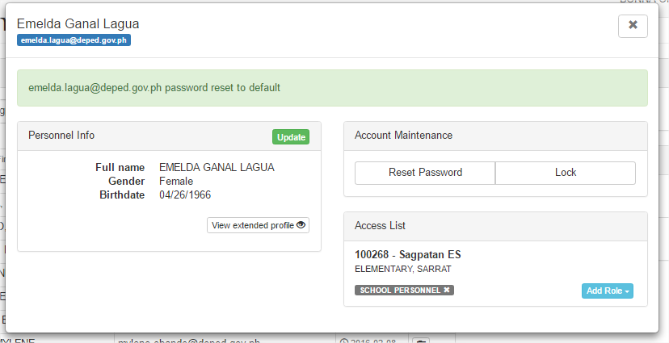
Click
After resetting the password, adviser can now log in using his/her Username and the password will be the username and after logging in, that will be the time to set the new password: Ex. Username: freddie.medrano@deped.gov.ph, Password: freddie.medrano@deped.gov.ph

Slide 39
REVIEW ON USER MANAGEMENT

Slide 40
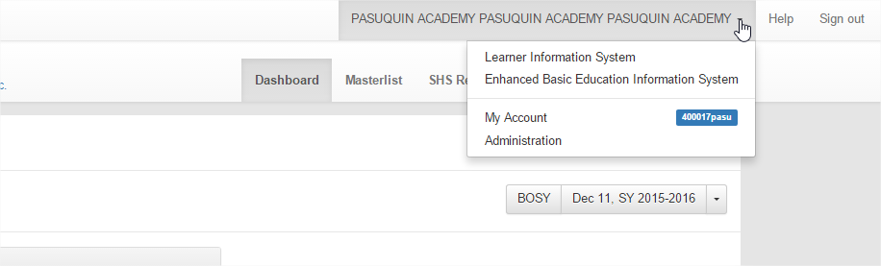
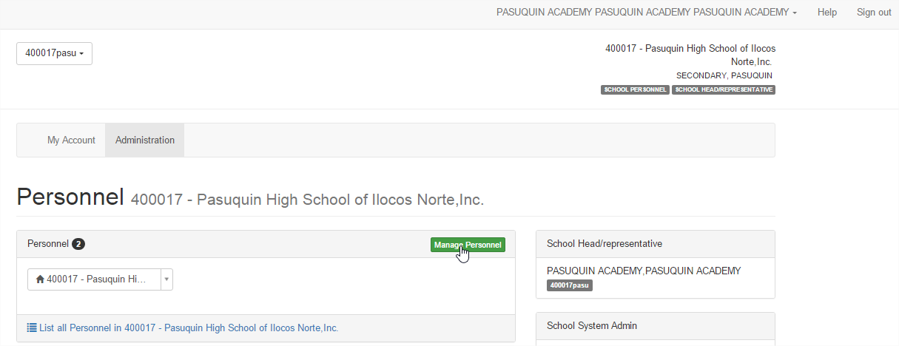
How to Add Personnel
Click
Click Administration
Click Manage Personnel
Click

Slide 41
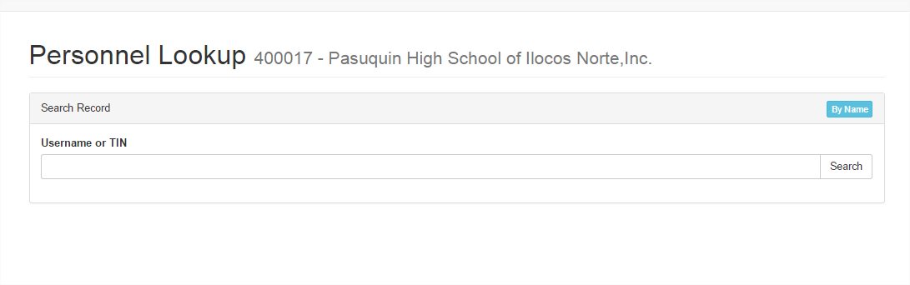
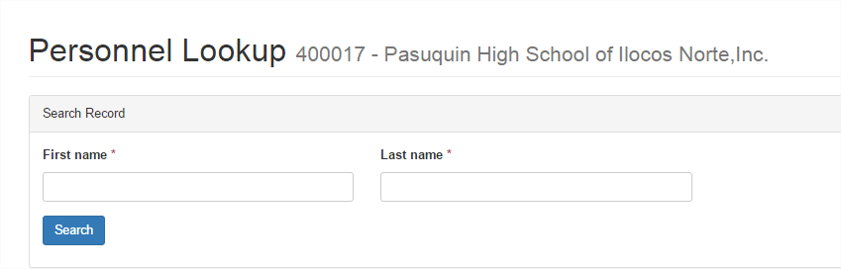
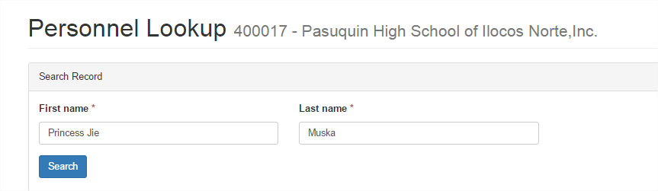
Click
Click by Name
Type the First name and Last Name
After typing the First name and Last name of Personnel, click Search
Click

Slide 42
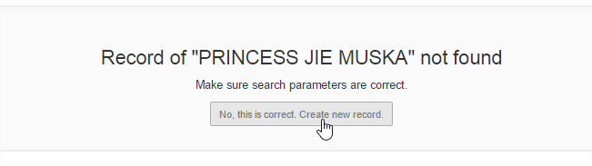
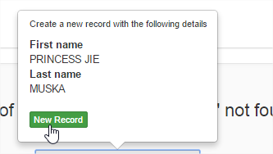
Click
Click

Slide 43
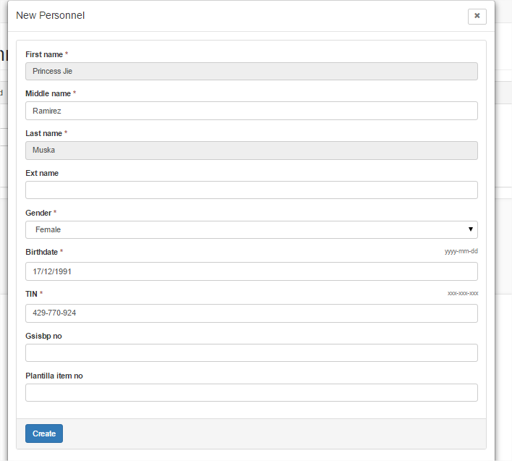
Please assign only those who have TIN number, for DepED, please add only those who have DepED Email Account
Type Middle name (- if none)
Select Gender
Type TIN number
Click

Slide 44
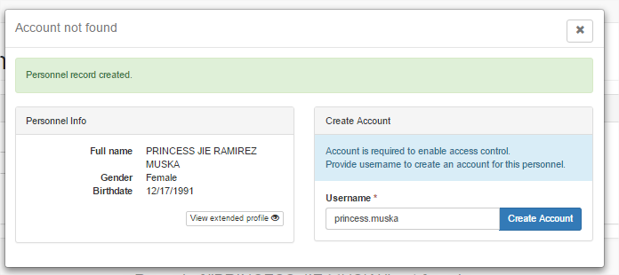

Type the desired username (for Private: firstname.lastname, Ex. alfredo.medrano
For DepED, use deped email account: Ex.
Alfredo.medrano@deped.gov.ph
Click
Select the Role
Select

Slide 45


Click
Read
Click

Slide 46

CHANGING USERNAME OF SCHOOL HEAD ACCOUNT
In the Dashboard, Click here then select My Account

Slide 47

NOTE: In the New Username, use your deped email address (Ex. alfredo.medrano@deped.gov.ph), it is a combination of your firstname and lastname separated by period, you can use this even if you do not have a valid deped email. (This is Recommended by the LIS Administrator)
barbara.james@deped.gov.ph
Click Username, then type the New Username, then click Update Username
Click here

Slide 48

Please Read

Slide 49

CHANGING THE PASSWORD OF SCHOOL HEAD ACCOUNT
Click My Account, type the current Password, the New Password and Repeat Password

Slide 50

After typing the Current and New Password, Click Change Password

Slide 51

Please Read

Slide 52
EDITING THE PROFILE OF SCHOOL HEAD
In My Account, Click View Detailed to update the profile of School Head

Slide 53

Click Update, to open the profile

Slide 54

Update/Edit the profile then Click Save Updates

Slide 55

Please Read

Slide 56

PERSONNEL MANAGEMENT
Click Administration to manipulate personnel account

Slide 57

Click Here to display the List of Personnel in the School

Slide 58

REMOVING PERSONNEL IN THE LIST OF PERSONNEL IN THE SCHOOL (ROLE OF SCHOOL HEAD AND SCHOOL SYSTEM ADMIN)
Click Here to display the profile of “Ruiz, Fe Baluan”

Slide 59

Click Reset Password to Reset the Password of Fe
Click x to remove Fe Baluan Ruiz as Personnel in the School

Slide 60

Please Read

Slide 61


The account of Fe Baluan Ruiz has been removed in the list

Slide 62

1 personnel added

Slide 63
In the Dashboard, Click here then select My Account

Slide 64

Click Administration to manipulate personnel account

Slide 65

Click Here to display the List of Personnel

Slide 66

After removing as school head, remove also in the list of personnel, Click Here

Slide 67

Click x to remove the Role as School Personnel

Slide 68

PLEASE READ

Slide 69

FOR SCHOOL HEAD WITH TWO OR MORE SCHOOLS:
SWITCHING ONE SCHOOL TO ANOTHER
Click Here, to open the dropdown list

Slide 70

Select the school to open

Slide 71

ANOTHER SCHOOL IS OPENED USING SINGLE ACCOUNT

Slide 72
THANK YOU!!!!

