Slide 1
Computation for the % of increase in Enrollment and Contextualized Mapping

Slide 2
Computation for enrollment % of increase
Option A (Enrollment % Increase)
S.Y. | Enrollment | % of Increase
SY 2013-2014 | 1,015
SY 2014-2015 | 1,117 | 10.05
SY 2015-2016 | 1,388 | 24.26
SY 2016-2017 | 1,463 | 5.40
Ave. % of increase |  | 13.24
% of increase = ((present-previous)/previous)x 100

Slide 3
Contextualized Mapping (Participation Rate) Computation
Option B (Contextualized Mapping - Participation Rate)

Slide 4
let: 1,517= total number of school age children in the assigned zone/ community/ barangay/municipality

Slide 5
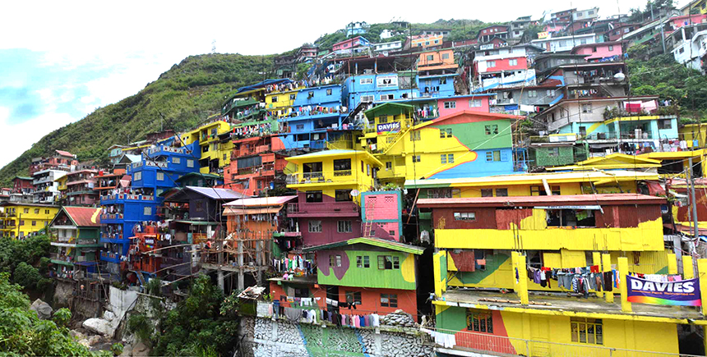
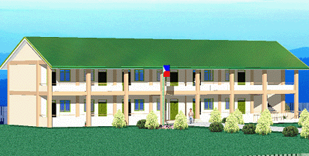
1,517 – School Age Children in the community
1,117-school enrolment
1,017-School Age Children, 100-over age
30-from other barangay(s)/community
987-within the barangay/community
Since there are 1517 school Age Children in the Community and only 987 enrolled in your school from the community…
…then, there are
530-not enrolled in your school
470 – Enrolled to other schools (thru mapping)
60 – unaccounted/ unenrolled (thru mapping)
Note: Of these 60-unenrolled children, enrolled in ALS/OSY programs, the figure 60 shall decrease hence, the computed rating shall also increase.
Computation: $100−\left[\left(\frac{60}{1517}\right)×100\right]=96.0448$
1pt.[85,90), 2pts. [90,95), 3pts. [95,100]

Slide 6
2017 – 2018 SBM Validation Form

Slide 7
Thank you

